Slide 1


Final Event – Perspective Brussels
Poster Session
Juan Caballero & Justine Gangneux
27/05/2026

Slide 2
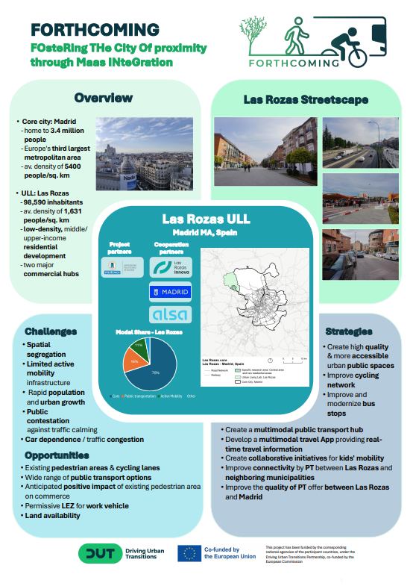
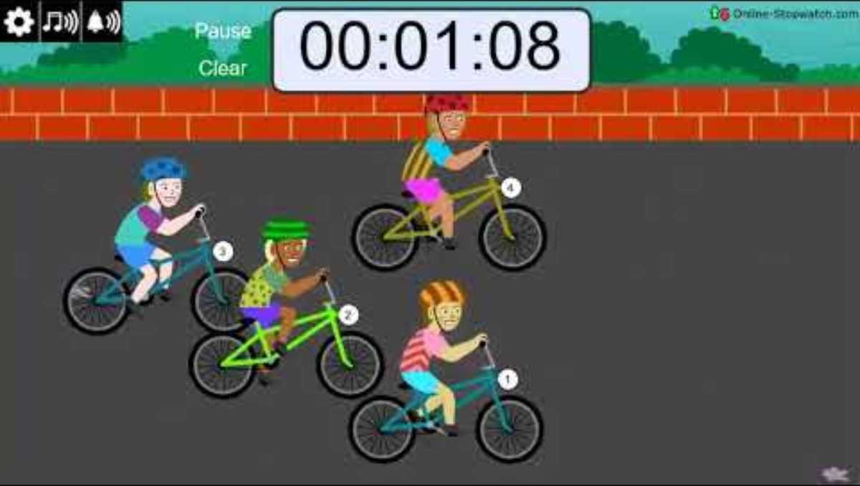
Poster session- One-Minute Pitch
Madrid – Las Rozas

Slide 3
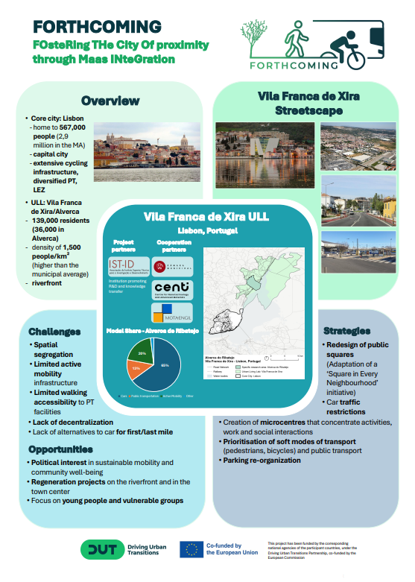
Poster session- One-Minute Pitch
Lisbon – Vila Franca de Xira

Slide 4
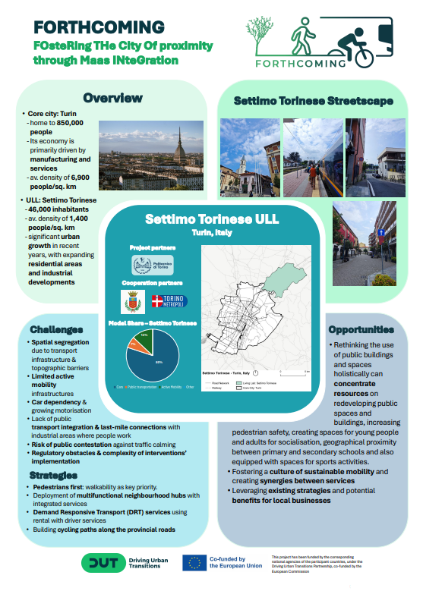
Poster session- One-Minute Pitch
Turin – Settimo Torinese

Slide 5
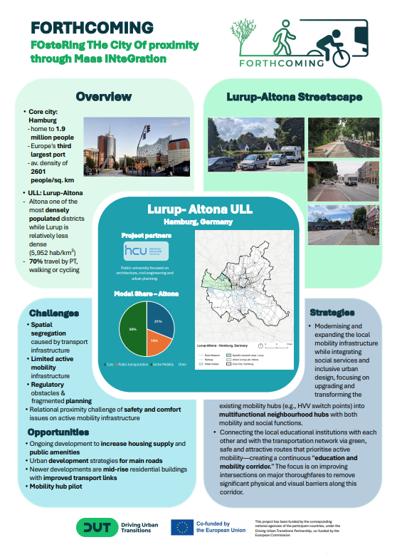
Poster session- One-Minute Pitch
Hamburg –Lurup/Altona

Slide 6
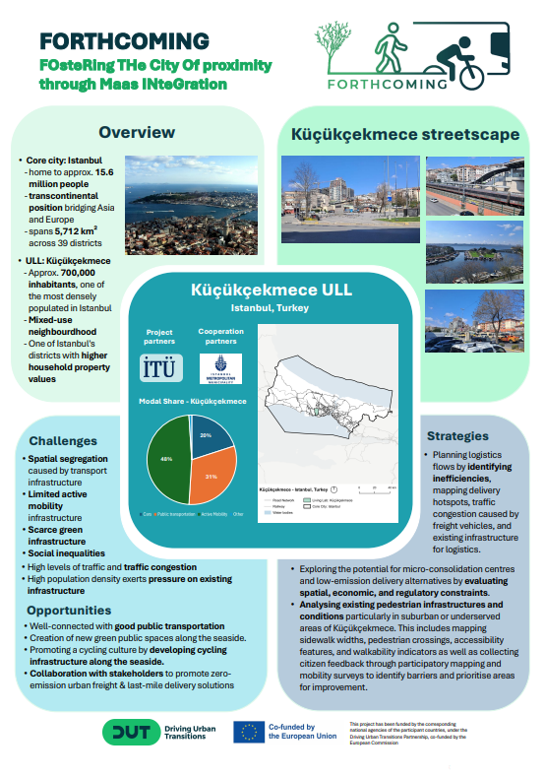
Poster session- One-Minute Pitch
Istambul- Küçükçekmece

Slide 7
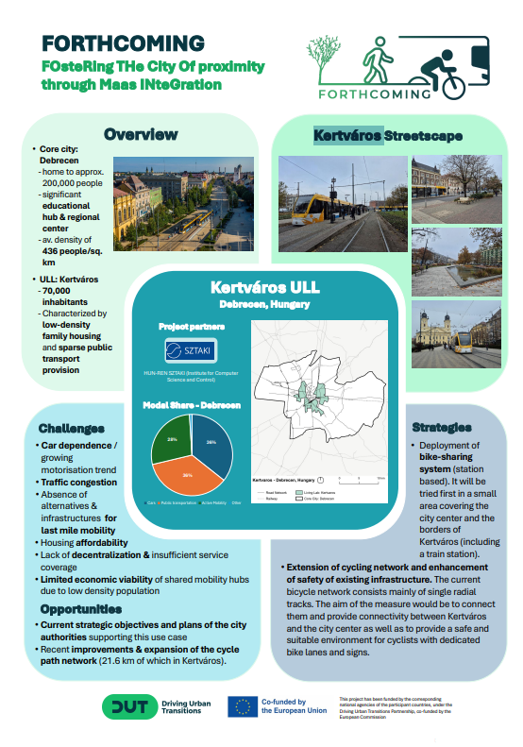
Poster session- One-Minute Pitch
Debrecen - Kertváros

Slide 8
Poster session
How will it work?
10:55-11:15 - Round 1: Madrid - Lisbon - Turin - Participants select one poster to go to (ideally, we will have three small groups of 10 people)
11:15 - 11:35 - Same posters - participants choose another poster from the first round (i.e. participants swap)
11:35- 11:55 - Round 2 : Hamburg - Istanbul - Debrecen -Participants select one poster to go to
11:55 - 12:20 - Same posters - participants swap

