Slide 1


15-Minute Cities in the US:
Realistic goal or crazy dream?
Susan Handy
May 28, 2026
Notes:
From US perspective – Europe is nothing but 15-minute cities!
Looking forward to hearing about challenges here.
My conclusion… not impossible, but not right now.

Slide 2
It’s not an entirely new idea for us.
Handy, S. (2020). Is accessibility an idea whose time has finally come?. Transportation Research Part D: Transport and Environment, 83, 102319.
Notes:
The first of three points I want to make today.

Slide 3
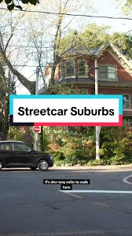
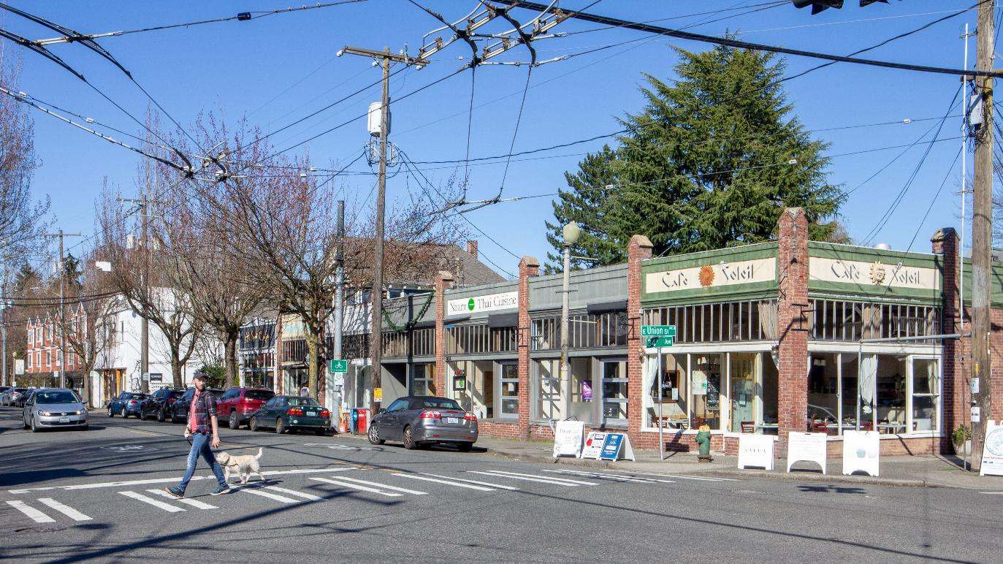
Pre-WWII neighborhoods
Notes:
Before WWII, most suburban areas were 15-minute cities… “streetcar suburbs”
https://www.youtube.com/watch?v=MbAd2LeOE1E
https://seattlearchitecture.boldtypetickets.com/events/168540682/madrona-streetcar-suburb-model-for-neighborhood-involvement

Slide 4

Post-WWII mobility – not accessibility
“What’s transportation for?… The purpose of transportation is to bring people or goods to places where they are needed... Why should anyone have to take a car and drive a couple of miles to get a package of cigarettes or a loaf of bread, as one must often do in a suburb?”
– Lewis Mumford, The Highway and the City, 1958
Notes:
But after the war, it was another story, what with highway building and sprawling suburbs.
Lewis Mumford, among others, recognized the problem early on: car mobility focus meant poor accessibility….
But concerns not heeded.

Slide 5
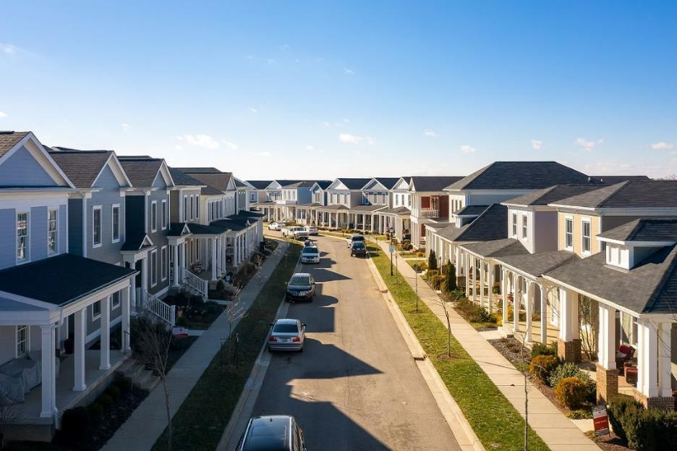
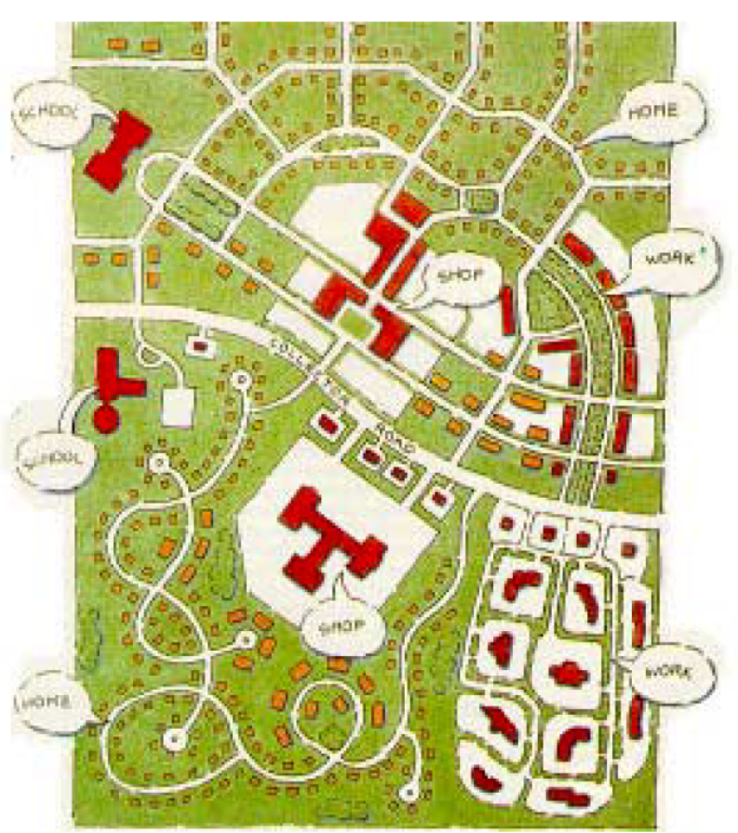
Neo-Traditional Development and the New Urbanism a 1990s movement
Notes:
No real challenge to the post-war approach to development until 1990s.
Design communities the way we used to, i.e. with good proximity.
Some lasting impact, mostly at the development scale.

Slide 6
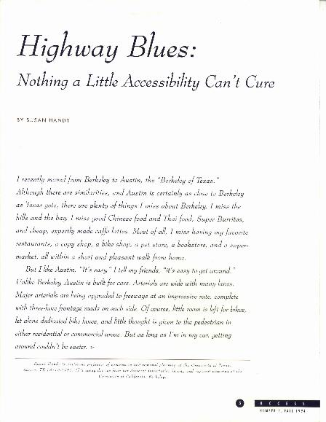
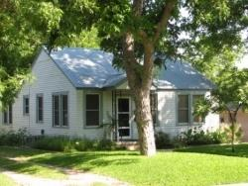

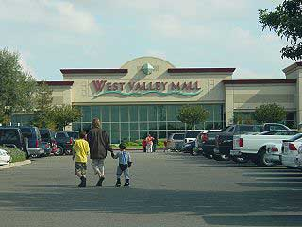

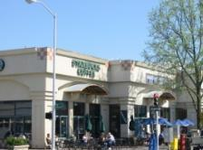
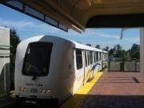

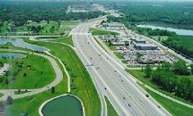
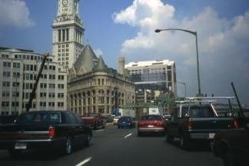
Local versus Regional Accessibility
Regional
Local
https://escholarship.org/content/qt66k8b8bz/qt66k8b8bz.pdf
Notes:
Around the same time, working on my dissertation which focused on concepts of local and regional accessibility, their implications for travel behavior.
My advisor said “You need better terms!”
I begged to differ at the time but I think she was right – needed some way to talk about the concept that made sense to the public.

Slide 7
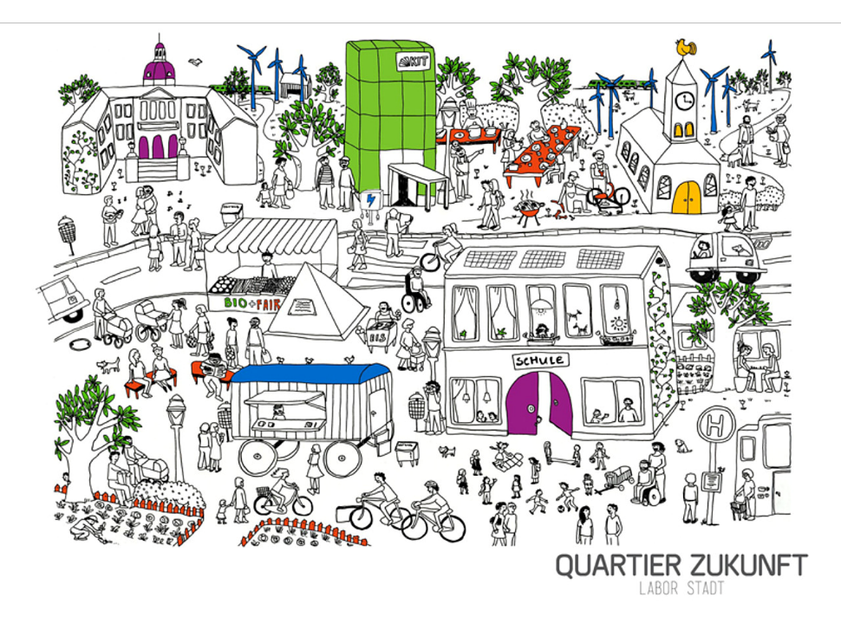
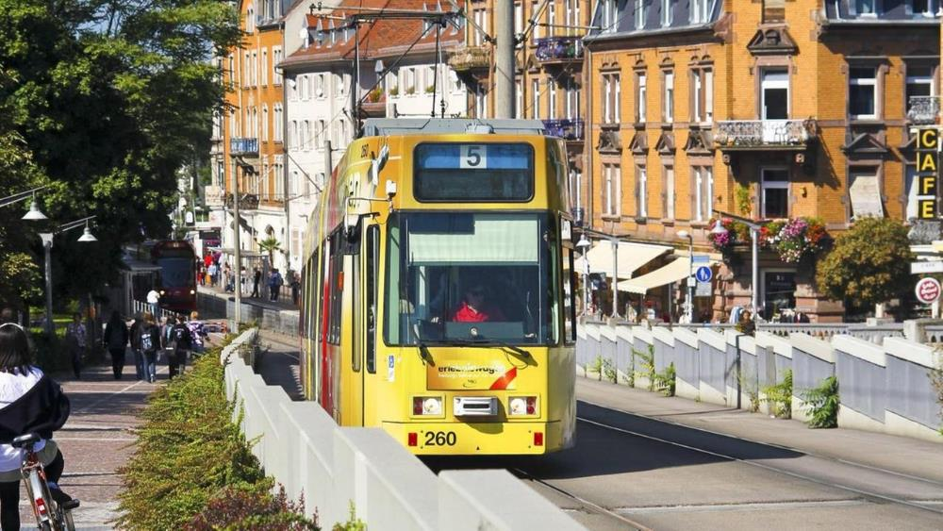
Stadt der Kürzen Wege aka City of Short Distances
https://www.deutschlandfunk.de/verkehrspolitik-in-freiburg-stadt-der-kurzen-wege-100.html
Notes:
Excited when I found the idea from Germany… that’s what I meant by local accessibility…
Pre-cursor to 15-minute city

Slide 8
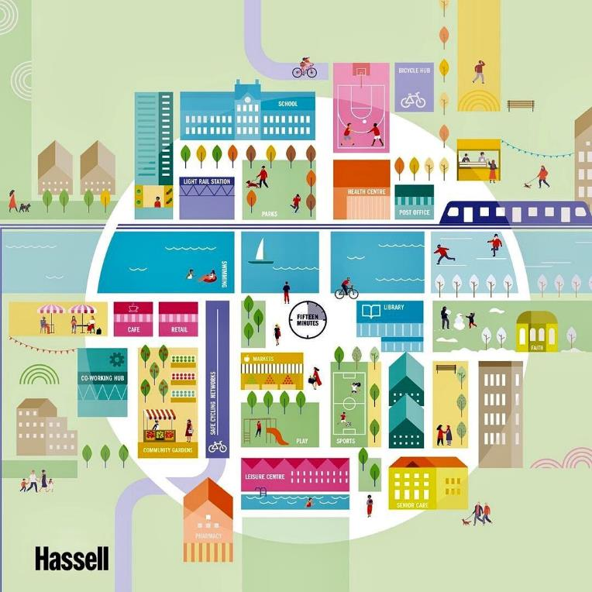
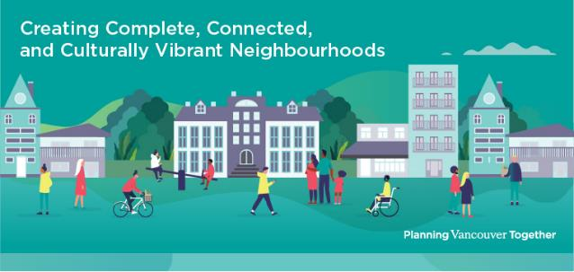
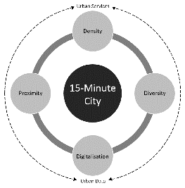
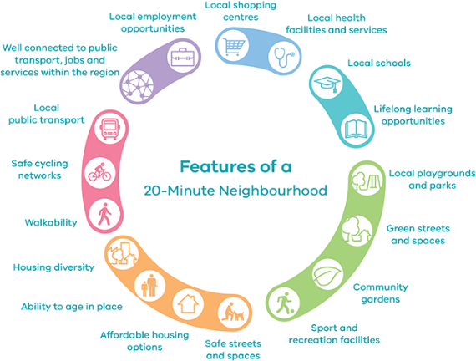
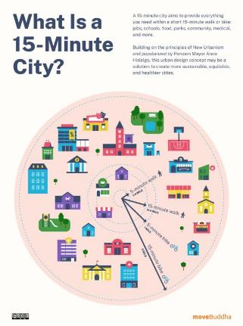
15-Minute City
Notes:
Precursor to 15-minute city idea, even more compelling way to communicate the concept of local accessibility.
https://www.theurbanist.org/2021/08/16/study-ranks-u-s-cities-by-15-minute-city-potential/

Slide 9
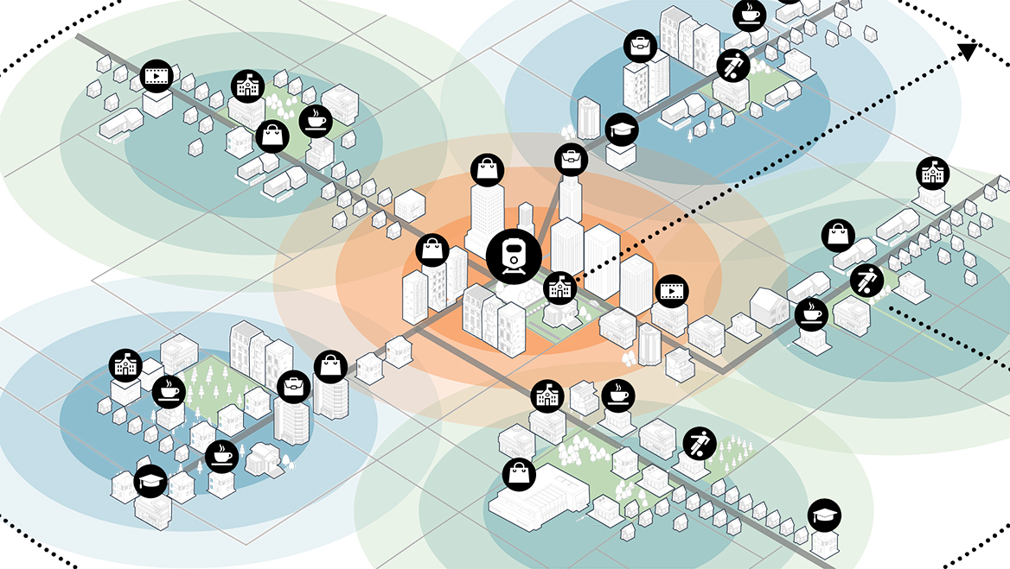
The 20-Minute Suburb
“The new concept swaps suburban sprawl for zoning reform, housing affordability, and sustainable transportation.”
From Skidmore, Owens, and Merrill
https://www.planning.org/planning/2023/winter/meet-the-15-minute-citys-cousin-the-20-minute-suburb/
Notes:
20-minute neighborhood or 20-minute suburb – by walking, biking?
Connected to the central city by transit.
Good local and good regional accessibility.
Well, this is Europe!

Slide 10
We even have some US examples.
Handy, S. 2019. “Accessibility-Oriented Urban Design,” in T. Banerjee and A. Loukaitou-Sideris, eds., The New Companion to Urban Design (London and New York: Routledge), pp. 585-598.
Notes:
My second point: we do have some US examples!
Not just pre-war places
Not just new urbanist developments.
But real cities that have done it right.

Slide 11
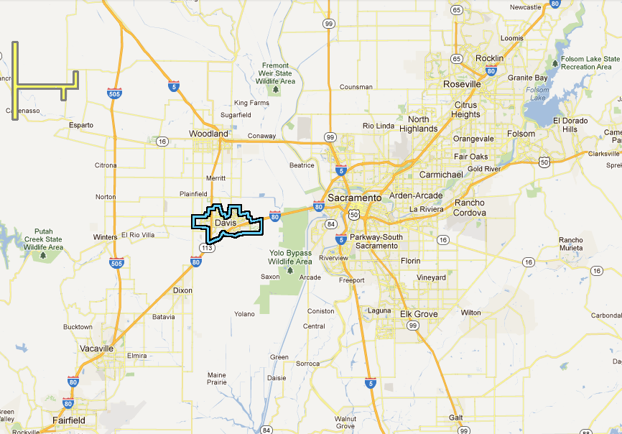
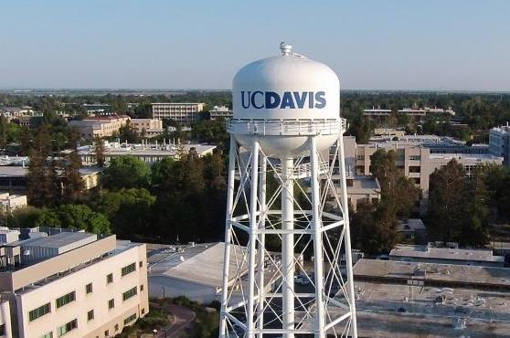
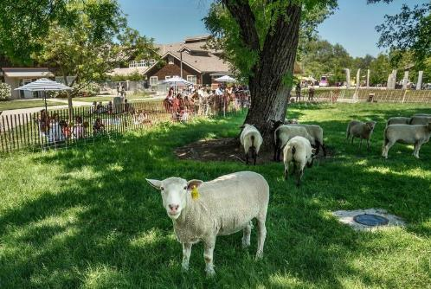
Davis, CA
10 km
5 mi
Notes:
Yes it is something of a cow town…
But it is a 15-minute city – at least a 20-minute city.

Slide 12
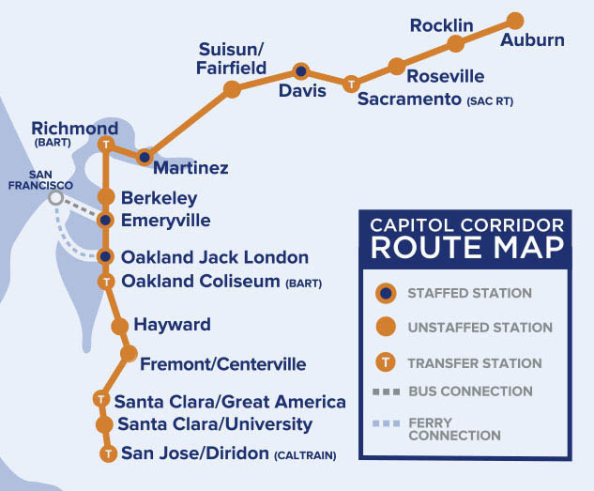
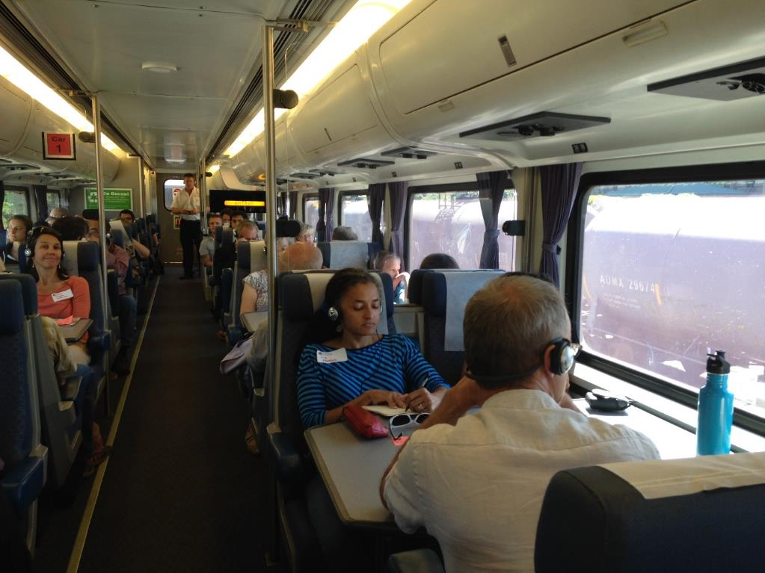
Regional accessibility
Notes:
Run by Amtrak, paid for by state.
Ridership and thus number of daily trains has grown steadily.
Shares tracks with freight, so reliability something of a problem.
Expensive but cushy!

Slide 13
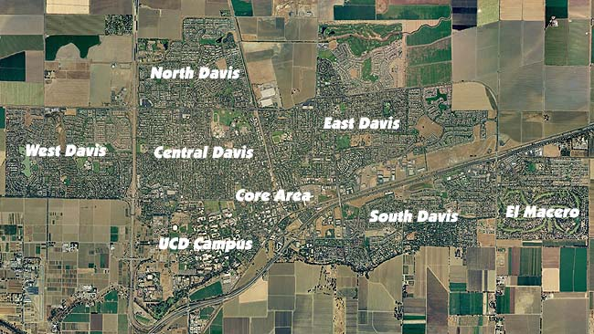
Local accessibility
Growth boundary
Ag land preservation
Neighborhood centers
Downtown protection
Affordable housing
Multifamily housing
About 5 miles
http://www.davis-ca-real-estate.com/images/davis_california.jpg
Notes:
It has good accessibility because it has good proximity… intentional!
Browth boundary that keeps city compact,
Policies that established neighborhood centers…
Pretty good densities by US suburban standards…

Slide 14
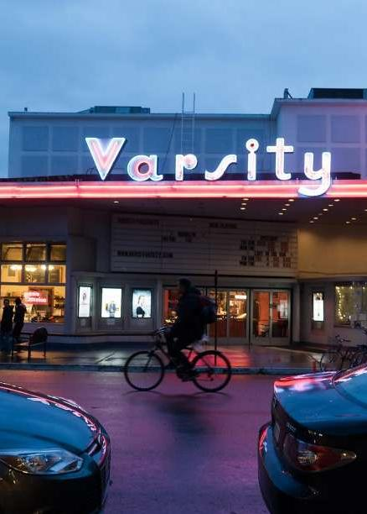
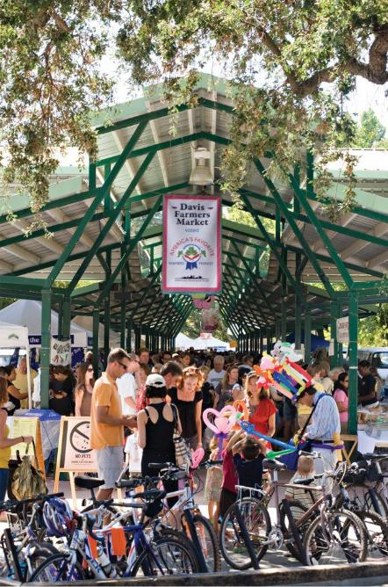
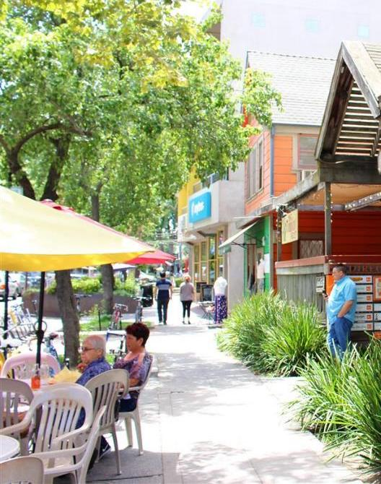
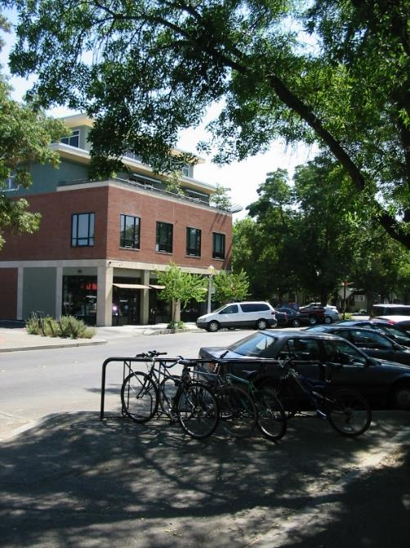

Downtown Davis
Downtown Davis
Notes:
…worked hard to preserve downtown as the center of the community.

Slide 15

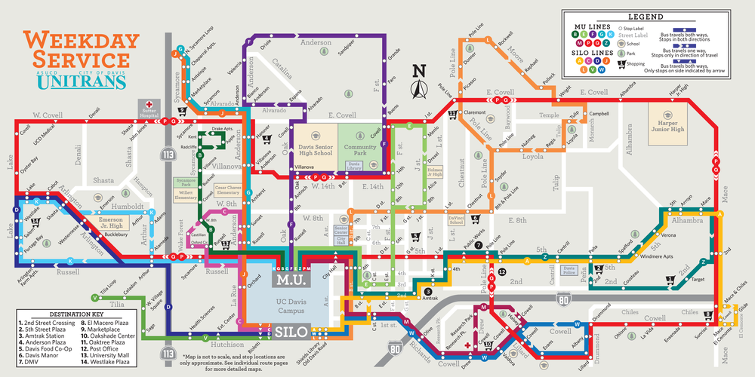
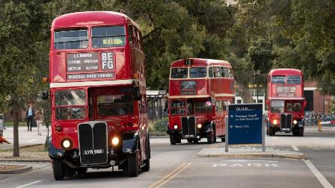
Local transit
Notes:
Run by university in partnership with the city.
Undergraduates pay for it as a part of their fees, ride for free.
Reasonably frequent and reliable – but crowded!
Third highest ridership per service hour in the state!

Slide 16
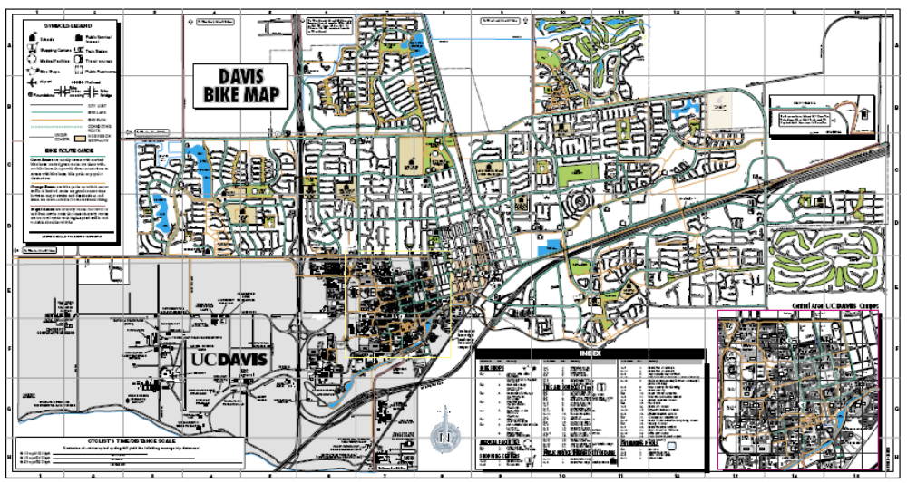
Bike Infrastructure
50+ miles of on-road bike lanes
60+ miles of off-road paths
Good bike connectivity
Notes:
Great bicycle network – by US standards – on-street and off-street

Slide 17
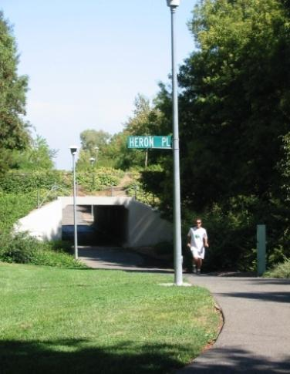
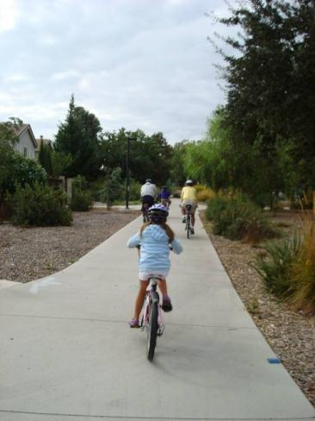
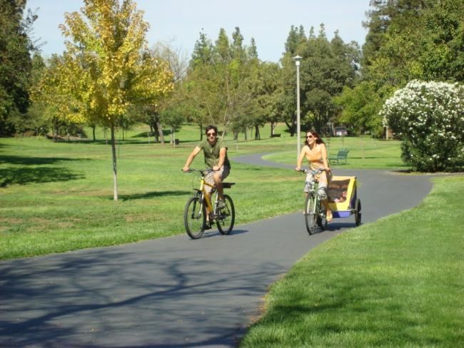
Shared-use, off-street paths
Notes:
Off-street paths part of greenbelt system., links to many elementary schools

Slide 18
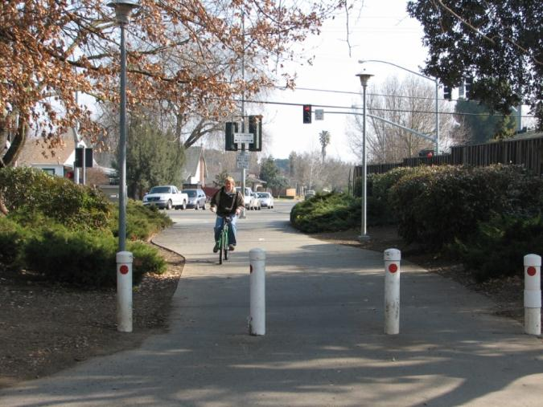
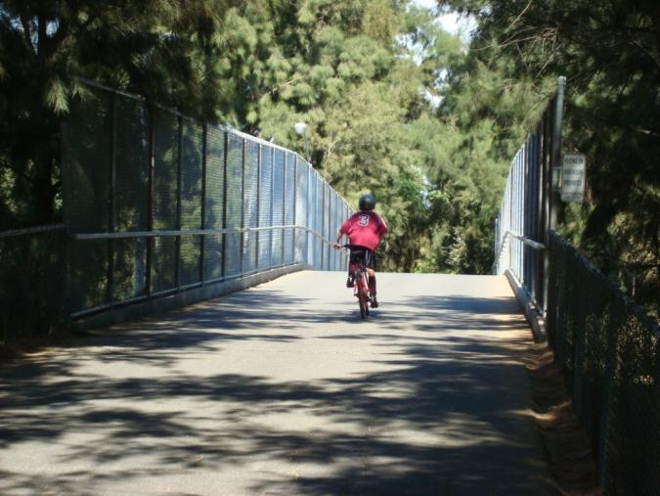
Key connections
Cut through to school
Bike bridge to school
Notes:
City has been smart about key links in the network that connect to schools and other important destinations.

Slide 19
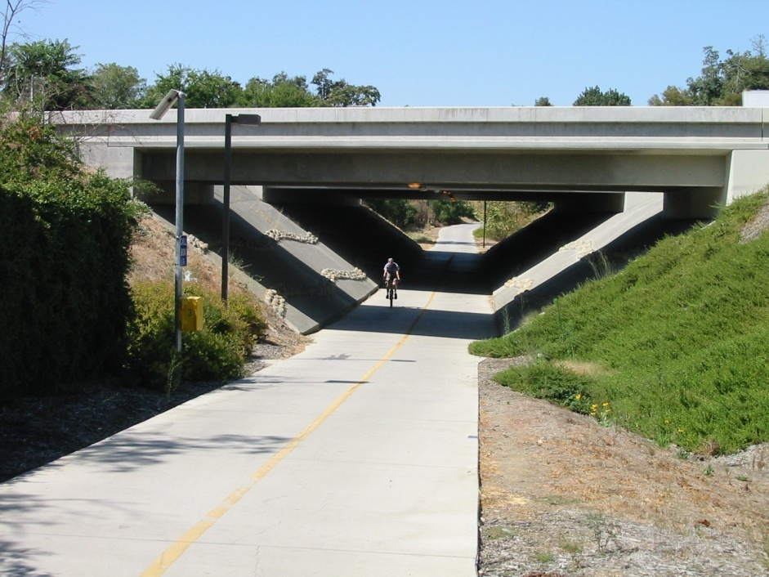
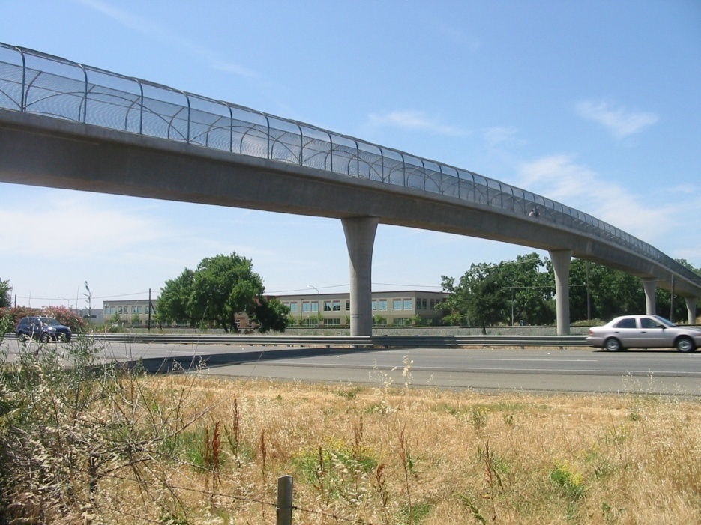
Key connections
Under and over I-80 and the railroad tracks
Notes:
City made bigger investments to get under or over freeway and railroad tracks separating south from rest of the city

Slide 20
Percent Biking to Work in Smaller Cities
Source: Handy, Heinen, and Krizek, 2012
Notes:
Highest bike mode share in the US, as far as we can tell.
Graph compares Davis to other small cities with major university….

Slide 21
Share of bike trips by women
Source: Pucher and Buehler (eds.) City Cycling. Cambridge, MA: MIT Press, 2012; UC Davis observations
Notes:
Another indicator of the city’s success – high share of bike trips made by women

Slide 22
It’ll take a big shift in thinking.
Handy, S. 2023. Shifting Gears. MIT Press.
Notes:
Davis is an example, but it is also an exception.
Doing this kind of planning more widely will take…

Slide 23
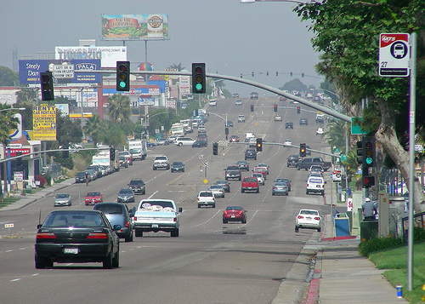
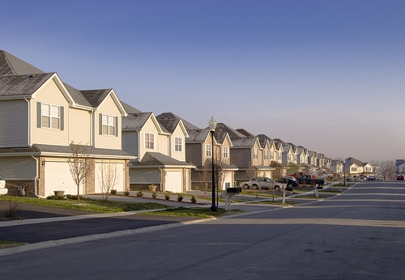
Typical suburban development
http://farm1.static.flickr.com/245/454715295_0f87587673.jpg
http://www.flickr.com/photos/22421801@N00/2581488338
Notes:
Because most development in the U.S. looks more like this.
This could be anywhere!

Slide 24
Shift 1: thinking about land use…
Notes:
Doing this kind of planning more widely will take…

Slide 25
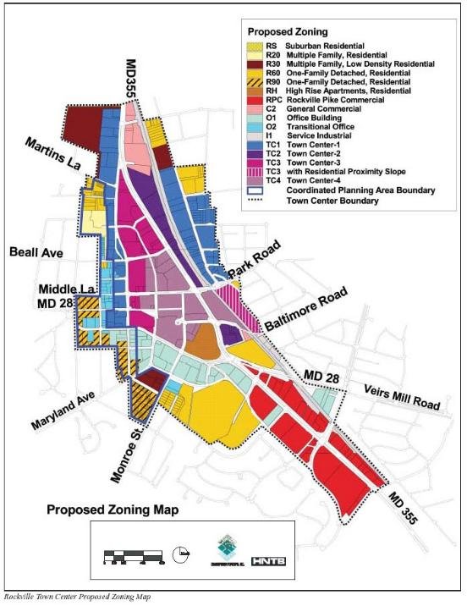
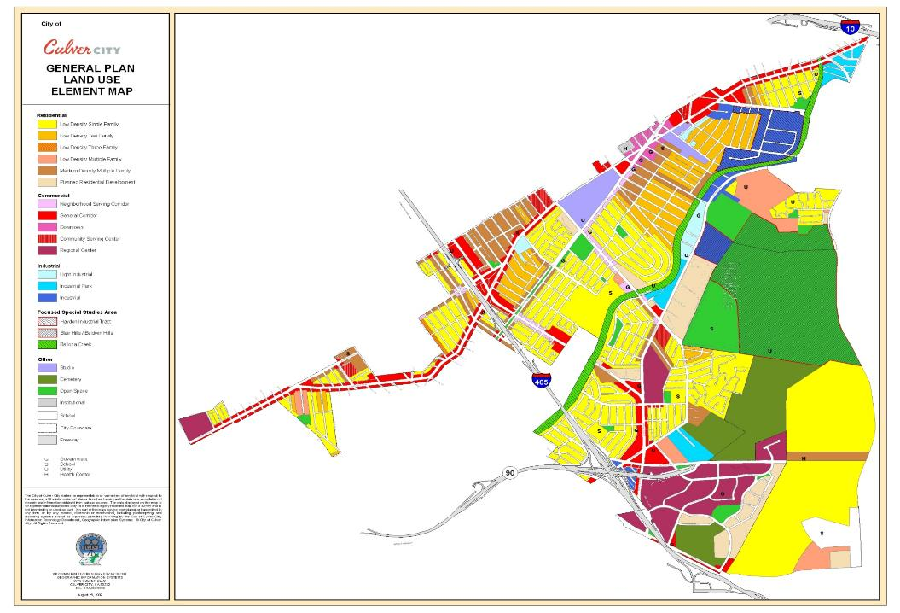
From zoning that separates land uses…
Residential
Commercial
Industrial
Open space
Other…
“Euclidean” or “exclusionary” zoning excludes uses not specified
Notes:
We need a shift from…. More than 100 years of strictly separately land uses

Slide 26
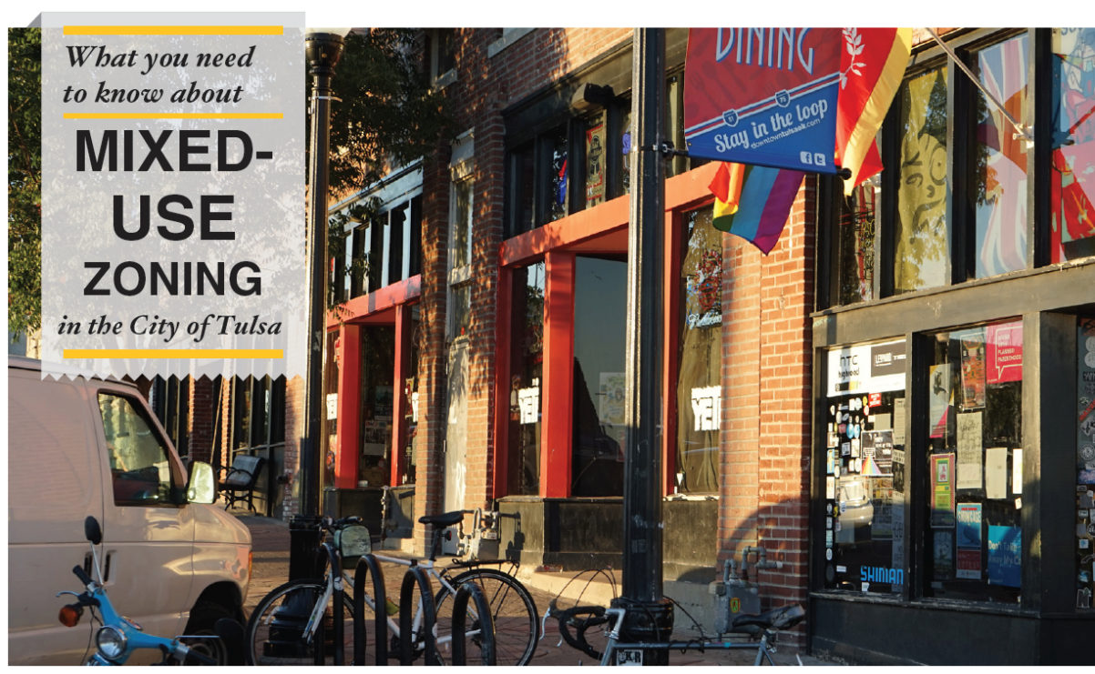
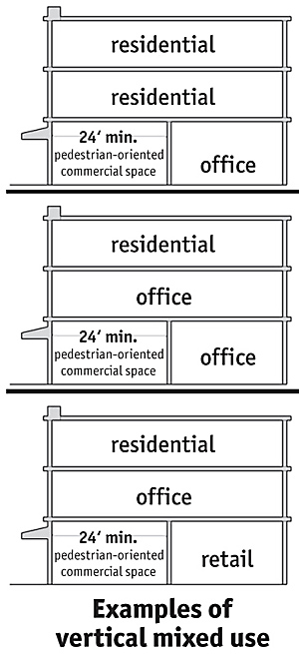
… to zoning that mixes land uses
Vertical mixing
Notes:
Zoning that allows for a mix of land uses, including vertical mixing.
https://tulsaplanning.org/programs/projects/mx/

Slide 27
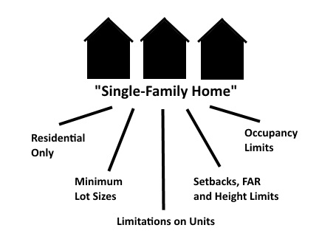
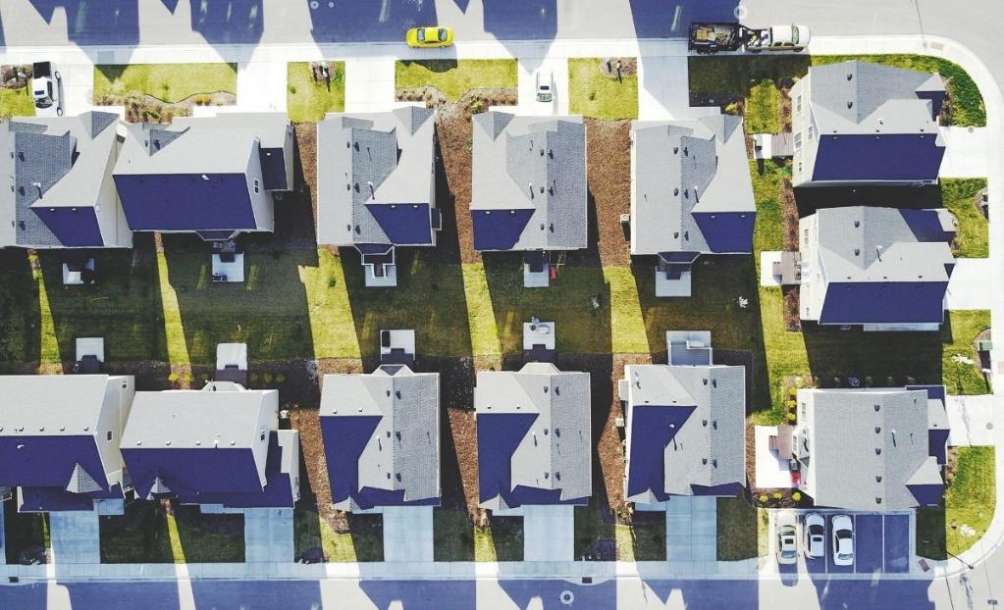
From zoning the limits density…
“R1” single-family zones
Notes:
We need a shift from zoning that limits density…
Most of the residential areas in the US have “R1 zoning”
https://oldurbanist.blogspot.com/2015/12/single-family-zoning-in-seattle-and.html
https://techequity.us/2021/04/28/5-reasons-why-single-family-zoning-sucks/

Slide 28
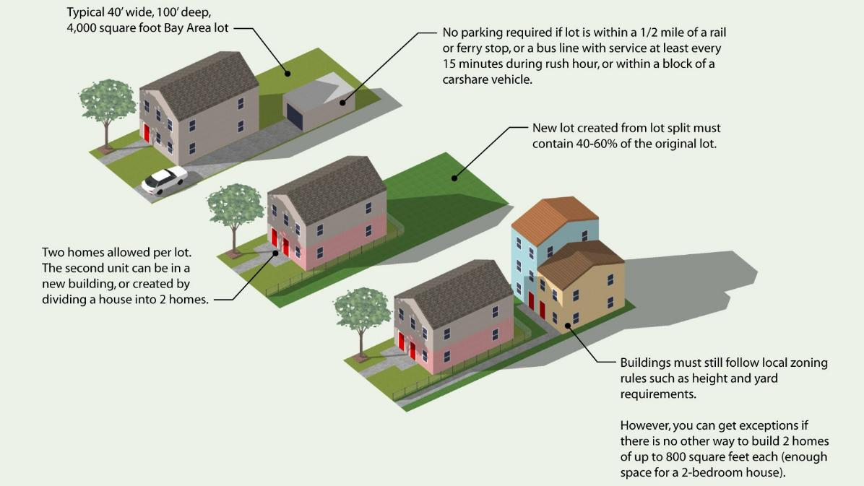
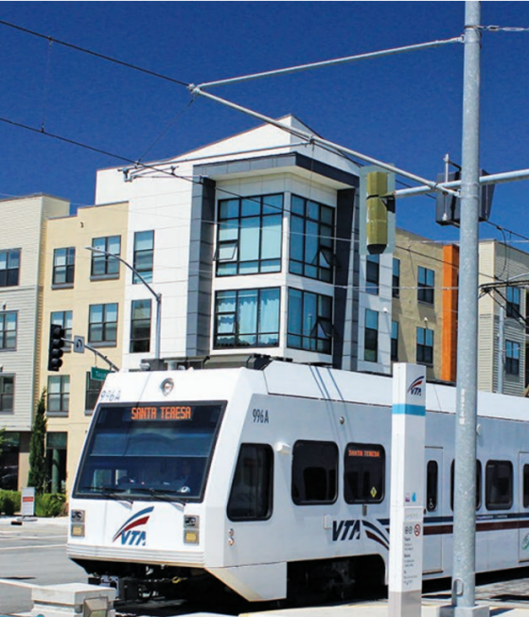
… to zoning that enables density
Up to four units “by right” in single-family zones
“Up-zoning” near transit
Notes:
But we’re seeing a shift to zoning that enables density…
Many communities – some states like California – have adopted…

Slide 29
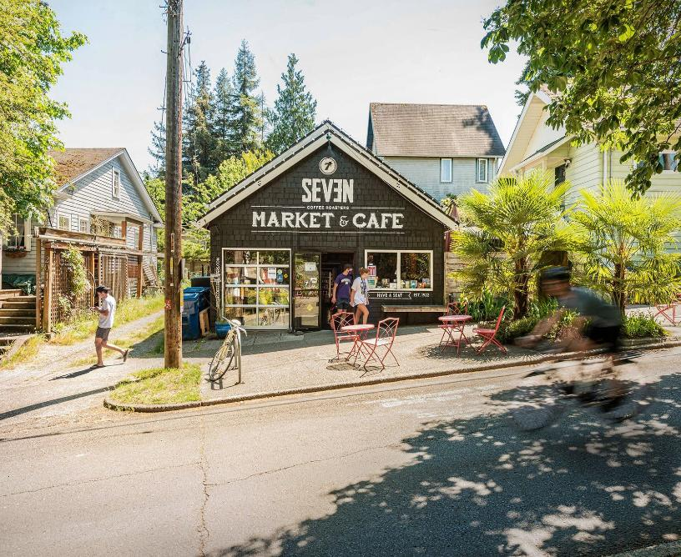

… and zoning that allows small-scale business
The return of the “corner store”
The return of the “corner store”…
… and home-based businesses
Notes:
Plus, in some cities, a return to small-scale businesses within neighborhoods…

Slide 30
Shift 2: thinking about transport
Notes:
Doing this kind of planning more widely will take…

Slide 31


From Level of Service…
LOS = f(volume/capacity)
Notes:
Use LOS to measure congestion… has dictated transportation investments as well as land development decisions.

Slide 32


… to accessibility measures
https://www.trb.org/Publications/Blurbs/182849.aspx
Notes:
Some movement toward accessibility measures – in addition to rather than instead of LOS
Many research teams have contributed to the development of accessibility measures for use in practice.
More about regional than local accessibility…
https://www.trb.org/Publications/Blurbs/182849.aspx

Slide 33


From space for cars…
Notes:
We have been focused on providing ample space for our very large vehicles – both street space and parking space.
https://x.com/levelsio/status/1181114764509843456

Slide 34


… to road space for other modes
Notes:
But many communities thinking about how road space could be better used.
Road diets increasingly popular in US as way to reclaim street space for other purposes – other modes, or even non-transportation uses – like trees.
https://usa.streetsblog.org/2026/04/22/for-earth-day-the-trump-administration-wants-to-expand-highways-across-america

Slide 35


… and parking space for other purposes
Notes:
Big change in thinking regarding providing abundant free parking.
Partly driven by concerns over contribution to housing costs!
https://www.nytimes.com/2023/03/07/business/fewer-parking-spots.html

Slide 36

From enabling speed…
The 85th Percentile Rule: Set the speed limit at the speed at which 85% of the drivers are going that speed or less.
How fast drivers are driving
How fast drivers are allowed to drive
How fast we want drivers to drive
How fast drivers are allowed to drive
Notes:
Way we set speed limits means that drivers are setting the speed limits themselves!
Rather than setting them based on how fast we want people to driver…

Slide 37






… to deterring speed
Vertical deflection
Horizontal deflection
Horizontal narrowing
Speed bump
Traffic circle
Bulb-outs
Raised crosswalk
Chicanes
Neck-down
Notes:
At the same time, for a long time, cities have been using traffic calming as a way to fix design mistakes.
(Wouldn’t need it if we designed streets appropriately from the start!)

Slide 38


From the freedom of the car…
Notes:
More fundamental shift… the hardest one of all.

Slide 39


… to freedom from the car
“California Forever” new town proposal
https://californiaforever.com/
Notes:
Gas prices way up – people are starting to understand the benefits of not having to drive!
https://www.latimes.com/opinion/story/2025-12-01/california-forever-regulatory-streamlining

Slide 40
Shift 3:
Political thinking
Notes:
Doing this kind of planning more widely will take…

Slide 41

California’s goals for reducing driving
25% below 2019 levels by 2030
30% below 2019 levels by 2045
Notes:
Many of the changes in local policy in California are tied to state’s policy about climate.
In particular, targets for reducing driving as strategy for reducing GHG emissions
https://dot.ca.gov/programs/sustainability/sb-743/ca-vmt
https://ww2.arb.ca.gov/sites/default/files/2023-04/2022-sp.pdf

Slide 42

Why is California still building freeways?
Amy Lee (2023) The Policy and Politics of Highway Expansions, UC Davis.
https://ncst.ucdavis.edu/research-product/policy-and-politics-highway-expansions
Notes:
But, at the same time, haven’t stopped expanding freeways
500 new lane miles of freeway since 2018.

Slide 43

US DOT’s Freedom to Drive Initiative launched April 20, 2026
“The Trump Administration is tackling congestion head on to eliminate endless traffic jams and ensure you spend less sitting wasting away in gridlock.”
“You may also need to recover roadway capacity from other purposes to support driving.”
– US DOT Secretary Sean Duffy, April 2026
https://www.transportation.gov/briefing-room/trumps-transportation-secretary-sean-p-duffy-launches-initiative-eliminate-traffic; https://ops.fhwa.dot.gov/freedom-to-drive-initiative.htm
Notes:
Federal level even trickier at the moment.
Unfortunately, also big back-sliding on federal level…
BUT, ironically, Trump may be helping…

Slide 44

Support from “the right”?
https://www.aei.org/op-eds/the-pro-family-case-for-walkability/
Notes:
AND… ust this month… conservative organization talking about benefits of walkability!

Slide 45




The outlook for the US?
It’s not a new idea for us.
We have good examples already.
We’re seeing a shift in thinking about land use.
But we need a big shift in thinking about transport.
Notes:
Good that we’re moving toward 15-minute cities… gives people options.
But not so optimistic it will free us from our car-dependent ways.

Slide 46





Thank you!
slhandy@ucdavis.edu
Notes:
Looking forward to hearing about your project!

