Slide 1

Prof. Cristina Pronello
FORTHCOMING overview survey insights & discussion on 15-minute city strategies
FORTHCOMING Final Conference
27 May 2026

Slide 2
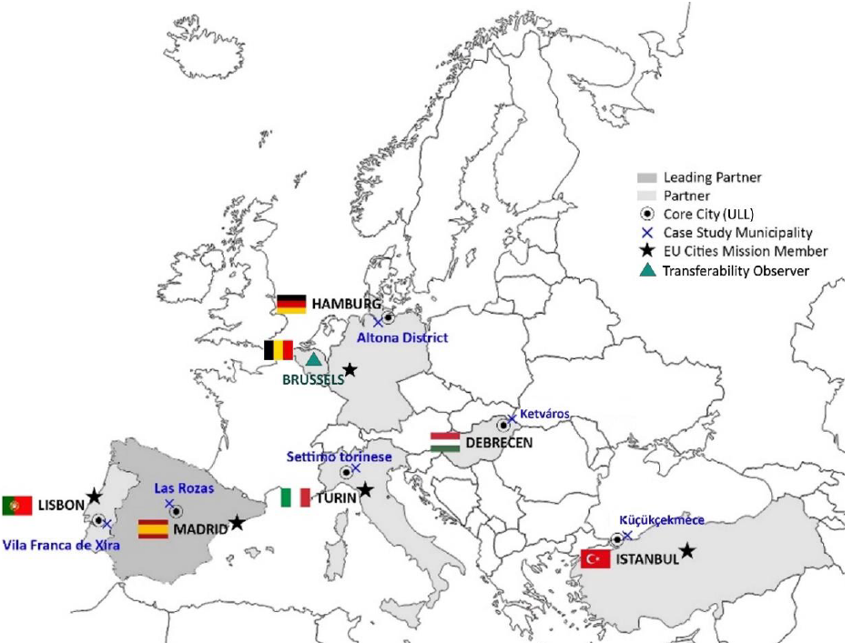
Cross-sectional assessment: objectives
  Assess and validate the impact of implemented strategies transferred from centres to the suburban cities

Slide 3
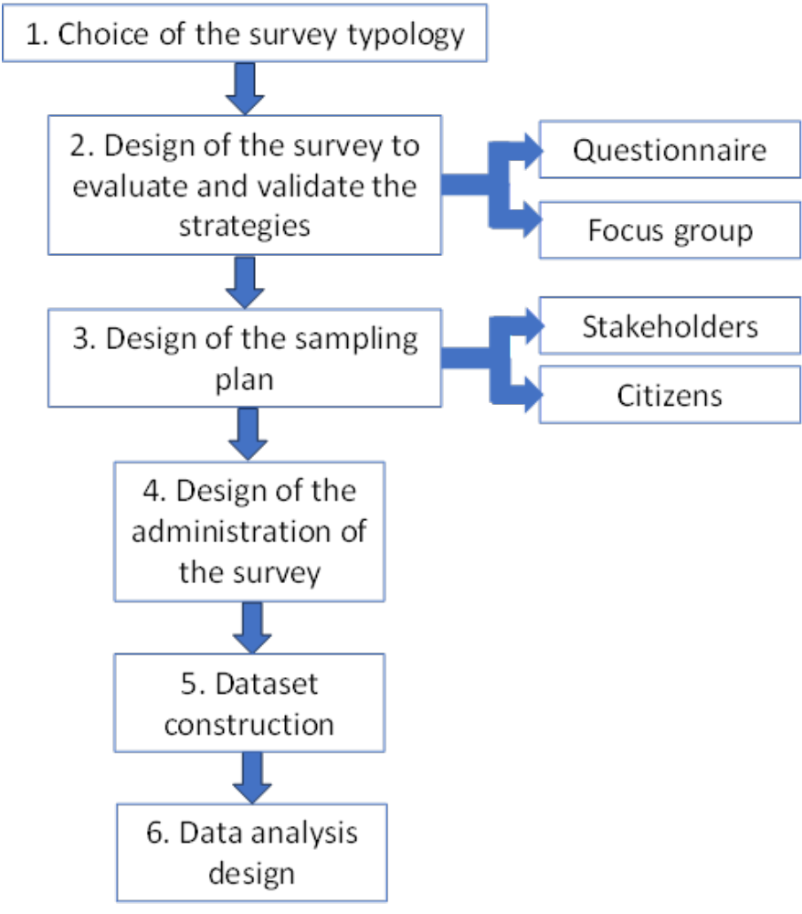

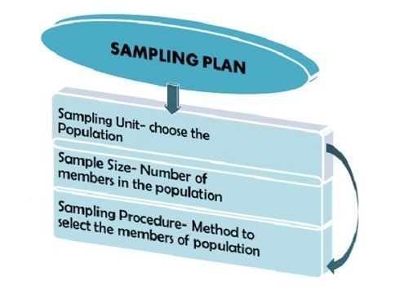




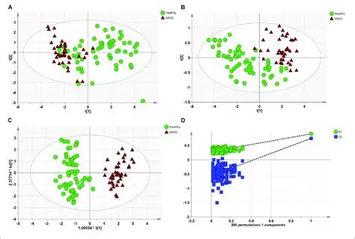
Cross-sectional assessment: methodology

Slide 4


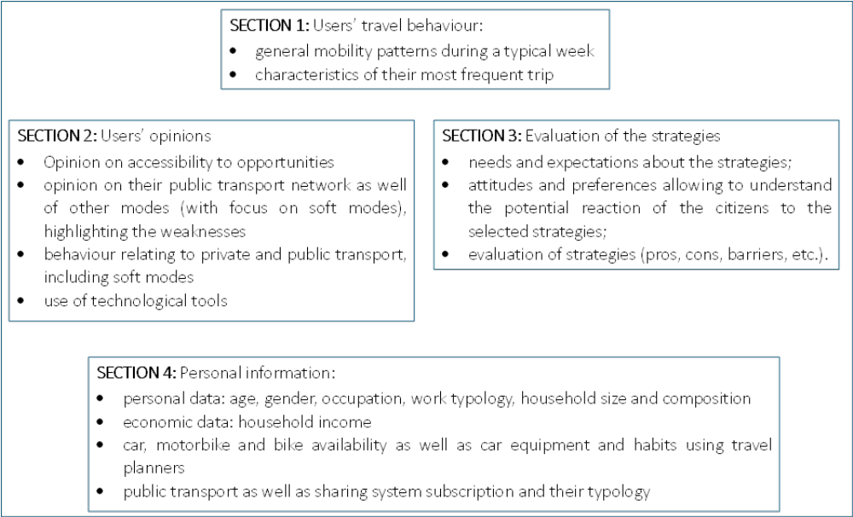
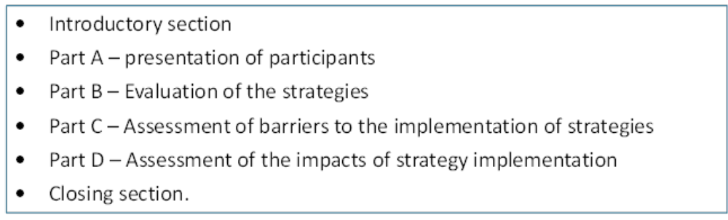
Methodology: data collection
  Questionnaire structure
  Focus Group structure

Slide 5


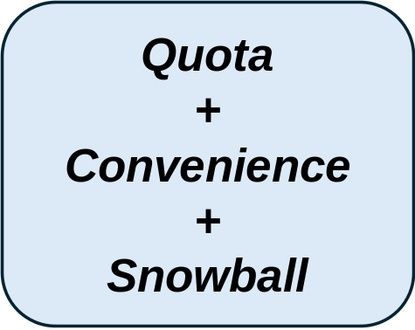



Methodology: sampling plan and survey administration
  Non probabilistic sampling methods, using a hybrid approach: more methods in chain
  Administration
  CAWI (Computer Assisted Web Interview) administered online through Lime Survey
  Link to the questionnaire was sent via e-mail to: commuter associations, environmental associations, companies, etc. and spread via social media
  Voluntary participation, without any incentive or reward
  Privacy policy for questionnaire and focus group (consent form)
  CITIZENS
  STAKEHOLDERS

Slide 6
Methodology: data analysis design
  Descriptive analysis + strategies’ analysis of each Urban Living Labs (ULL)
  Comparative analysis among the characteristics of ULLs:
    exploratory factor analysis (EFA) to identify the main “latent” factors that could explain respondents’ preferences regarding the different strategies
    clustering based on latent factors to identify homogenous group of citizens across the six ULLs
  Comparative analysis of strategies through the six ULLs
    heterogeneity of the strategies across the six ULLs: 43 strategies, covering different thematic areas, territorial scales, implementation conditions, and operational objectives

Slide 7
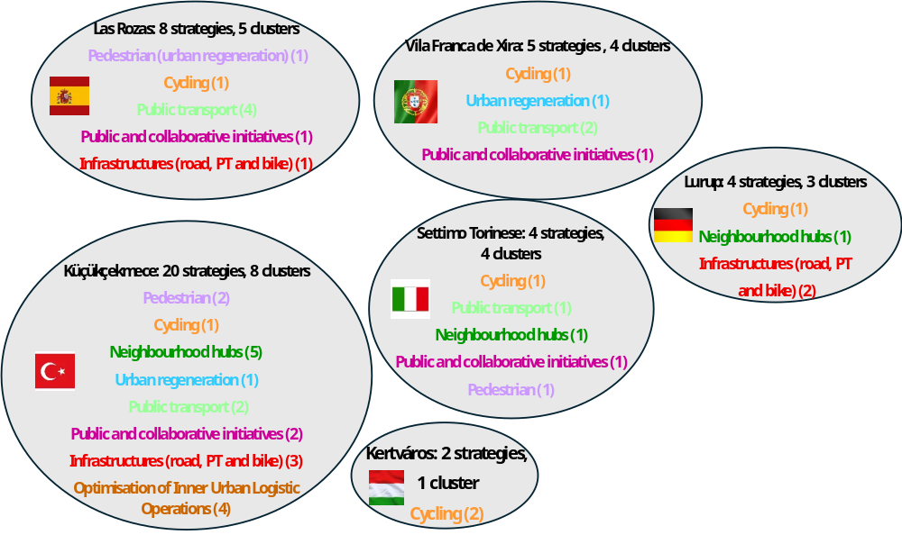
Methodology: data analysis design
  Cluster-based comparative framework grouping strategies into seven thematic clusters reflecting broad areas of intervention and partially shared policy objectives, making them comparable:
Cycling → 6 ULLs
Public transport → 4 ULLs
Public and collaborative initiatives → 3 ULLs
Infrastructures (road, PT and bike) → 3 ULLs
Neighbourhood hubs → 3 ULLs
Urban regeneration → 2 ULLs
Optimisation of Inner Urban Logistic Operations → 1 ULL (no comparison)

Slide 8
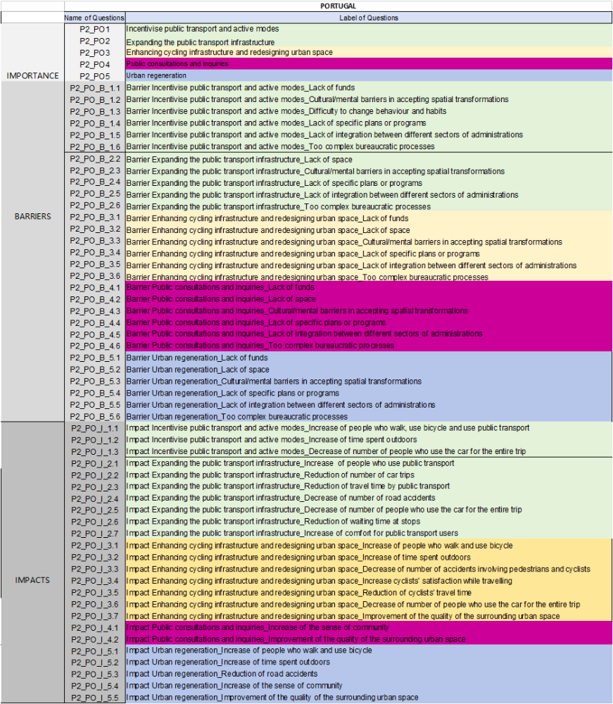
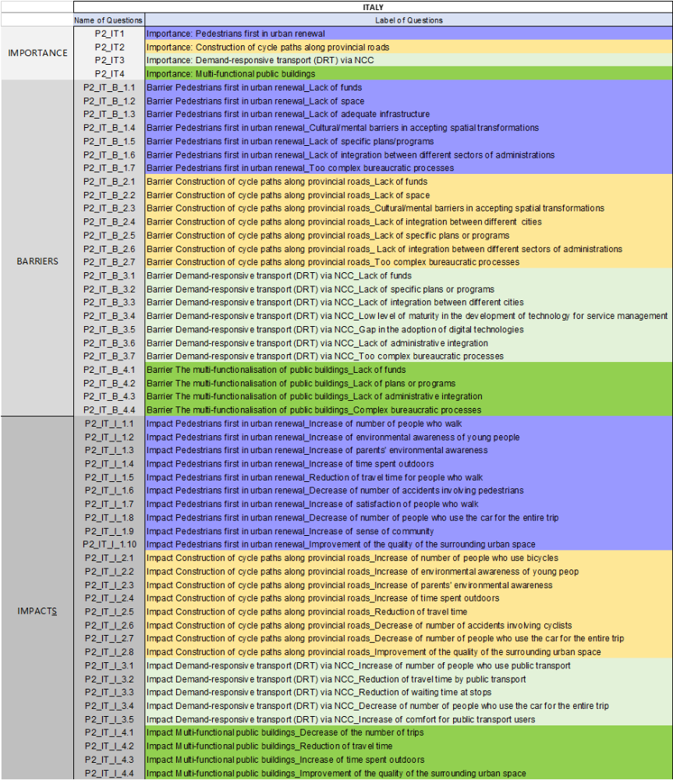
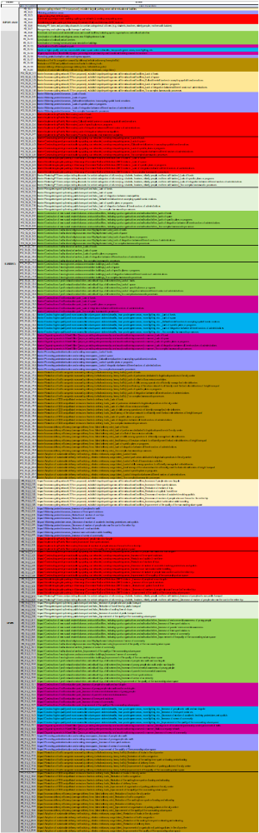
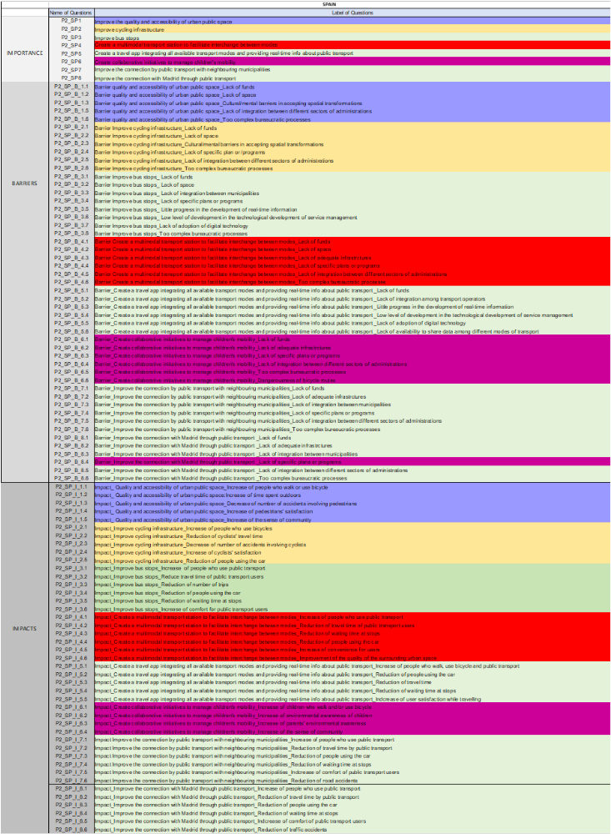

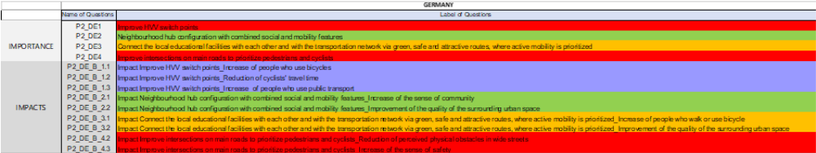
Methodology: data analysis design
  The comparative analysis of barriers and impacts was conducted using a cluster-based approach
  Since each strategy is associated with a specific set of barrier/impacts items, for each cluster, the items common to the different contexts were identified
  For each ULL, an average barrier/impact value for the cluster is calculated as the average of the values of the common items

Slide 9
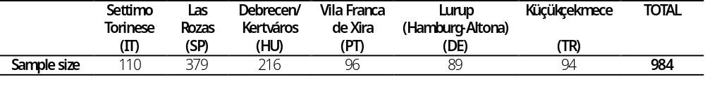
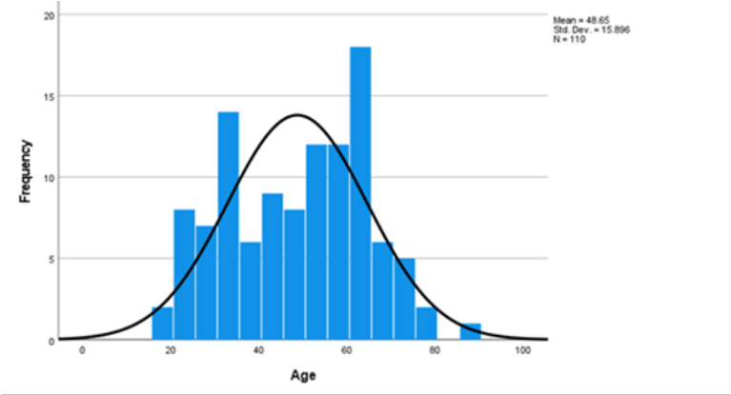
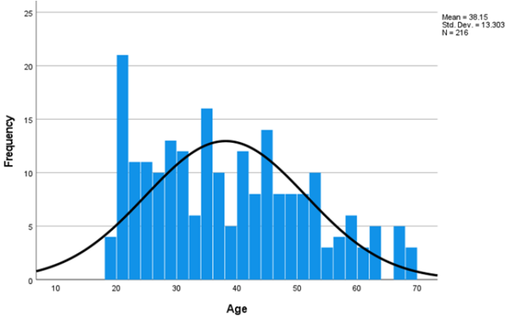
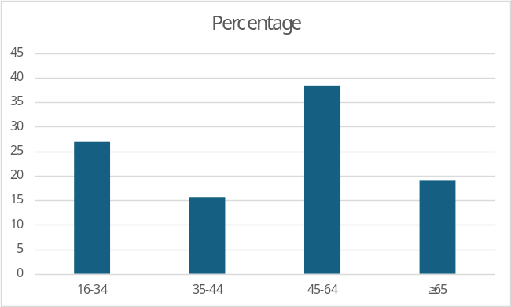




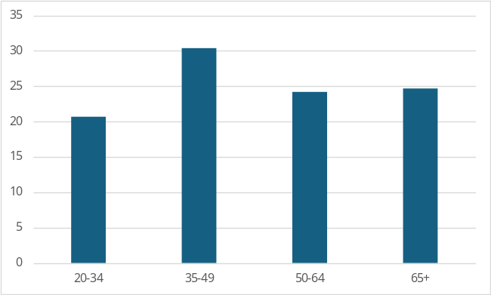
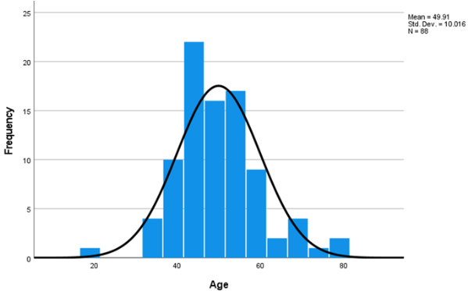
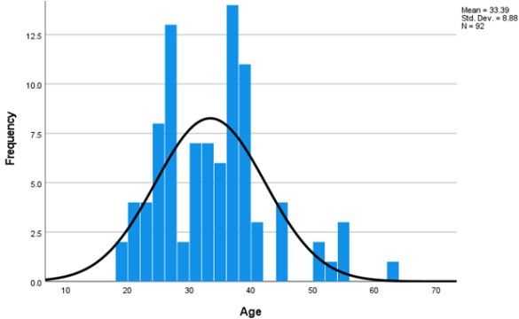


Results: the sample
Age

Slide 10
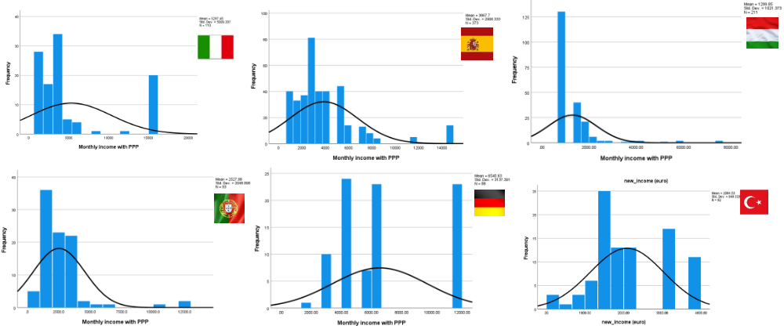
Results: the sample
Income

Slide 11
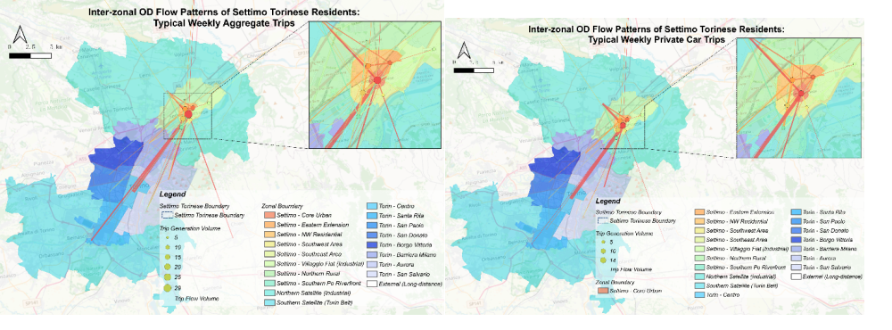
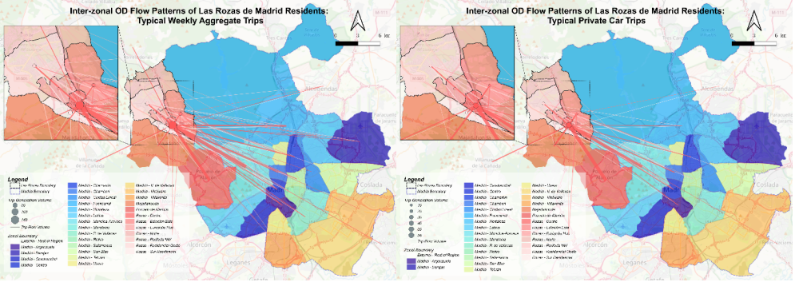
Results: the mobility patterns
  Employees (41.8%), retired people (17.3%) students and freelancers (both 7.3%)
  45% university degree and 51% high school degree
  Household average size: 2.77 persons; average number of children per household: 0.97; 0.27 children < 13 years old
  92% own a driving license; average number of cars: 1.75 cars; fuelled with gasoline (49.1%) and diesel (24.5%), average car age: 8.7 years; 95 HP
  Annual PT urban pass: 10%; extra-urban pass: 5.5%
  60% use cars; walking: 19.1%; bicycle: 5.5%; multimodal: 8.2%
  Trip purpose: work/commute: 65.5%; education: 7.3%
  Employees (55.2%), students (12.9%); retired people (9.1%); freelancers (7.0%)
  64.6% university degree and 10.5% high school diploma
  Household average size: 2.5 persons; average number of children per household: 0.82; 0.25 children < 13 years old
  average number of cars: 1.5 cars; fuelled with gasoline (30.3%) and diesel (30.9%); LPG+petrol and hybrid cars (20.3%); average car age: 9.3 years; 137 HP
  Extra-urban PT pass: 74.3%
  33.8% use cars; multimodal: 27.4%; PT: 21.4%; regional train: 10.6%
  Trip purpose: 73% for work or study

Slide 12
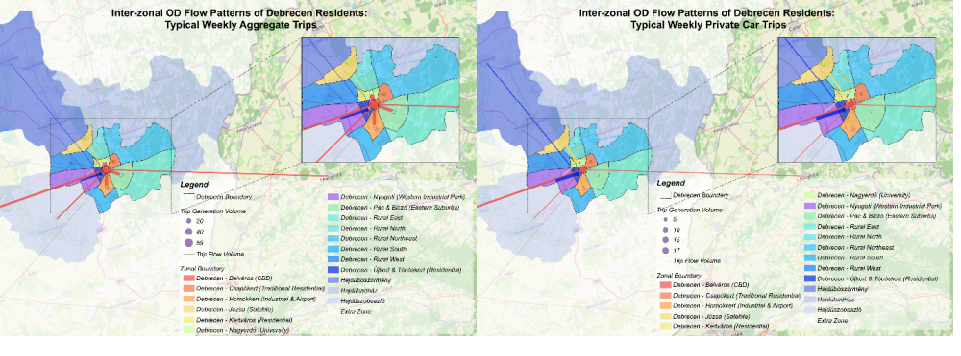
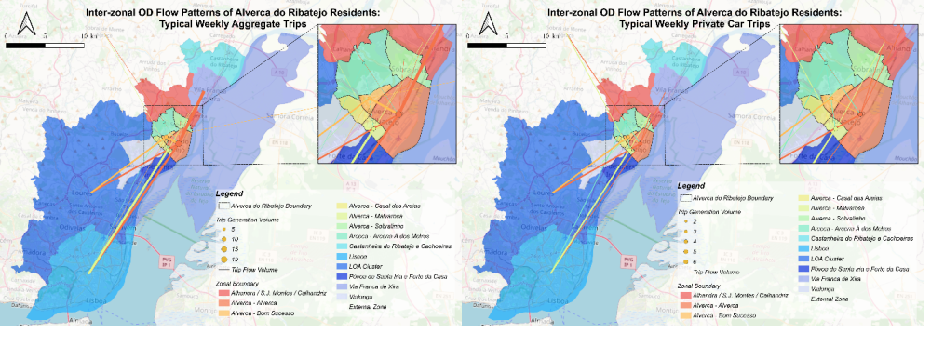
Results: the mobility patterns
  Employees (24.4%); workers/labourers (23.5%); unemployed looking for work (14.6%); homemakers (8.5%); students (7.0%)
  19.7% university degree; 39.4% high school degree; 25.4% secondary education without high school degree
  Household average size: 3.24 persons; average number of children per household: 1.09; 0.71 children < 13 years old
  average number of cars: 1.14 cars; fuelled with gasoline (64.4%) and diesel (26.4%), average car age: 13.55 years; 127.55 HP
  Urban PT pass (10.0%); extra-urban pass (5.5%)
  38.4% use cars; PT: 22.7%; walking: 12.0%; bicycle: 8.8%; multimodal: 5.6%
  Trip purpose: work/commute: 33.3%; education: 9.3%
  Employees (59.6%), retired people (13.8%); freelancers (9.60%); students (very small %);
  68.0% university degree and 7.4% high school diploma
  Household average size: 2.84 persons; average number of children per household: 0.63; 0.39 children < 13 years old
  average number of cars: 1.65 cars; fuelled with gasoline (42.0%) and diesel (44.3%); LPG+petrol and hybrid cars (6.8%); average car age: 11.37 years; 114.6 HP
  50.0% use cars; multimodal: 20.8%; other modes very small %
  Trip purpose: 65.3%: 8.4% for shopping/errands

Slide 13
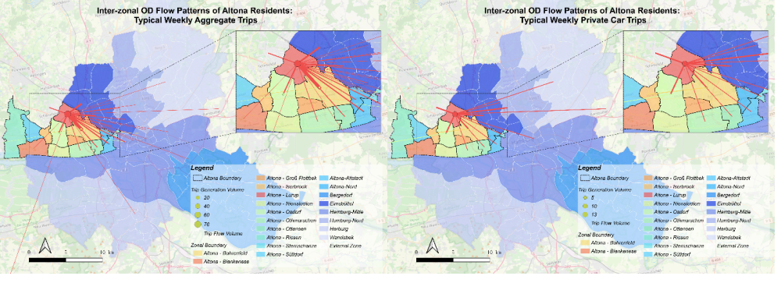
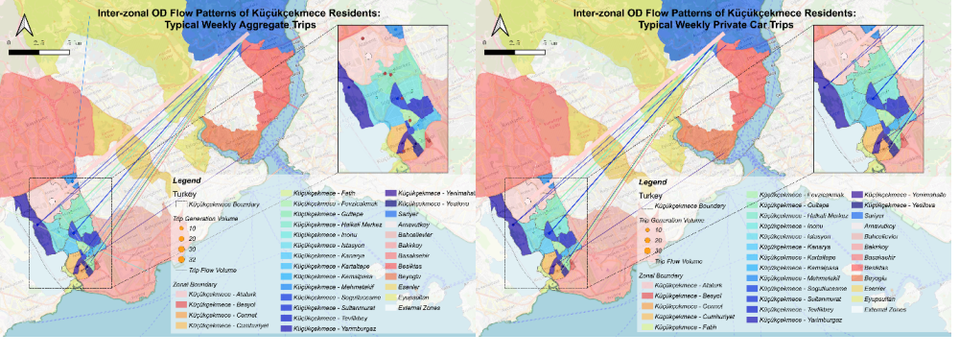
Results: the mobility patterns
  Employees (54.5%), workers/labourers (9.1%); retired people (9.1%)
  38.2% university degree and 23.6% high school degree
  Household average size: 3.56 persons; average number of children per household: 1.56; 1.04 children < 13 years old
  Average number of cars: 1.19 cars; fuelled with gasoline (45.0%) and diesel (42.5%); hybrid: 5.0% average car age: 8.8 years; 118.32 HP: average number of bicycles: 4.28
  Germany Ticket: 52.3%; national monthly rail and bus pass: 28.4%
  Bicycle: 37.1%; 31.5% use cars; PT: 16.9%; walking: 4.5%; multimodal: 10.1%
  Trip purpose: work/commute: 66.3%; leisure: 7.9%
  Employees (35.9%), students (32.6%); others are marginal
  89.1% university degree
  Household average size: 3.04 persons; average number of children per household: 1.1; 0.37 children < 13 years old
  Average number of cars: 0.86 cars; fuelled with gasoline (83.1%) and diesel (11.3%); average car age: 4.69 years
  Extra-urban PT pass: 3.0%
  75.5% use cars; PT: 17%; multimodsl: 2.0%
  Trip purpose: majority for work

Slide 14
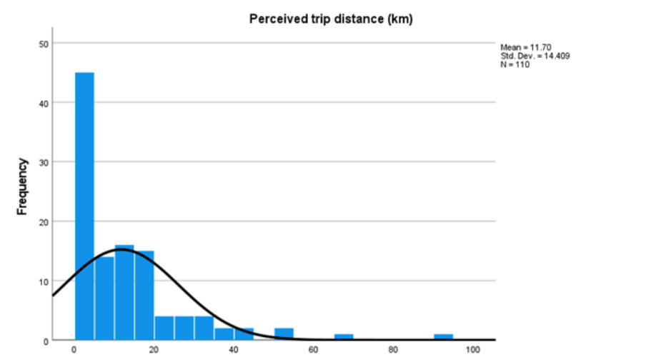
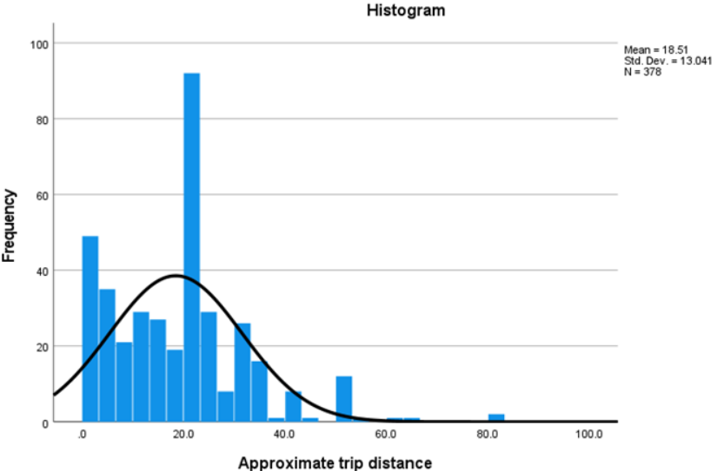
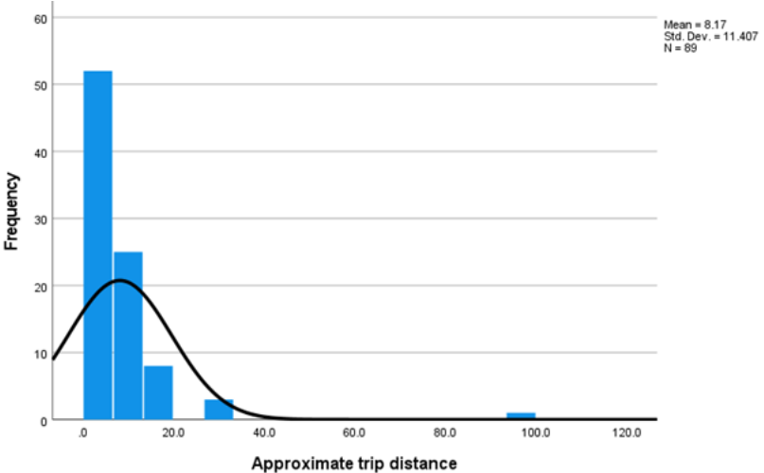
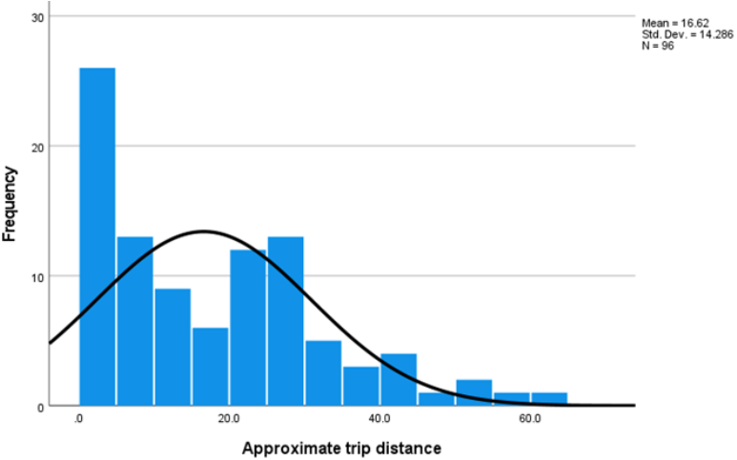
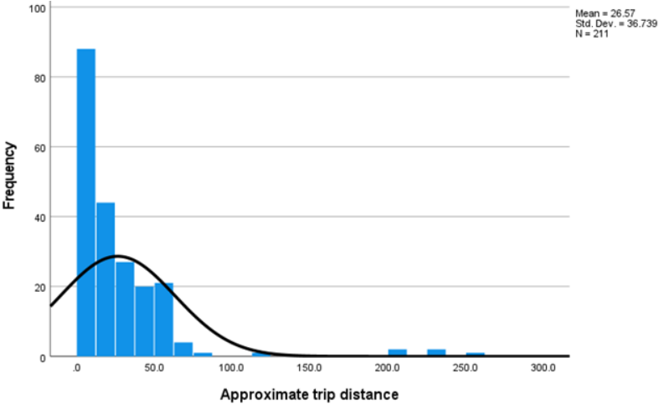
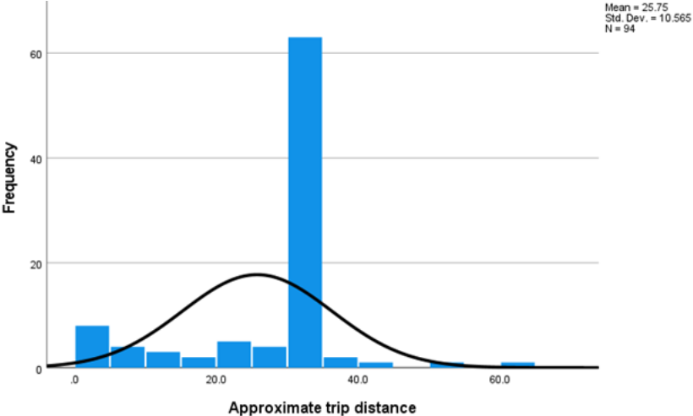
Results: the mobility patterns

Slide 15
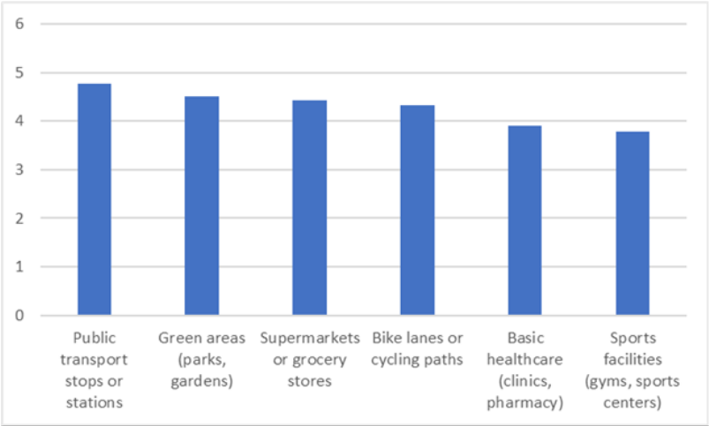
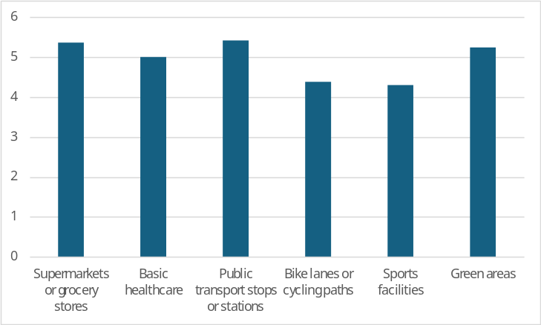
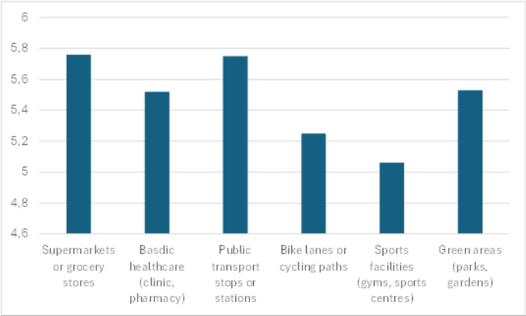
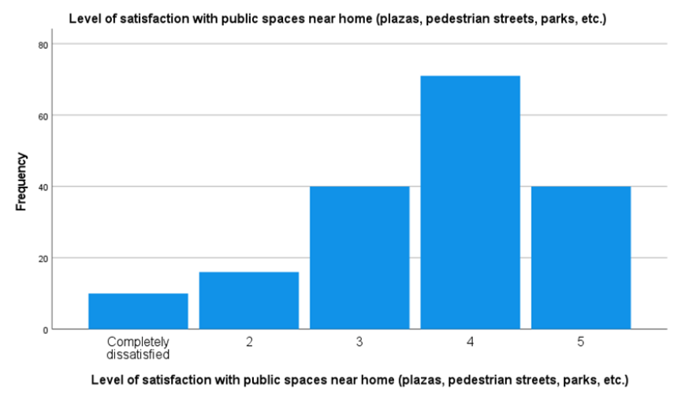
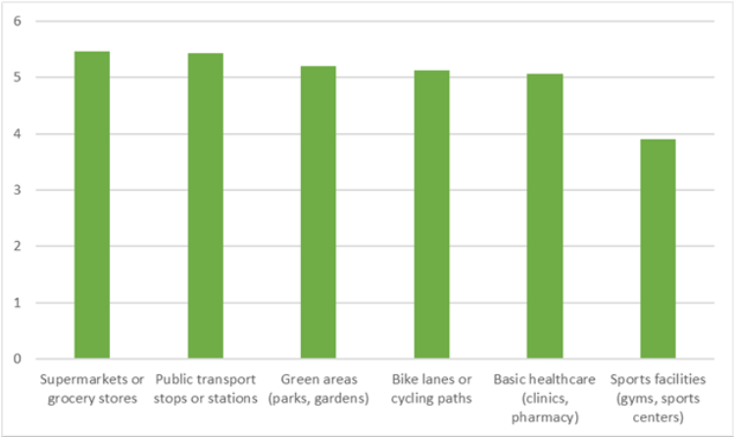
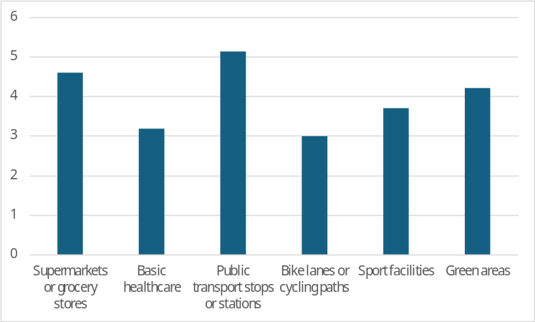
Results: the perception of 15-min accessibility on foot

Slide 16
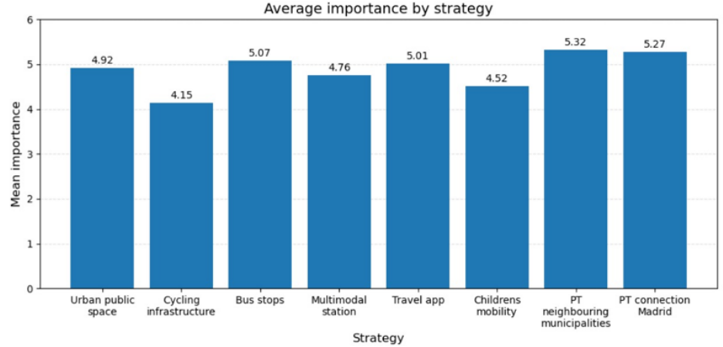
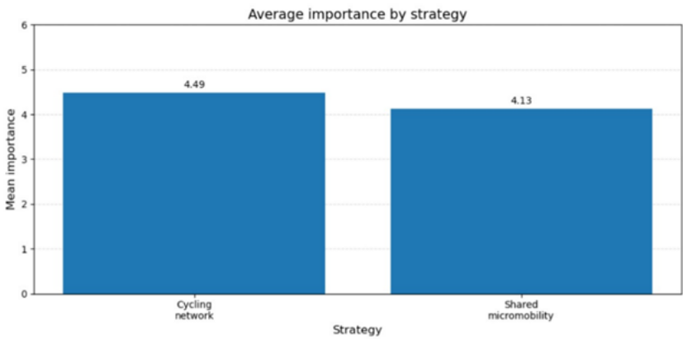
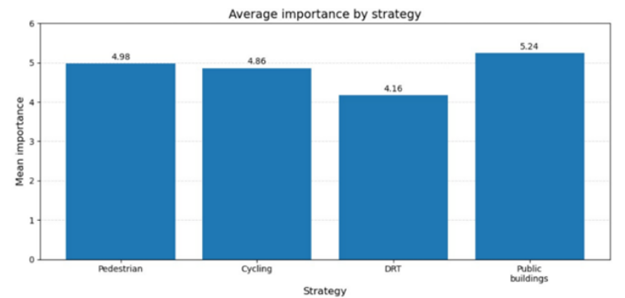
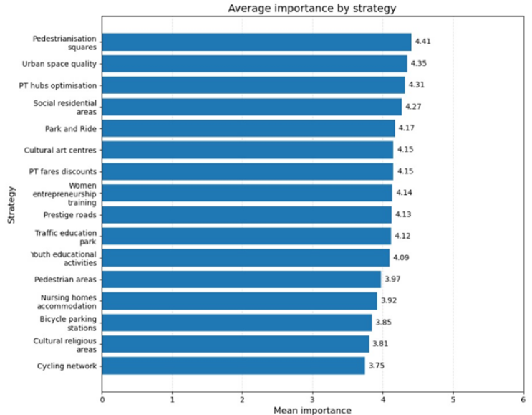
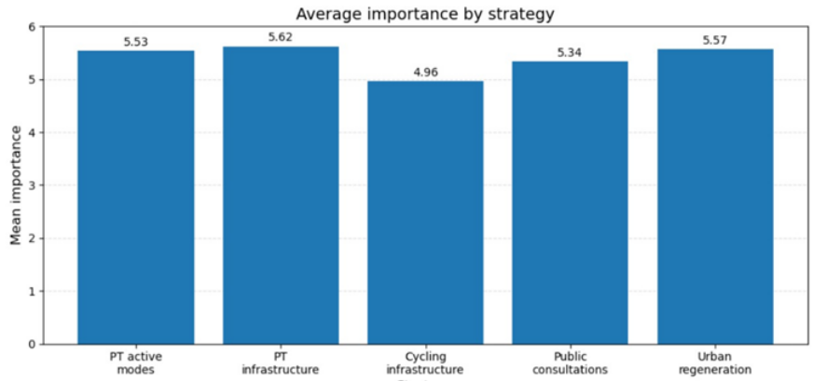
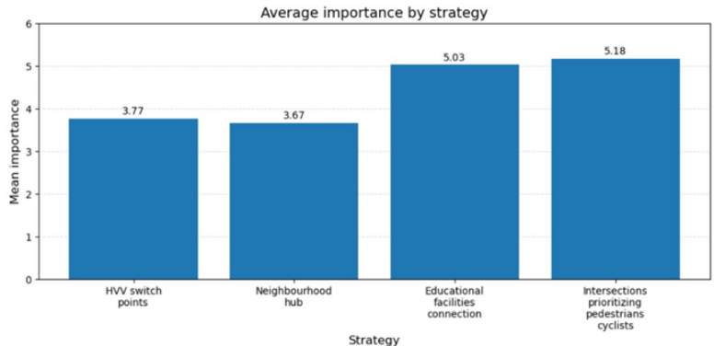
Results: the importance of strategies

Slide 17
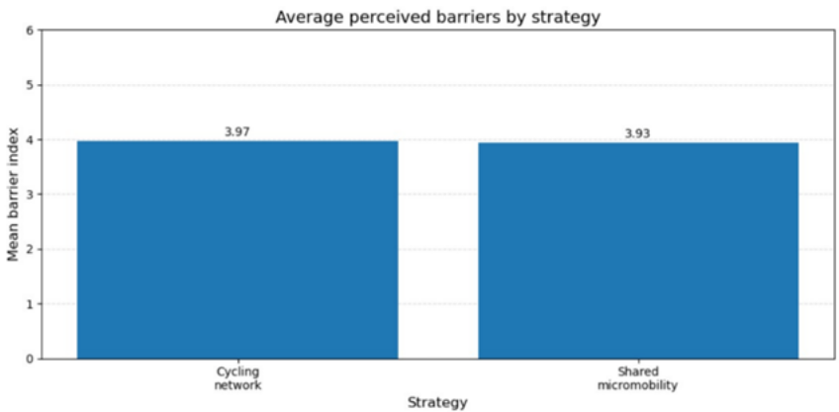
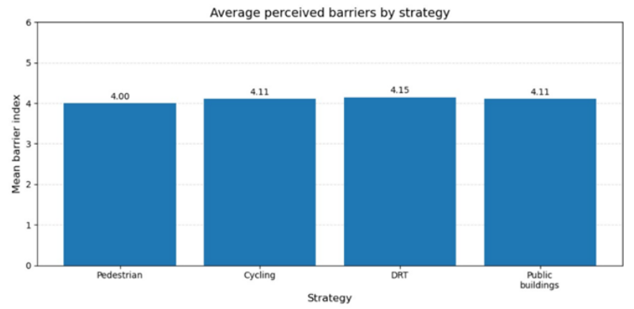
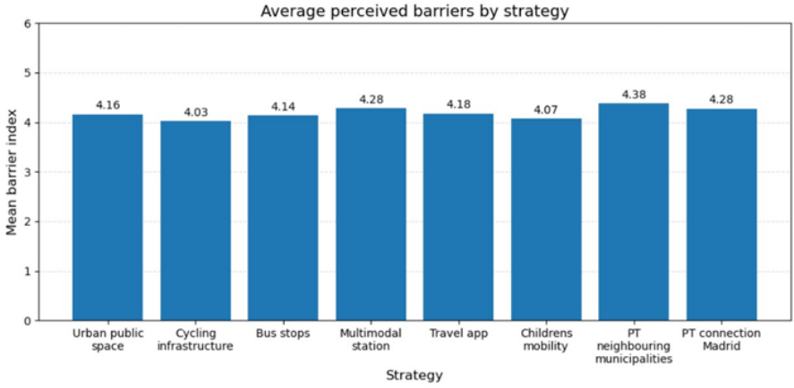
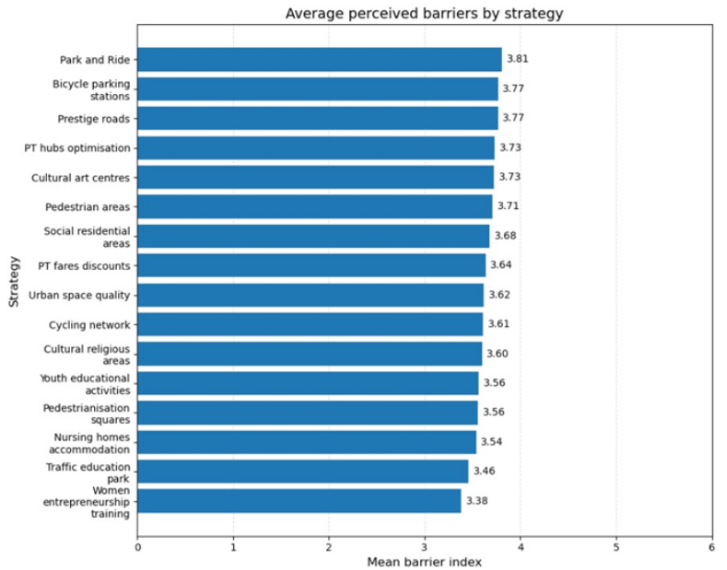
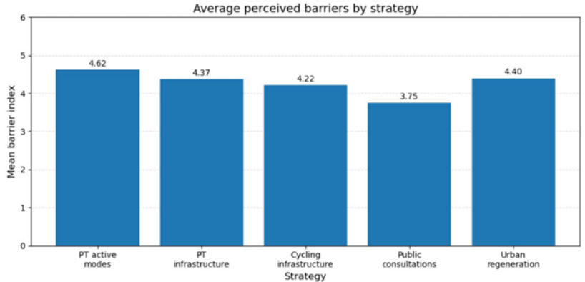
Results: evaluation of barriers to implement strategies

Slide 18





Results: evaluation of expected impact of strategies

Slide 19








Results: citizens’ perception of strategies
LATENT FACTORS
Strong negative component related to sustainable mobility and active mobility. Negative value also in the criteria for choosing the transport mode (Factor 4), suggesting poorly structured behaviours, or strongly oriented towards traditional modes. Pro-environmental commitment (Factor 5) is significantly negative, highlighting low awareness of environmental issues and limited attention to the impact of one's mobility choices.
Perception of the urban context (Factor 1) and technological familiarity (Factor 2) are slightly positive, indicating that the barriers are not so much related to context or technology, but rather to individual attitudes and preferences
Accessibility and security
Low perception of the quality and security of urban spaces (Factor 1) and a limited familiarity with technology (Factor 2). The propensity for active mobility (Factor 3) is slightly negative, although less pronounced compared to other clusters. The criteria guiding the choice of transport mode (Factor 4) are also poorly structured, suggesting travel behaviours more related to habit than to conscious evaluations. The only positive element is represented by pro-environmental commitment (Factor 5), which appears moderately high. However, this sensitivity does not seem to translate into consistent behaviours in the other dimensions considered
Positive values across all the factors, showing a coherent profile oriented towards sustainable mobility. A strong inclination towards active mobility (Factor 3) and a well-structured approach to choosing transport mode (Factor 4), suggesting conscious behaviours guided by functional evaluations.
Positive perception of the urban context (Factor 1) and a good level of familiarity with technology (Factor 2), which can facilitate the adoption of innovative and sustainable mobility solutions.
Pro-environmental commitment (Factor 5) is positive, although less pronounced compared to other factors
Digital skill
Active mobility
Mode pleasure
Pro-environment low tech behaviour
338 individuals
429 individuals
429 individuals

Slide 20

Results: average importance values per cluster and per country

Slide 21







Results: average importance values per cluster and per country
PUBLIC AND COLLABORATIVE INITIATIVES
PEDESTRIAN
CYCLING
PUBLIC TRANSPORT
INFRASTRUCTURE
NEIGHBOURHOOD HUBS
URBAN REGENERATION

Slide 22








Results: comparative analysis of barriers per cluster and country

Slide 23



Results: comparative analysis of impacts per cluster and country

Slide 24

Results: the focus groups
  First common pattern: tendency to prioritise strategies perceived as directly relevant to everyday mobility, accessibility, and the quality of urban space

Slide 25
Results: the focus groups
  Second common pattern: more cautious evaluation of strategies whose usefulness depends on enabling conditions that are not yet fully in place:
    Debrecen: shared micro mobility was considered potentially useful but clearly subordinate to the availability of safe infrastructure
    Settimo Torinese: demand-responsive transport (DRT) generated uncertainty and scepticism, particularly among stakeholders
    Las Rozas: digital applications and cycling infrastructure were evaluated less positively than metropolitan public transport strategies
    Hamburg-Daltona District: stand-alone HVV switch points were discussed more critically, whereas multifunctional neighbourhood hubs received more positive but still conditional assessments linked to location, existing activity nodes, and integration with local services
    Vila Franca de Xira: participatory processes were recognised as important but not as direct mobility measures.

Slide 26
Results: the focus groups
  Third common pattern: recurring importance of implementation conditions beyond technical design:
    across the six ULLS, participants repeatedly referred to governance coordination, behavioural change, political support, and institutional capacity as decisive factors shaping feasibility
    The results show that the perceived value of strategies depends not only on their intended objectives, but also on the credibility of their implementation pathways

Slide 27
Results: the key take-away from focus groups
  First, participants consistently prioritised measures capable of improving everyday mobility in visible and practical ways. Walkability, cycling safety, public transport accessibility, and public-space quality were generally valued more strongly than abstract or purely technological solutions
  Second, implementation barriers were rarely limited to funding alone. Across the cases, governance fragmentation, bureaucratic complexity, behavioural resistance, political acceptability, and weak coordination repeatedly emerged as equally important constraints. This confirms that successful implementation depends as much on institutional and social conditions as on technical design
  Third, expected impacts were strongest where strategies responded directly to concrete local needs such as safer routes, shorter travel times, reduced car dependence, and improved urban liveability. At the same time, participants often evaluated expected impacts critically and conditionally, especially where implementation pathways remained unclear
  More broadly, the six cases suggest that the city of proximity should be understood not only as a matter of distance, but also as a matter of how people are able, willing, and supported to travel through everyday urban space

Slide 28
Conclusions
  Mix method, joining a quantitative data collection through a web questionnaire with a qualitative discussion within focus groups in six different countries, has allowed to have a wide perspective on how citizens perceive the strategies aimed at favouring more liveable cities. In addition, comparing citizens perspective and stakeholders one has generated an insight in frequent misalignments between the perception of decision makers and citizens
  Despite the so diverse cultures of mobility, the centrality of cars persists also in countries as Germany, more advanced in terms of sustainable mobility:
    it is related to the appealing car has for people, allowing, better than any other mode, comfort, flexibility, and possibility to carry objects and accompany someone.
  Attitudes toward technology is transversal to the different cities but our samples were a bit overeducated compared to the average. This should induce a cautiousness in overestimating the adoption of digital technologies to support transport systems, not forgetting that in countries with a high average age this remains an issue

Slide 29
Conclusions
  Relevant from a policy perspective, the cluster analysis distinguishes three clearly recognisable user profiles. The eco-friendly group represents the segment most predisposed to adopt sustainable mobility solutions
  The factor with the greatest discriminating power among the clusters is the propensity for active mobility:
    walking and cycling are not simply two travel options among others, but a real dividing line between different social and cultural profiles
    thus, the strategies cannot be thought of as universally effective → segmentation also provides a key to calibrate tools, messages, and implementation priorities
  One of the most important aspects of the integrated analysis is the remarkable convergence, in many contexts, between the priorities emerging in focus groups and the evaluations collected through questionnaires
  A second very strong cross-cutting result concerns the nature of barriers:
    in different countries, obstacles are almost never solely attributable to a lack of funds. The shortage of resources is certainly present, but it is systematically accompanied by problems of bureaucratic complexity, administrative fragmentation, poor integration between sectors, weak planning, and difficulties in coordination between levels of government

Slide 30
Conclusions
  The evaluation of sustainable mobility strategies is strongly shaped by local context but reveals a set of shared priorities and recurring implementation challenges:
    across the ULLs, strategies directly affecting everyday mobility — especially public transport improvement, walkability, cycling infrastructure, and public-space quality — consistently emerged as the most relevant, capable of producing visible and meaningful benefits in terms of accessibility, safety, comfort, and quality of life
  Participants consistently distinguished between structural and enabling strategies:
    measures related to participation, governance, communication, education, social infrastructure, and digital tools were often recognised as important, but they were rarely seen as substitutes for core transport and public-space interventions
    instead, they were treated as supporting conditions that can strengthen the implementation and acceptance of more structural strategies
Effective transport policies should combine hard and soft measures rather than relying on one type alone

Slide 31
THANKS FOR YOUR ATTENTION.

