Slide 1


Making the 15-minute city work beyond the centre: Imagining 15-minute accessibility in urban outskirts
Forthcoming Final Event – Brussels, 27 May 2026
DREAMS
Imre Keseru, associate professor
Vrije Universiteit Brussel, Mobilise Research Group; House of Sustainable Transitions

Slide 2

Photo: https://www.dreams.co.uk/sleep-matters-club/do-people-actually-believe-dreams-mean-something-to-us

Slide 3
Our DREAMS
To examine how co-created and user-centric mobility services, mobility hubs and flexible activity hubs can contribute to accessible, sustainable and inclusive 15mC neighbourhoods in urban outskirts in European cities and regions.
Better understand accessibility needs
Develop new business models for shared mobility
Assess the societal impacts of these new services
Develop a decision support tool

Slide 4












DREAMS
(Jan 2023-Dec 2026)
28 partners from 6 countries
Our Dream team

Slide 5
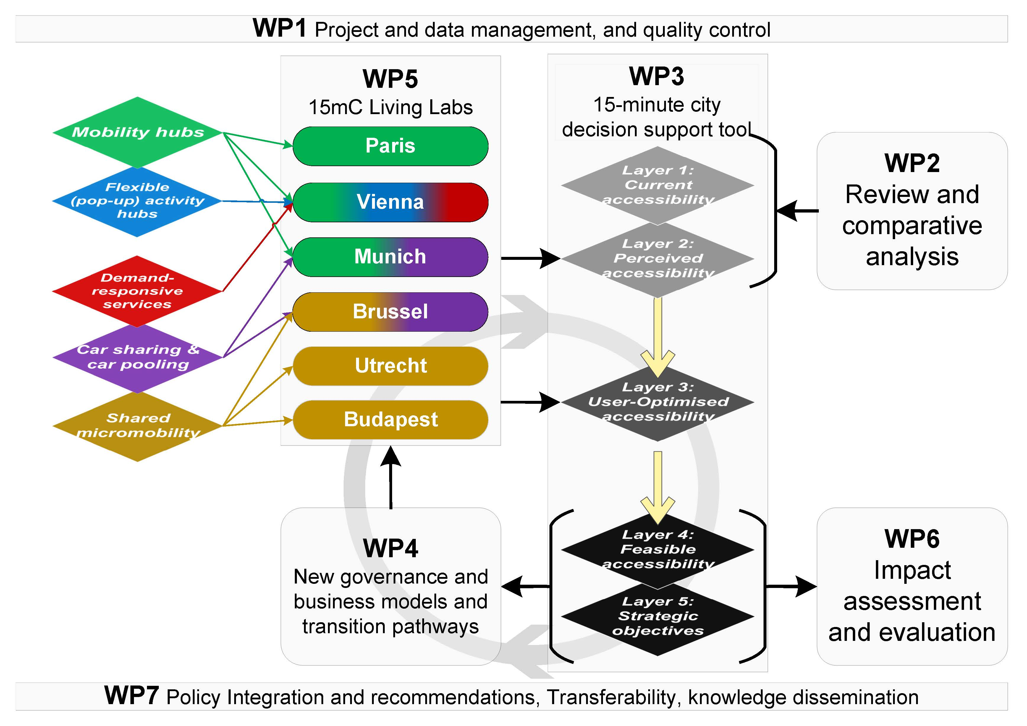
DREAMS 15-minute city Decision Support Tool
Survey
GIS tool
Flowers of proximity

Slide 6
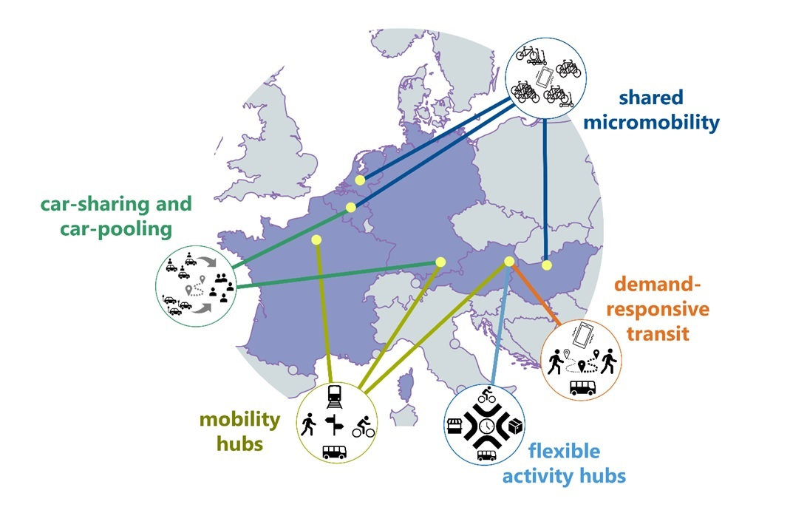
Dreams living labs
Budapest (HU)
Utrecht
Brussels
Paris
Vienna
Munich
6

Slide 7
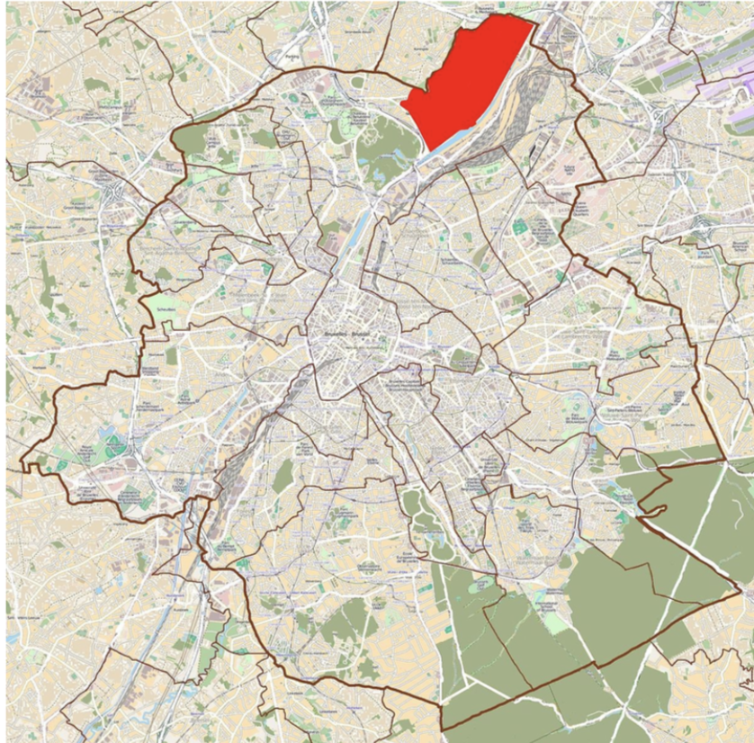
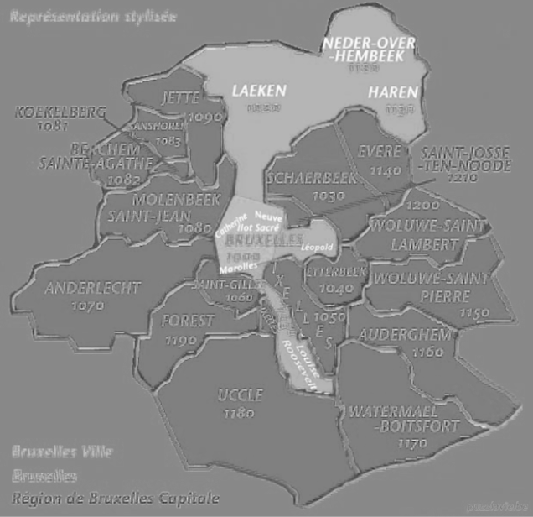


Brussels living lab: Neder-Over-Heembeek (NOH)
City of Brussels
CAMBIO Car Sharing

Slide 8
Challenges in Neder-over-Heembeek
Spatial isolation and weak connections to the city centre
Administratively part of the City of Brussels
  General feeling of being 'forgotten’
  Strong mobility pressures
      Insufficient or missing pedestrian and cycling links
  Heavy freight traffic
  Unequal access to amenities and services
Notes:
Main shortages include:
lack of shops in the southern part of the district;
insufficient cultural facilities;
limited tourist and administrative facilities;
lack of outdoor spaces designed specifically for young people;
shortage of local health services.

Slide 9
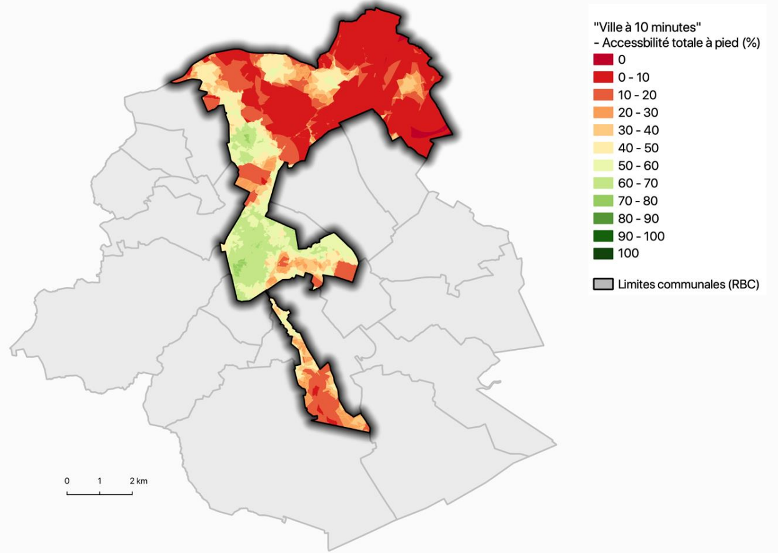
Current 10-minute accessibility on foot – City of Brussels
Source: Brussel Studies Institute: La Ville à 10 minutes.
https://bsi.brussels/wp-content/uploads/sites/2/2021/10/PlaquetteV10min.pdf

Slide 10
Layer 1: Current accessibility – GIS-based decision support tool

Slide 11
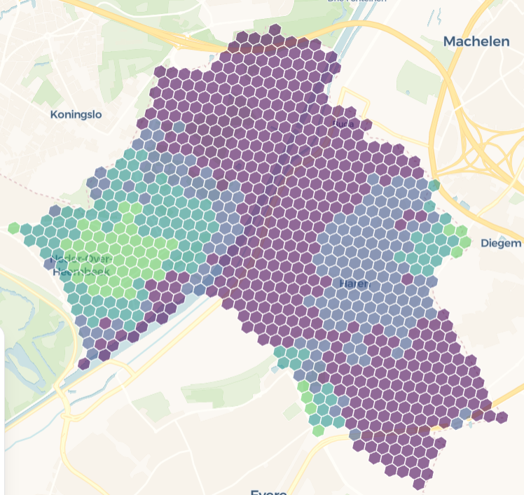
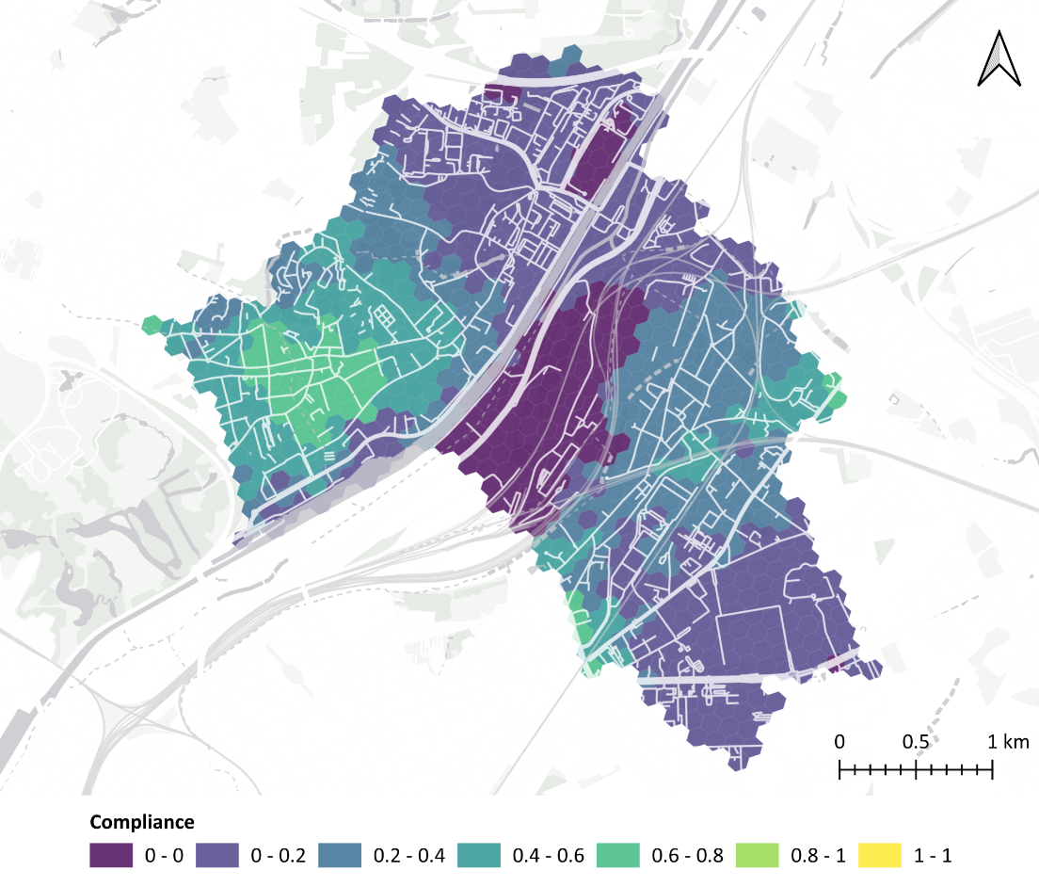
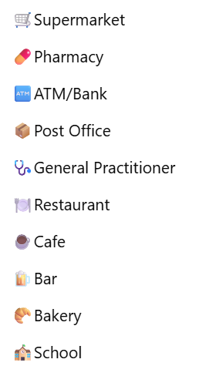
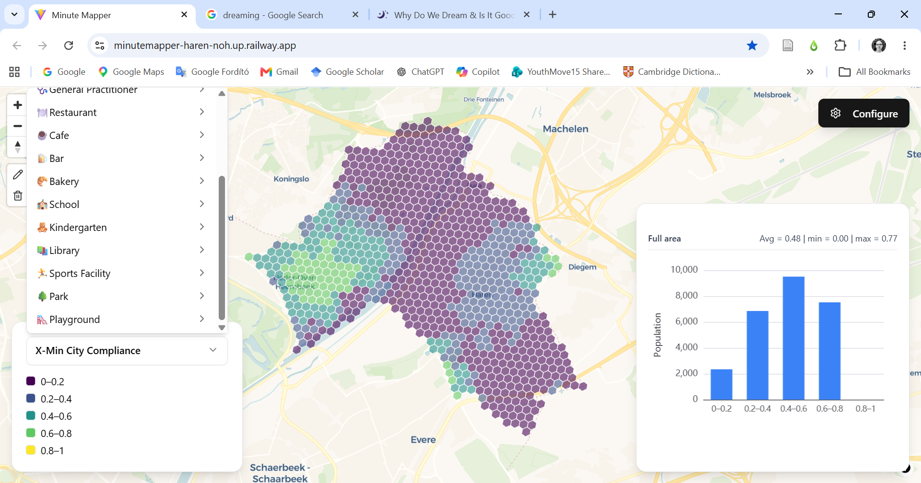
Layer 1: Current accessibility: DREAMS Accessibility Tool
15-Min City Compliance
The proportion of destinations that can be reached within 15-minute threshold.
15-minute city compliance in Neder-Over-Heembeek
Notes:
On average, residents of Haren & Neder-Over-Heembeek can access at least one location within a 15-minute walk for 75% of amenities (multi-amenity compliance of 0.75). When considering the preferences of parents, the multi-amenity compliance falls to 0.46. A map of the spatial distribution is provided in Figure 8. The distributions and corresponding summary statistics for all preference sets are provided in Figure 9 and Table 4, respectively.
This reduction in compliance is largely driven by access to grocery stores and pharmacies, which are highly weighted but have a low compliance (population-weighted average of 0.09 and 0.14, respectively). Other amenities with low compliance are post offices and cafés (refer to Figure 24 for more detail).

Slide 12
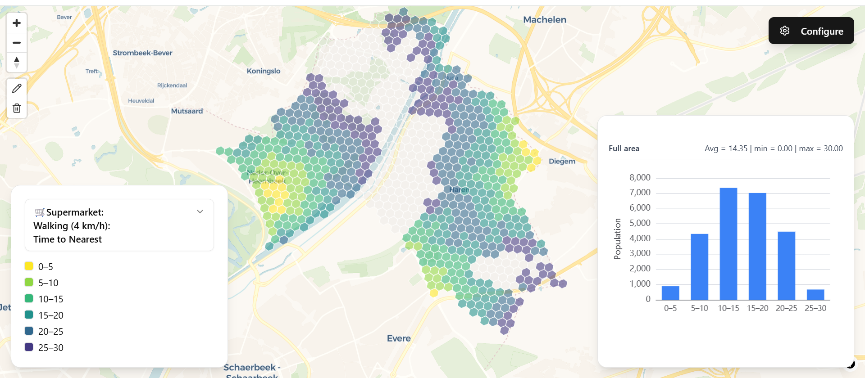
Layer 1: Current accessibility: DREAMS Accessibility Tool
Accessibility of supermarkets on foot (minutes)
Notes:
On average, residents of Haren & Neder-Over-Heembeek can access at least one location within a 15-minute walk for 75% of amenities (multi-amenity compliance of 0.75). When considering the preferences of parents, the multi-amenity compliance falls to 0.46. A map of the spatial distribution is provided in Figure 8. The distributions and corresponding summary statistics for all preference sets are provided in Figure 9 and Table 4, respectively.
This reduction in compliance is largely driven by access to grocery stores and pharmacies, which are highly weighted but have a low compliance (population-weighted average of 0.09 and 0.14, respectively). Other amenities with low compliance are post offices and cafés (refer to Figure 24 for more detail).

Slide 13
Layer 2: Perceived accessibility – DREAMS survey

Slide 14
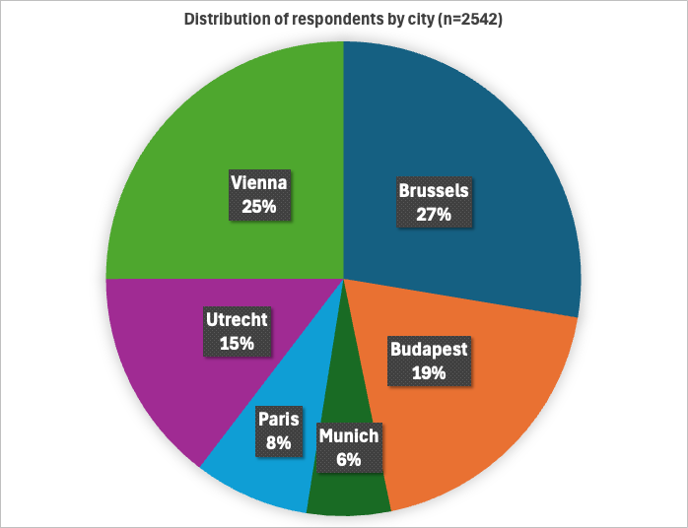
Layer 2: Perceived accessibility
DREAMS survey on 15-minute neighbourhoods
Conducted in 6 cities:
Brussels, Budapest, Munich, Paris, Utrecht, Vienna
Sample: 2542 respondents
Mobility behaviour (mode choice, travel frequency, etc.)
Currently accessed amenities
Stated preferences for services at
walking/cycling distance (top 3-5)
Perceived barriers for reaching services
Brussels survey: N= 793, distributed the
Brussels Region
Notes:
Gender distribution: 53% women, 47% men
Migrant background: 82% born in Belgium, 15% has been living in Belgium for over 10 years but is not originally from the country, small number of people that have lived there for under 10 years
Employment status: 36% fulltime, 11% parttime, 7% self-employed, 5% student, 7% unpaid/household care/unemployed, 34% retired
Educational background: 23% secondary/vocational training, 75% tertiary, minority primary or less
Household composition: 34% single household, 10% single household with children, 32% couple, 21% shared housing (not a family)
Income& digital skills: very well distributed
Top 3 chosen amenities (meaning, these are currently important for people to access nearby)
Grocery store (395)
Bakery (355)
Pharmacy (349)(I personally found this suprising, but it might be due to the relatively high number of older and retrired people, I assume they need more care and medicine. But this is just an assumption, not something we can know from the data)
Main barriers (note: only answered if people answered ‘yes’ to the previous question ‘do you experience barriers’) Also note: these are all selected by a really small subsection of the sample and we cannot assume normal distribution.
Too far away (35)
Difficult to reach with transport options available to me (28)
Not open when I need it (21) / Traffic is too busy when I need to go there (20)
“Are there any amenities that you currently do not have nearby but wish you had?”
No, all amenities I need are nearby (235)
Banking servives (ATM, bank office) (60)
Cinema (53)
→ Interesting here is that ‘no’ is the main answer of people, that’s quite positive. And there isn’t a huge difference in the other preferred amenities, so I suppose that may indicate that these are highly personal choices and nothing is structurally missing

Slide 15
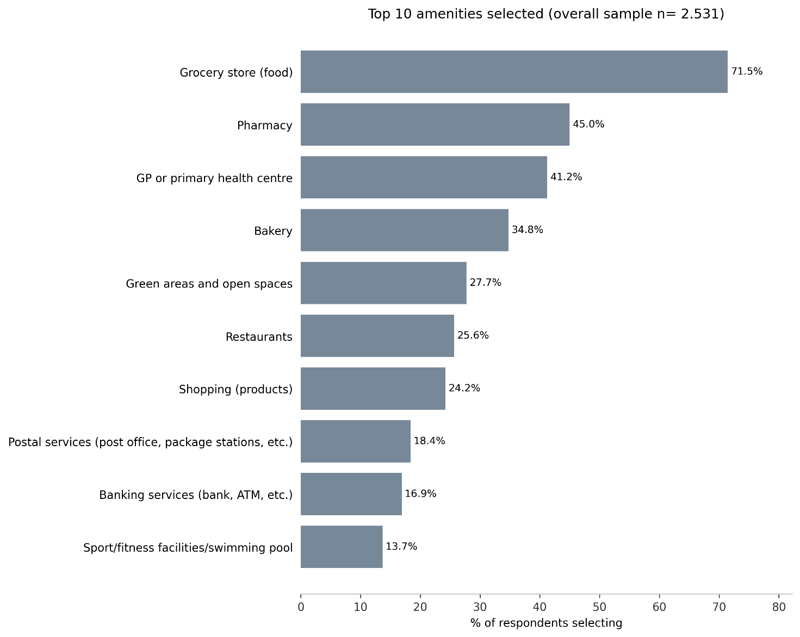
Top 10 amenities selected as important to have nearby
Clear prioritisation of essential, everyday services
Groceries, health services and green spaces are important
50%
44%
34%
48%
32%
6-city survey
Brussels Region
Source: DREAMS Brussels Survey 2025
Notes:
Figure 17 shows a clear prioritisation of essential, everyday services among respondents. Grocery stores stand out as the most important amenity to have close to home, selected by 71.5% of respondents, indicating the central role of food-related activities in daily life. Health-related services are also highly valued, with pharmacies (45%) and GP or primary health centres (41.2%) ranking second and third, respectively.

Slide 16
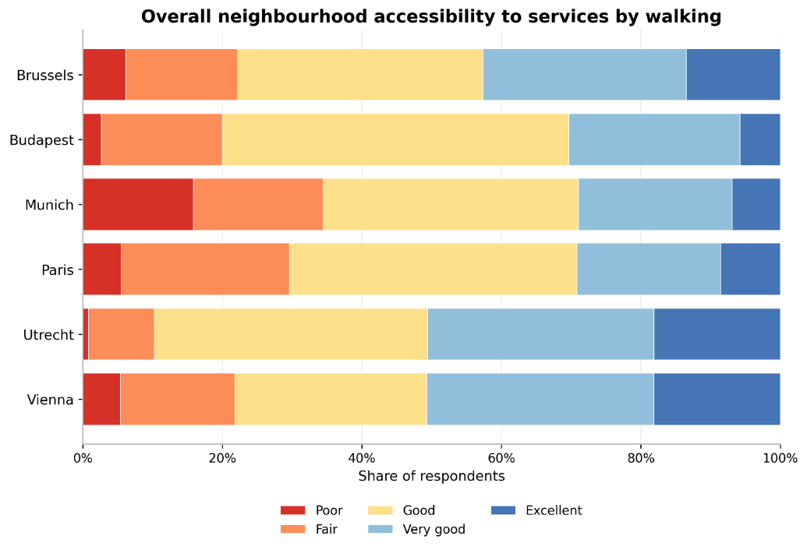
Overall neighbourhood walking accessibility rating

Slide 17
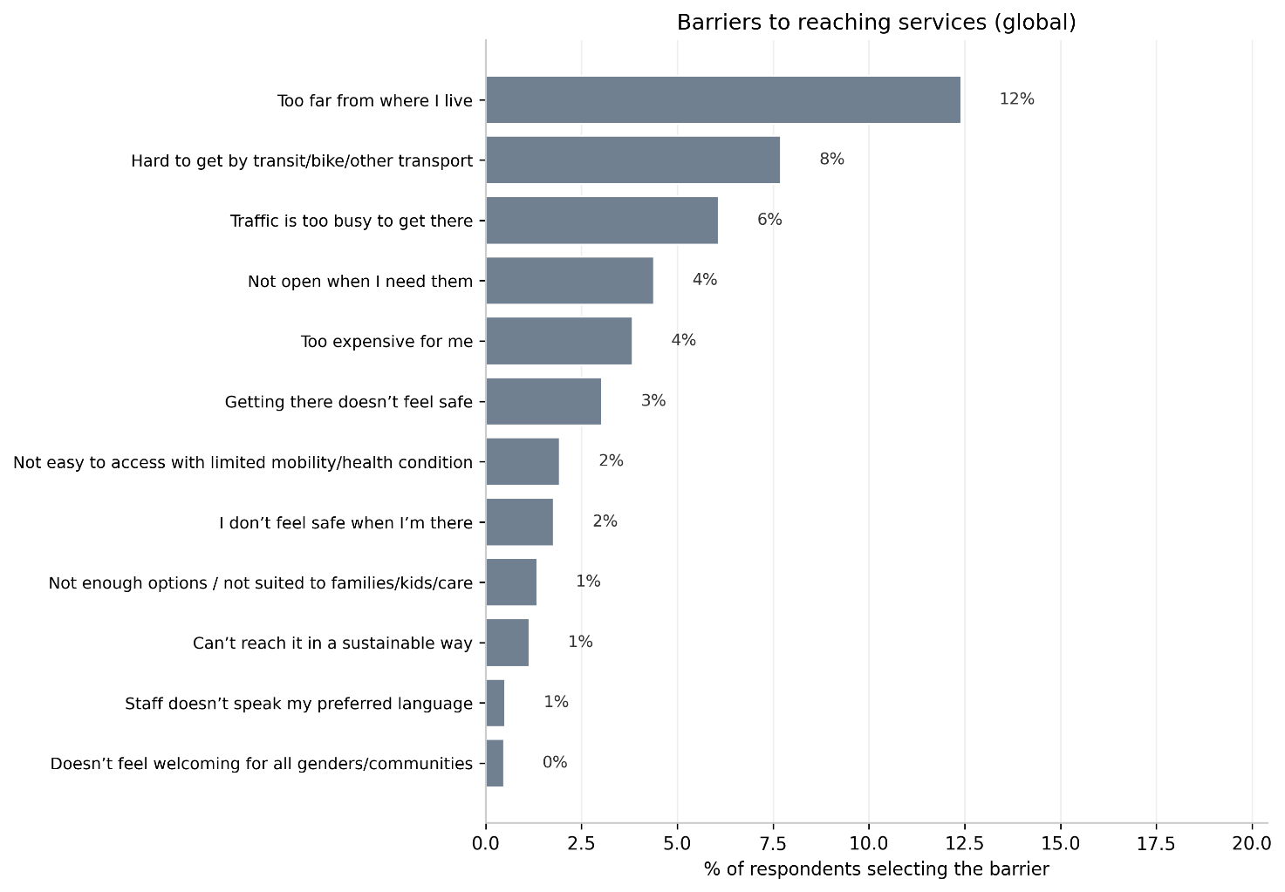
Barriers to reach preferred services
(Brussels Region)
4%
3.5%
Most respondents do not have major barriers to reach preferred amenities
Most significant barrier is proximity to amenities (beyond 15 minutes)
2.5%
2.6%
2.5%
6-city survey
Brussels Region
Source: DREAMS Brussels Survey 2025
Notes:
When addressing the barriers that limit people to have good reachability for services (see Figure 29), findings indicate that spatial and transport-related barriers dominate, but remain limited to a small share of respondents. The most frequently cited barrier is that services are too far from where people live (12%), followed by difficulties in reaching them by public transport, bike, or other modes (8%), and traffic congestion (6%). Other barriers, such as limited opening hours, high costs, or safety concerns during the trip, are mentioned by only small shares (around 3–4%). Barriers related to accessibility, inclusiveness, sustainability, or language are rarely reported (1–2% or less). Overall, the results suggest that while distance and transport connectivity remain the key constraints, most respondents do not perceive major systemic barriers to accessing services.

Slide 18
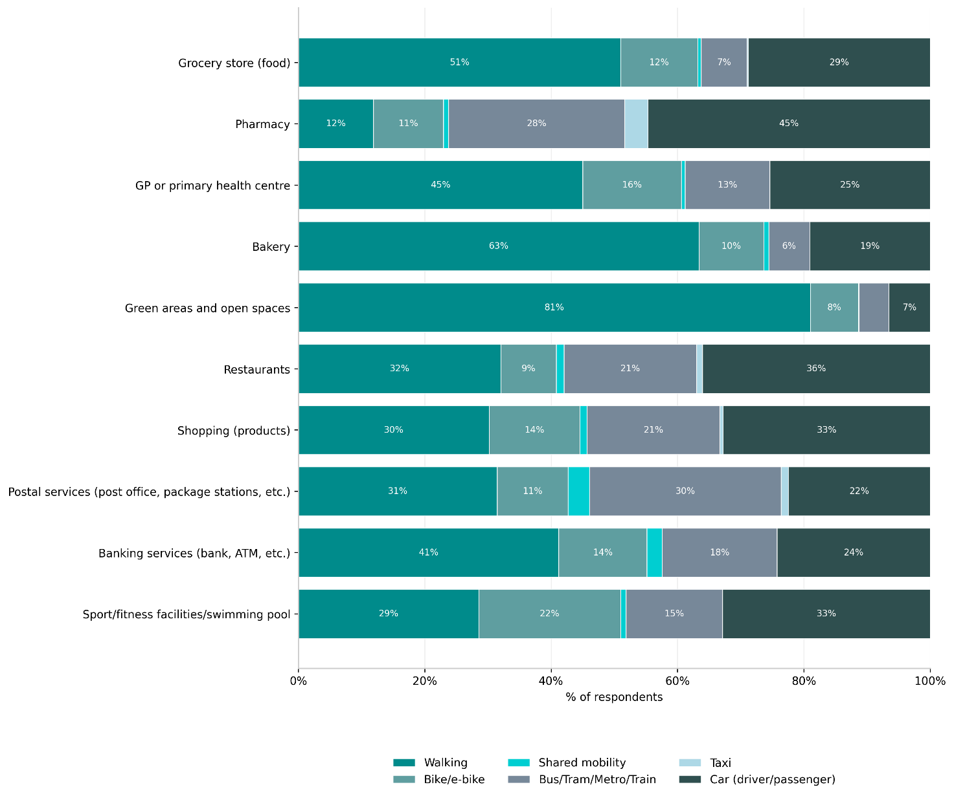
Travel mode to top amenities
Walking is the dominant mode for nearby, everyday services
Notes:
walking is the dominant mode for nearby, everyday services, particularly green areas and open spaces (81%), bakeries (63%), and grocery stores (51%), indicating strong local accessibility for these activities. Walking also plays an important role for access to GPs and banking services, where around 40–45% of trips are made on foot.

Slide 19
Travel mode to top amenities in the Brussels Region
Walking is the dominant mode for nearby, everyday services
Source: DREAMS Brussels Survey 2025
Notes:
walking is the dominant mode for nearby, everyday services, particularly green areas and open spaces (81%), bakeries (63%), and grocery stores (51%), indicating strong local accessibility for these activities. Walking also plays an important role for access to GPs and banking services, where around 40–45% of trips are made on foot.

Slide 20
Layer 3: User-optimised/desired accessibility – Flowers of proximity workshops

Slide 21
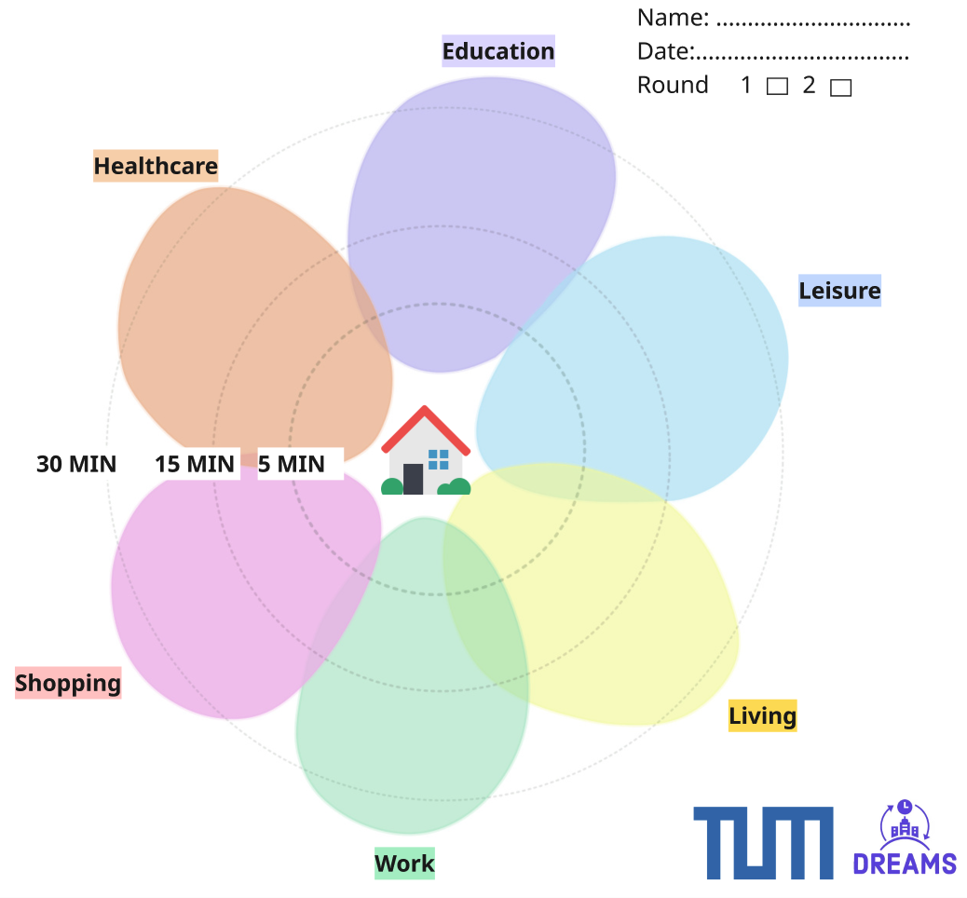
Layer 3: Desired accessibility
Why do people (not) visit certain amenities in their neighborhood?
"Flowers of Proximity" workshops
Current and desired daily access
www.flowersofproximity.com
Notes:
Qualitative Layer
"Flowers of Proximity" (TUM) workshops
Drawing current and desired daily access to amenities
Each 'petal' is a different sector of a person's daily life
Meant to facilitate discussions on where people (don't) go, and why, and what they would want to change

Slide 22
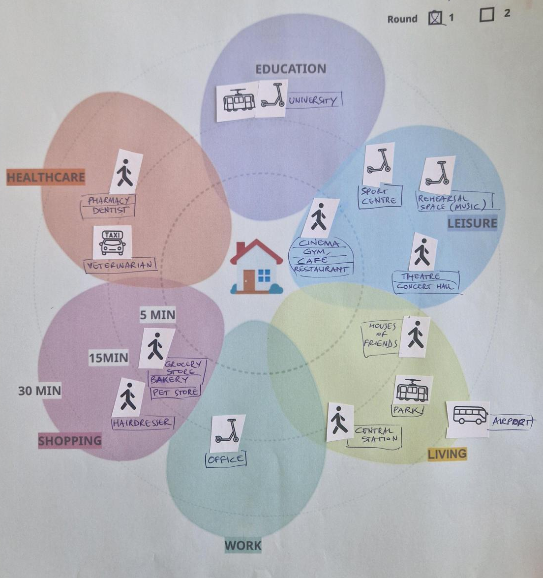
Layer 3: Current accessibility

Slide 23
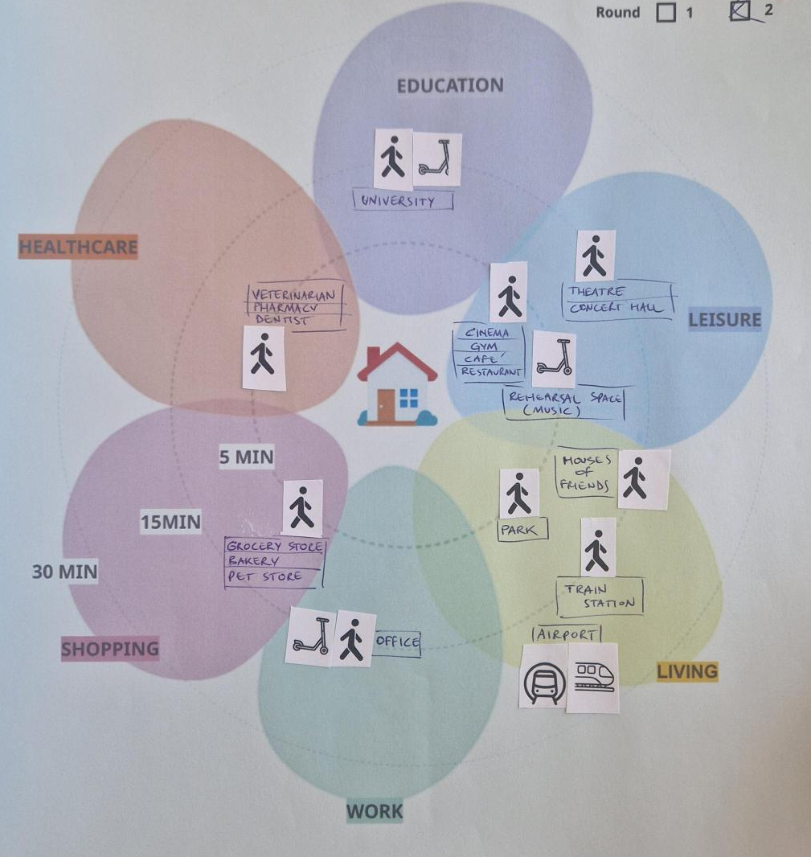
Layer 3: Desired accessibility

Slide 24
Layer 3: Desired accessibility – workshop results
No difference in current and desired accessibility of groceries, shopping or healthcare
Main difference between current and desired: access to social life (seeing friends, family) and green spaces (parks, nature)
Close but not too close:
  Distance to work: some participants want a closer workplace, but some value the distance as it gives time to transition from work to private life → Is work part of 15-minute living?
  Airport as amenity: 30 minutes but not too close

Slide 25
Dreaming on: Next steps
Further statistical analysis of survey results and development of personas based on cluster analysis
Layer 4: Feasible (constrained) accessibility: realistic constraints considering governmental policies, available physical infrastructure, costs, and new shared mobility services
Layer 5: What are the key societal impacts of different accessibility scenarios (air quality, health, carbon emissions, and placemaking).

Slide 26
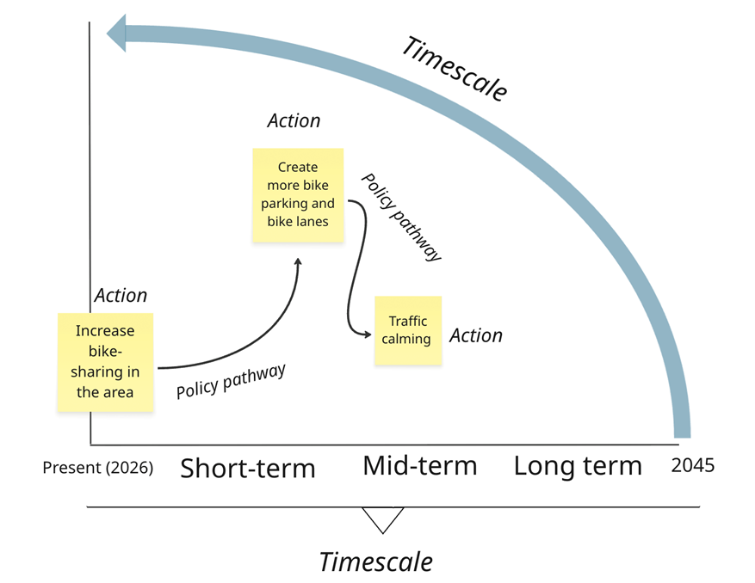
Policy pathways for better accessibility in urban outskirts – Participatory backcasting

Slide 27
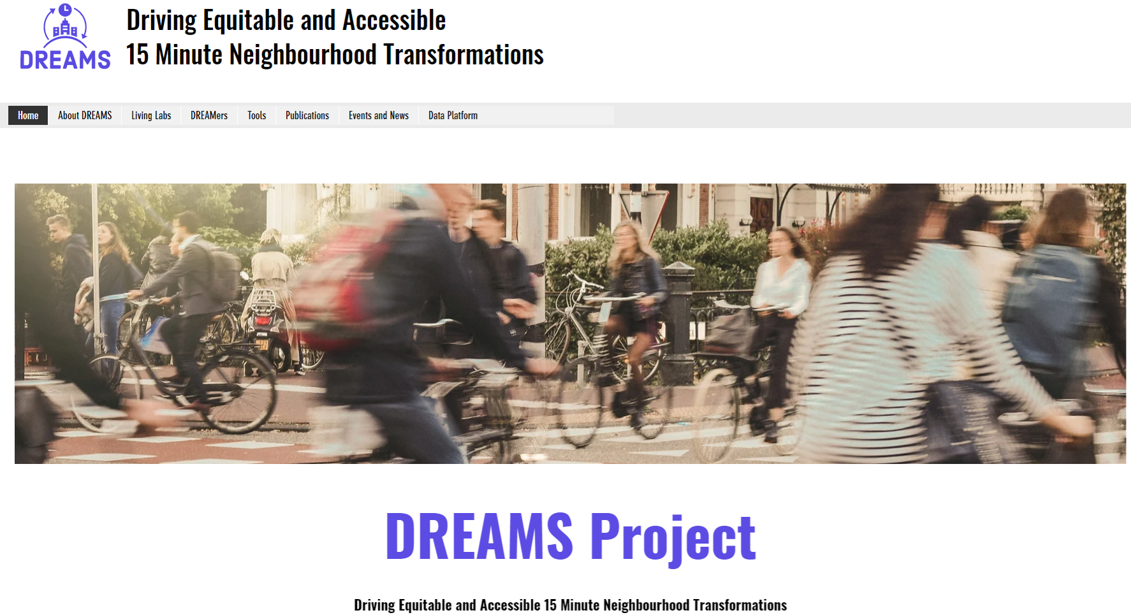
DREAMS Website and knowledge hub
E-mail: imre.keseru@vub.be
www.dreams15mc.eu

