Slide 1
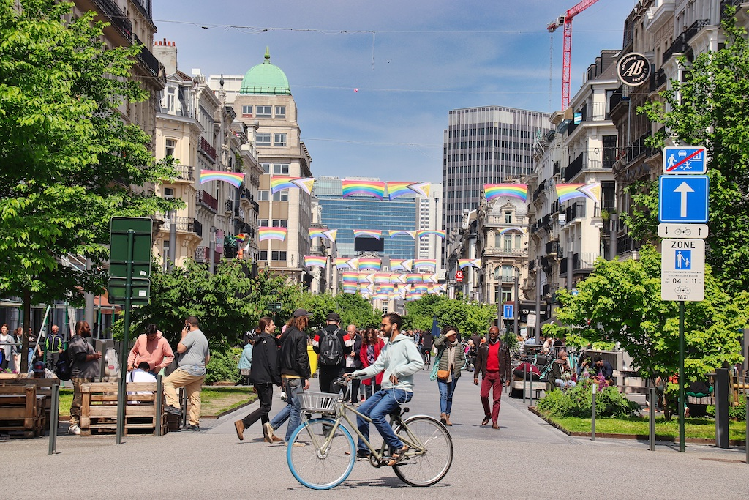
Brussels Site visit
From “urban highway” to pedestrian zone: The large-scale reconfiguration of Boulevard Anspach
Jean-Philippe De Visscher, Professor – Louvain Research Institute for Landscape, Architecture, Built Environment; Université Catholique de Louvain
Livia de Béthune, Architect and Urban designer - Faculty of Architecture at KU Leuven, MultipliCity architecture & urbanism
Meeting point: Fontainasplein, 1000 Brussel (Metro Anneessens) at 10:30
End point: De Brouckère at 13:00

Slide 2
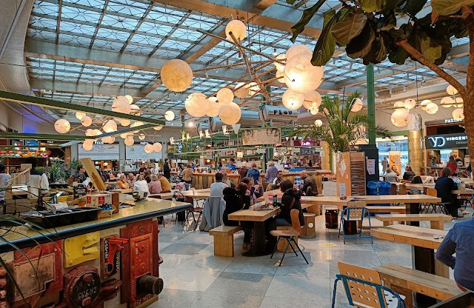
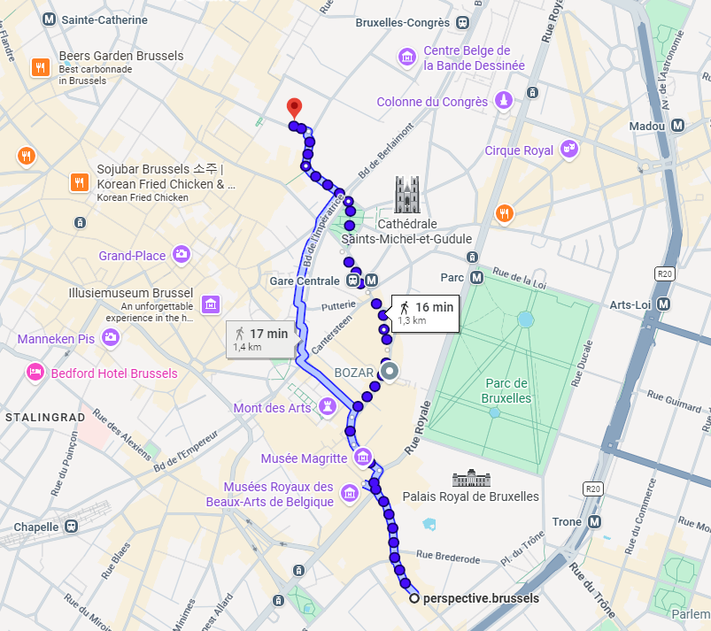
Informal dinner – 19:30
Wolf Sharing Food Market - Rue du Fossé aux Loups 50, 1000 Bruxelles
Please kindly note that dinner will be at participants’ own expense.

Slide 3


Final Event – Perspective Brussels
Thank you!
27/05/2026

