Slide 1
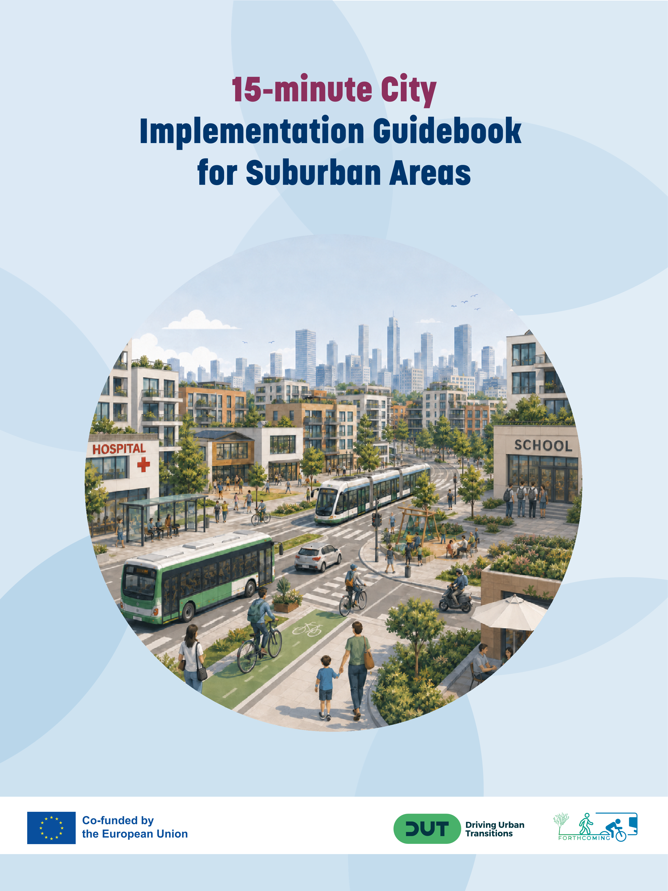

15-minute City Implementation Guidebook for Suburban Areas
Anna Ibraeva - UPM

Slide 2
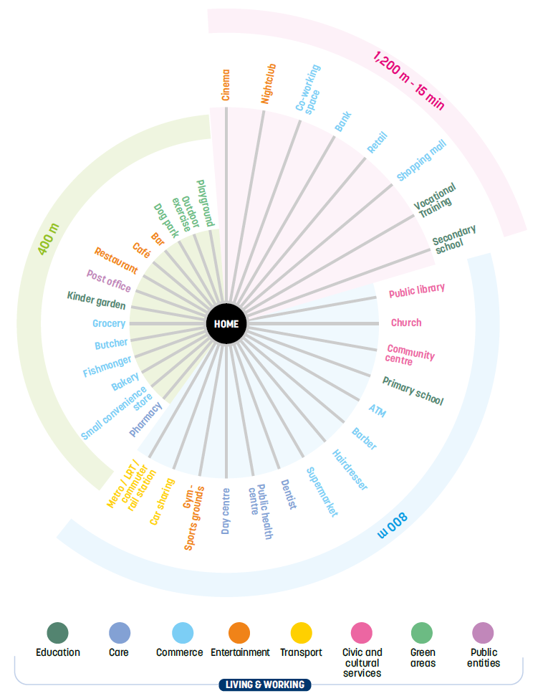
Objectives
Summarize main achievements of FORTHCOMING
Disseminate FORTHCOMING findings and results for the benefit of other cities
Provide guidelines on 15minC implementation in suburbs
Focus on practitioners and general public

Slide 3
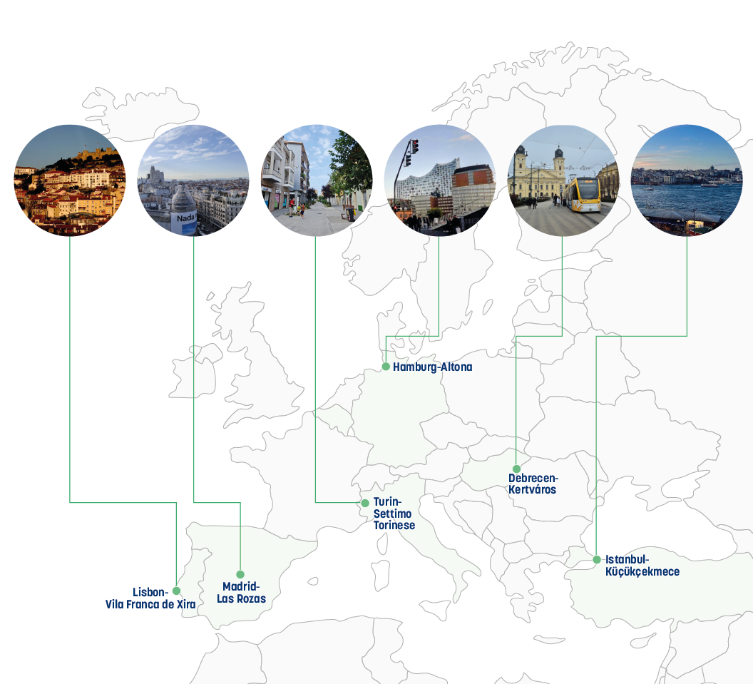
Data
6 ULLs in different countries
Proximity analysis: isochrone mapping and coverage computation for all ULLs
Comprehensive approach: location, institutional and financial factors
43 different 15minC strategies for from diverse contexts
15 Focus Groups with 139 stakeholders
Survey campaign collecting opinions of 984 suburban residents
14 interviews with stakeholders outside of the project

Slide 4

Contents
Foreword
Andrés Monzón, Anna Ibraeva
Chapter 1 - Understanding the 15-Minute City
Justine Gangneux, Lucian Zagan
Chapter 2 - Forthcoming Cities and Urban Living Labs (ULLs)
Tasneem Miqdady, Anna Ibraeva, Domokos Esztergár-Kiss, Justine Gangneux
Chapter 3 - Replicating and upscaling 15-minute city practices
Hilal Cepni, Lucian Zagan, João de Abreu e Silva
Chapter 4 - Multidimensional Impact Assessment
Cristina Pronello, Alessandra Boggio-Marzet
Chapter 5 - Key findings for the successful implementation of 15mC strategies in peri-urban areas​
Andrés Monzón, Hande Demirel

Slide 5
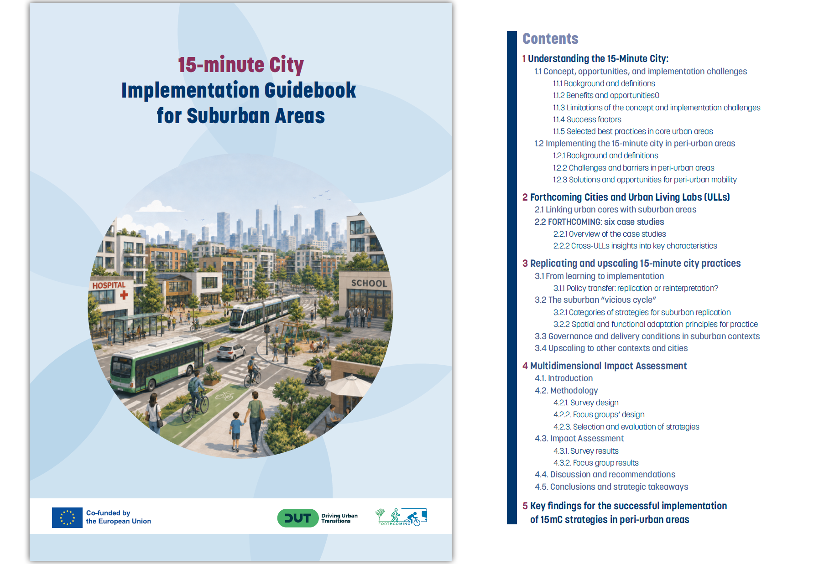
Contents

Slide 6
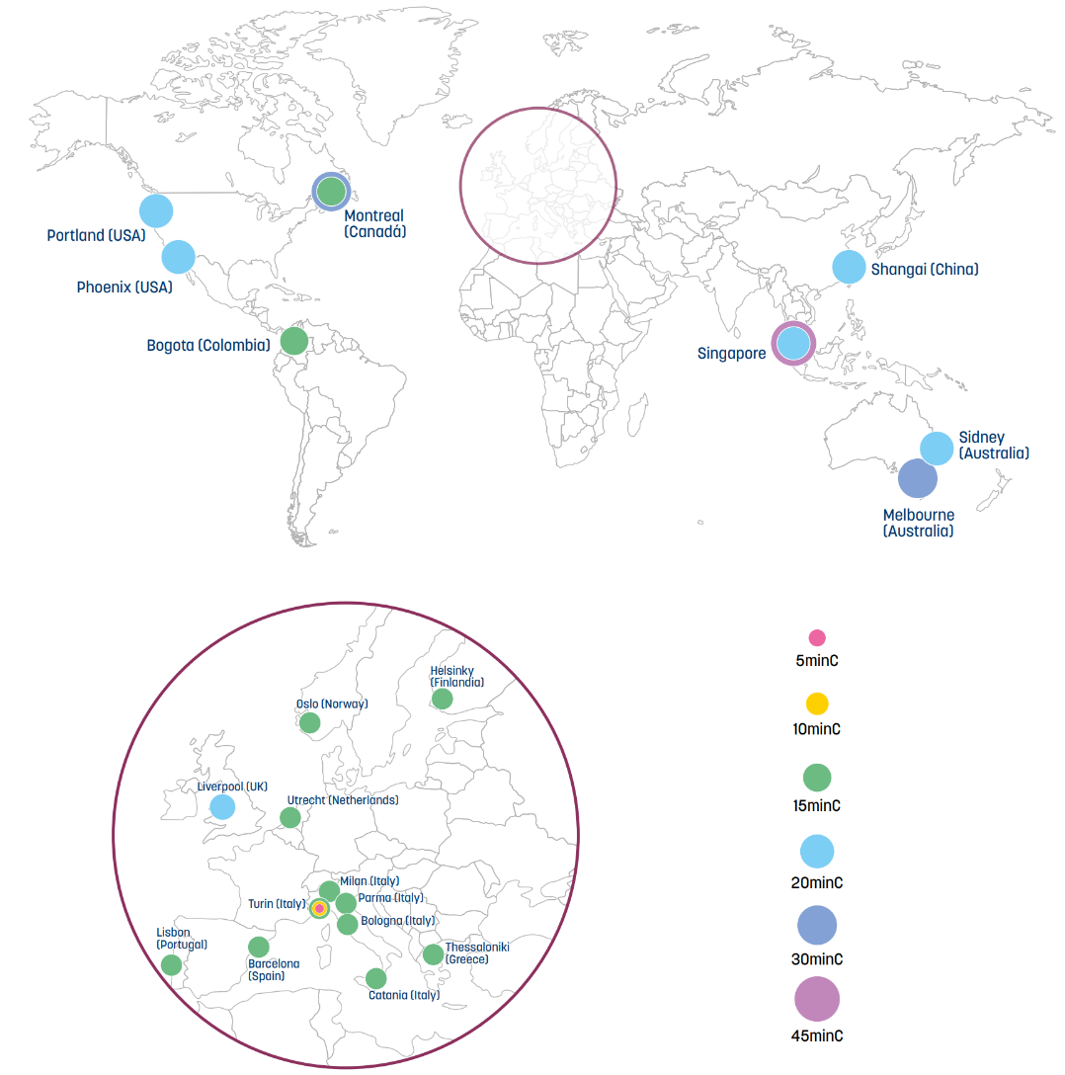
Chapter 1 - Understanding the 15-Minute City
Concept, opportunities, and implementation challenges
Background and definitions
Benefits and opportunities
Conceptual and methodological limitations
Key implementation challenges
Success factors
Selected best practices in core urban areas
Implementing the 15-minute city in peri-urban areas
Challenges and barriers in peri-urban areas
Solutions and opportunities for peri-urban mobility

Slide 7
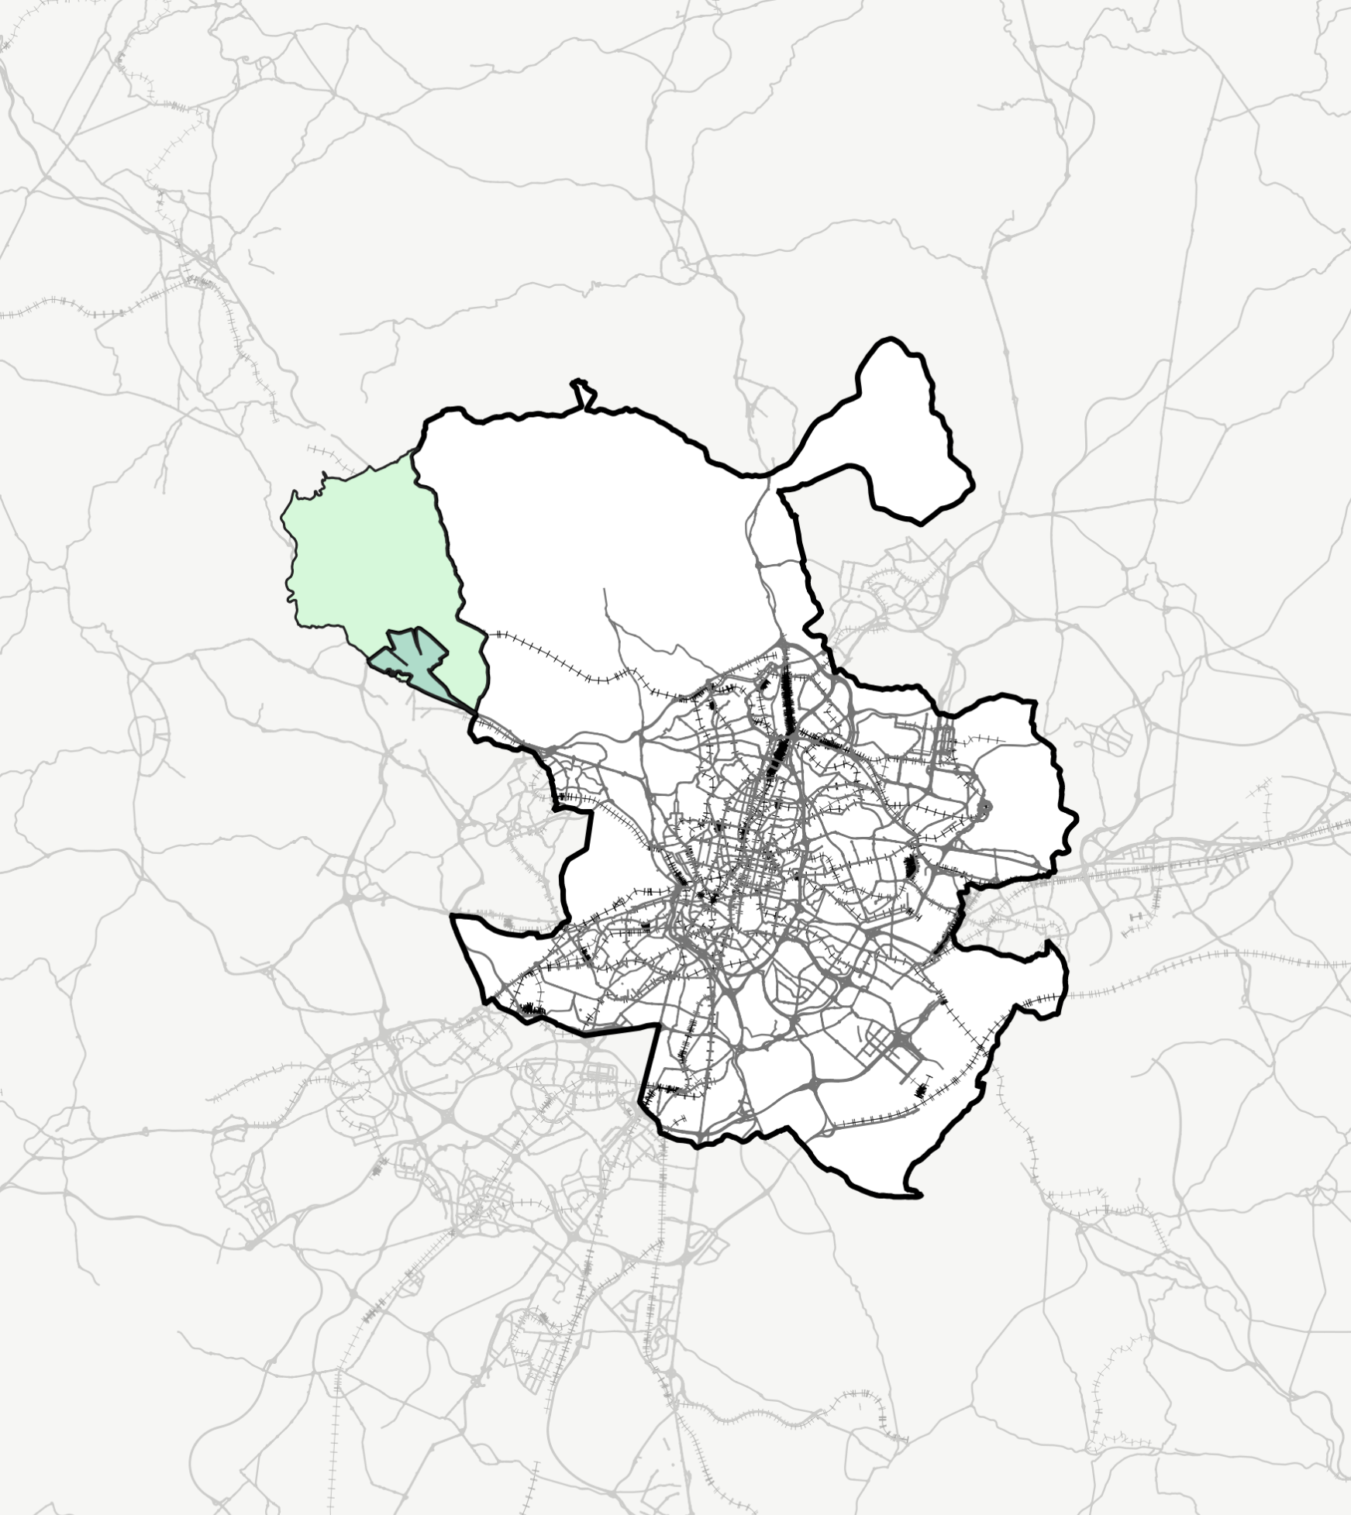
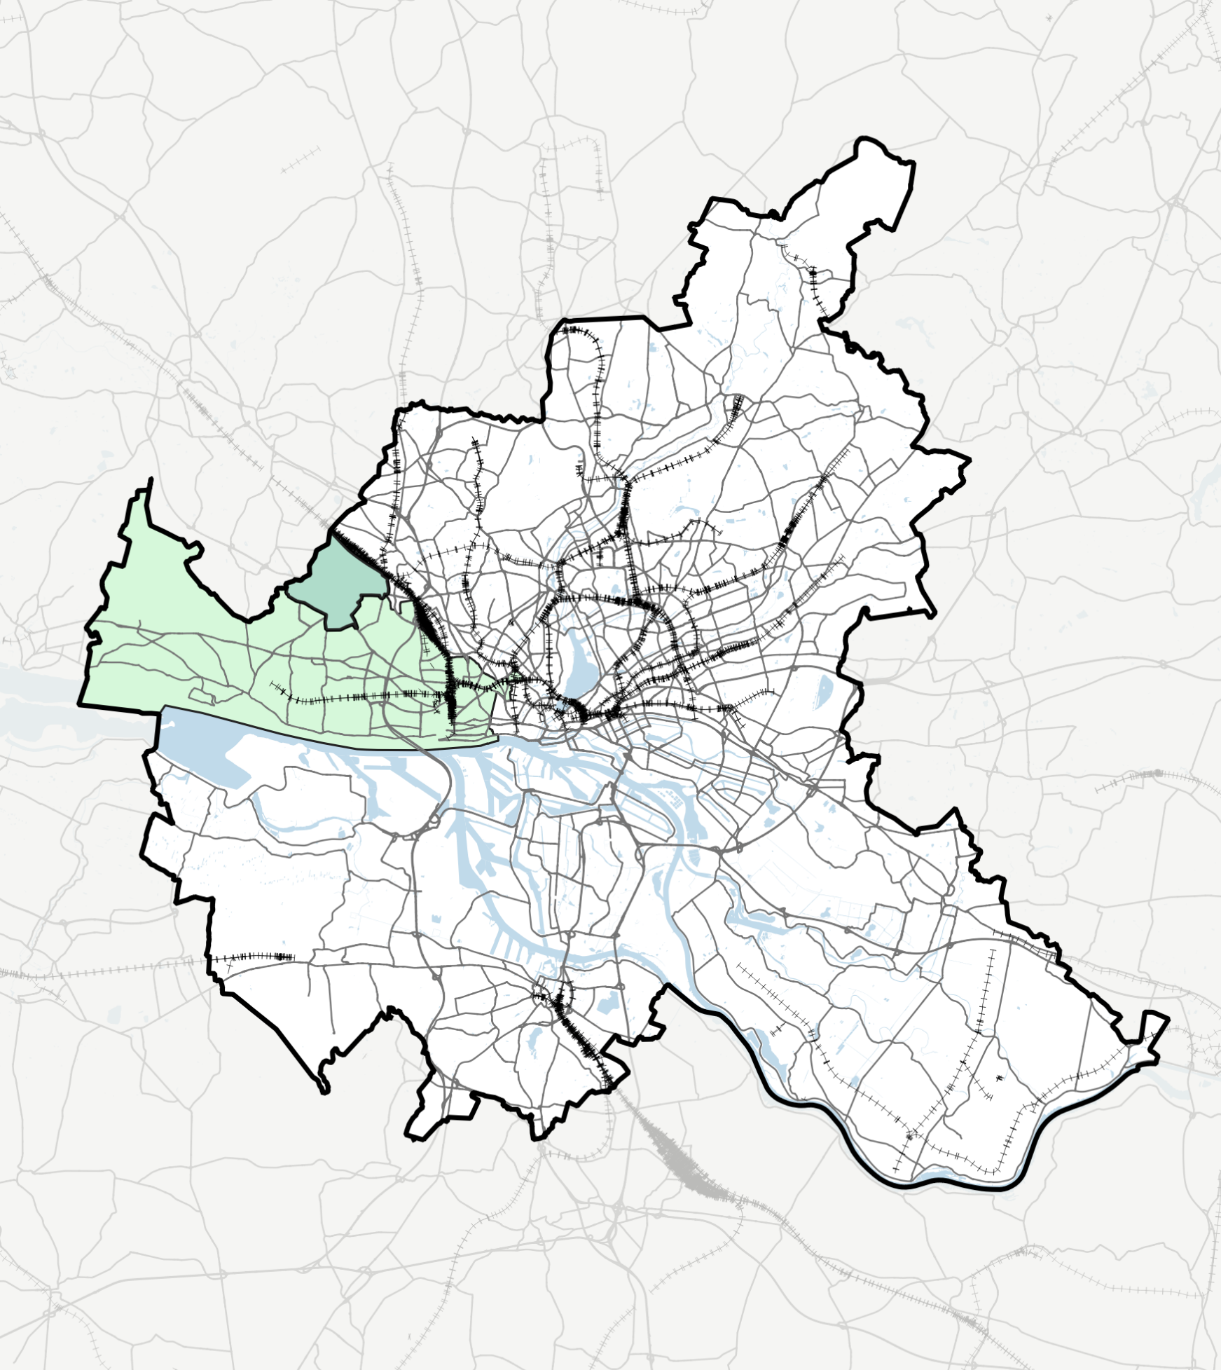
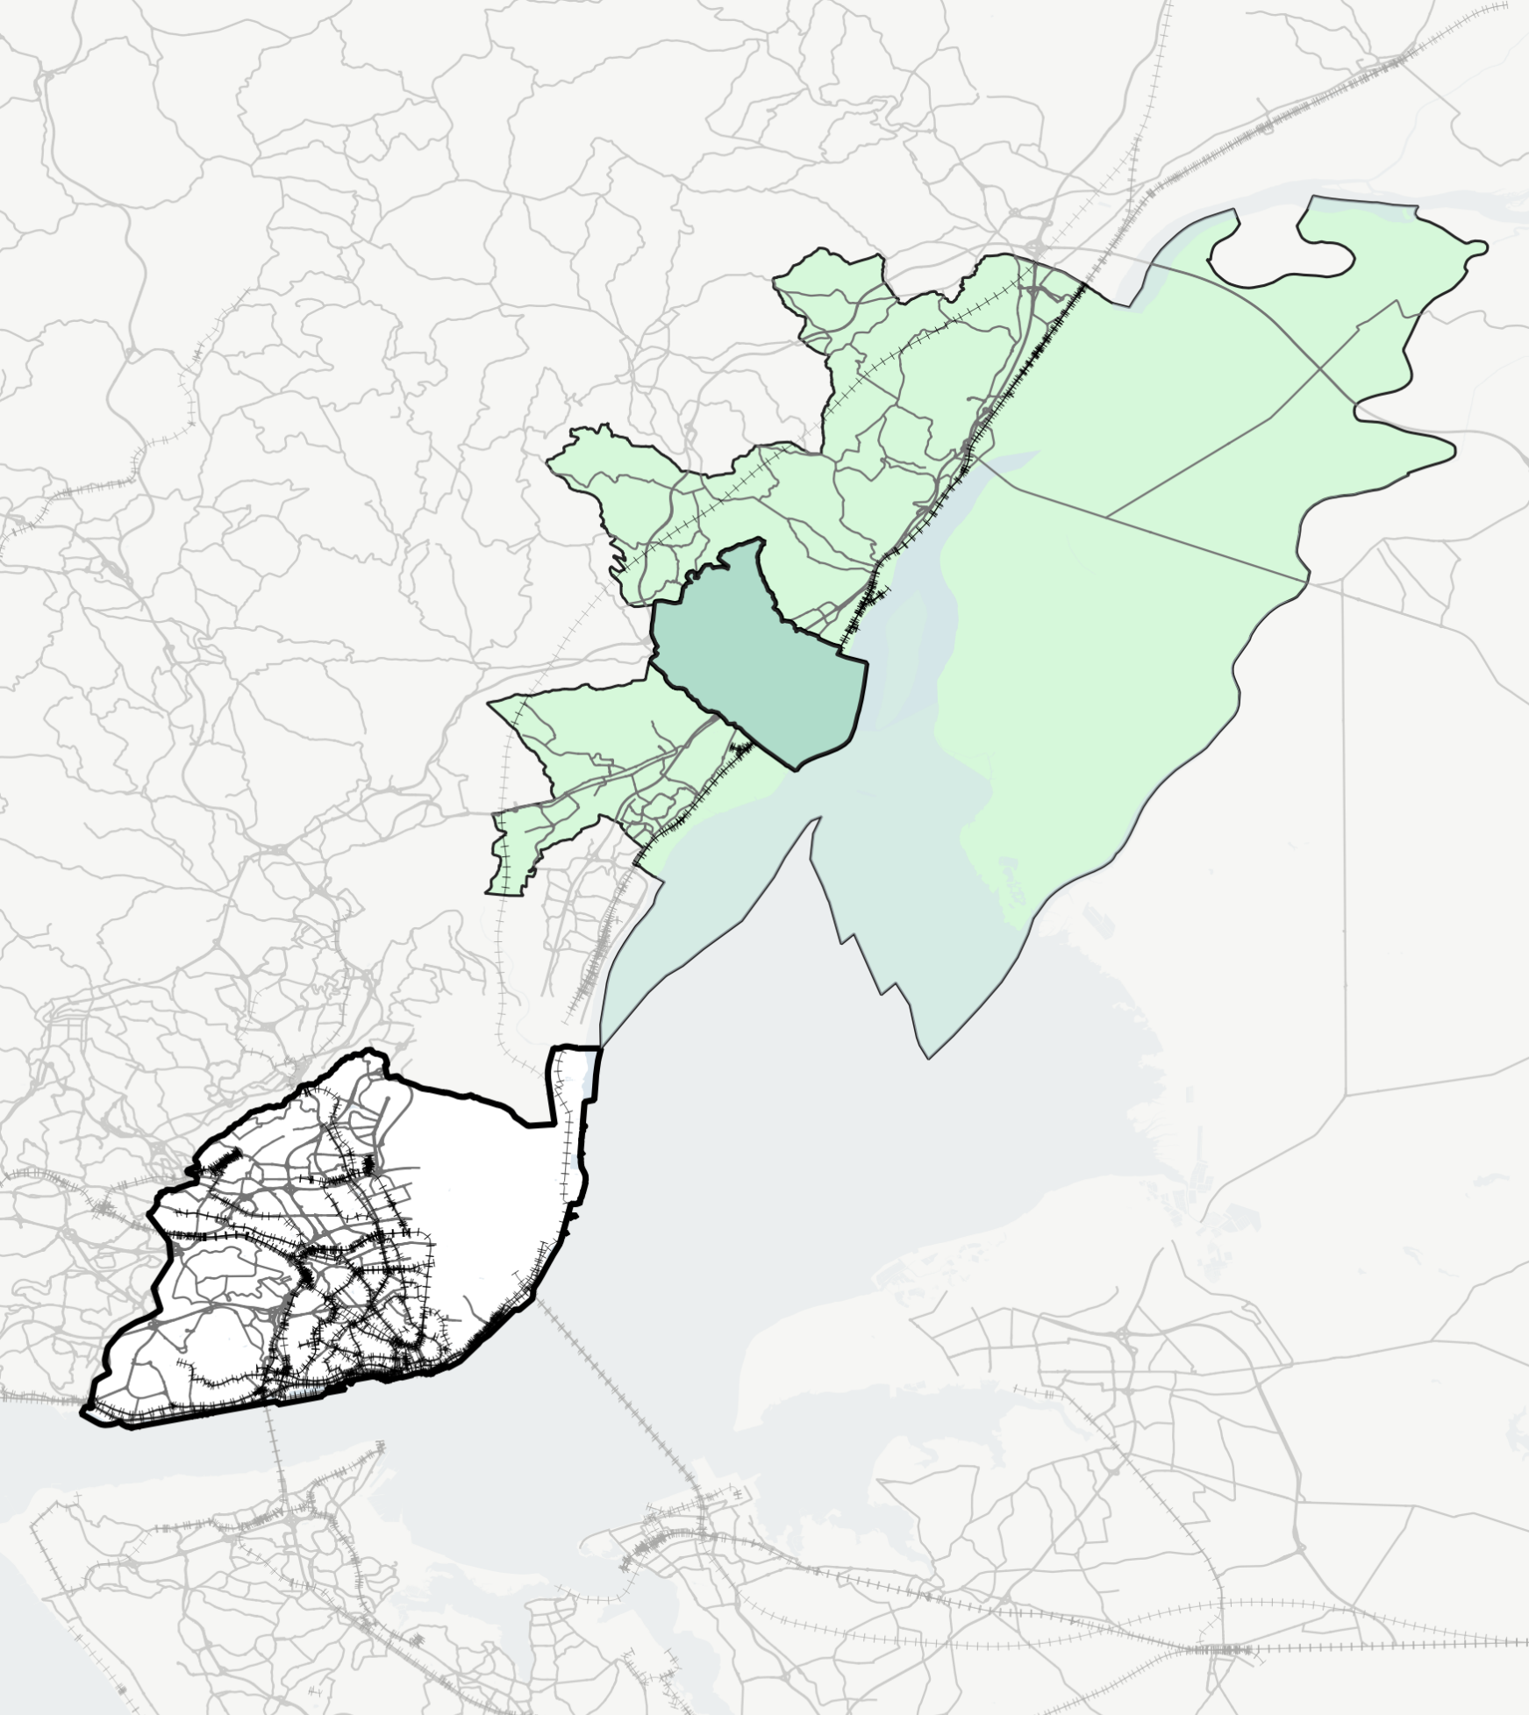
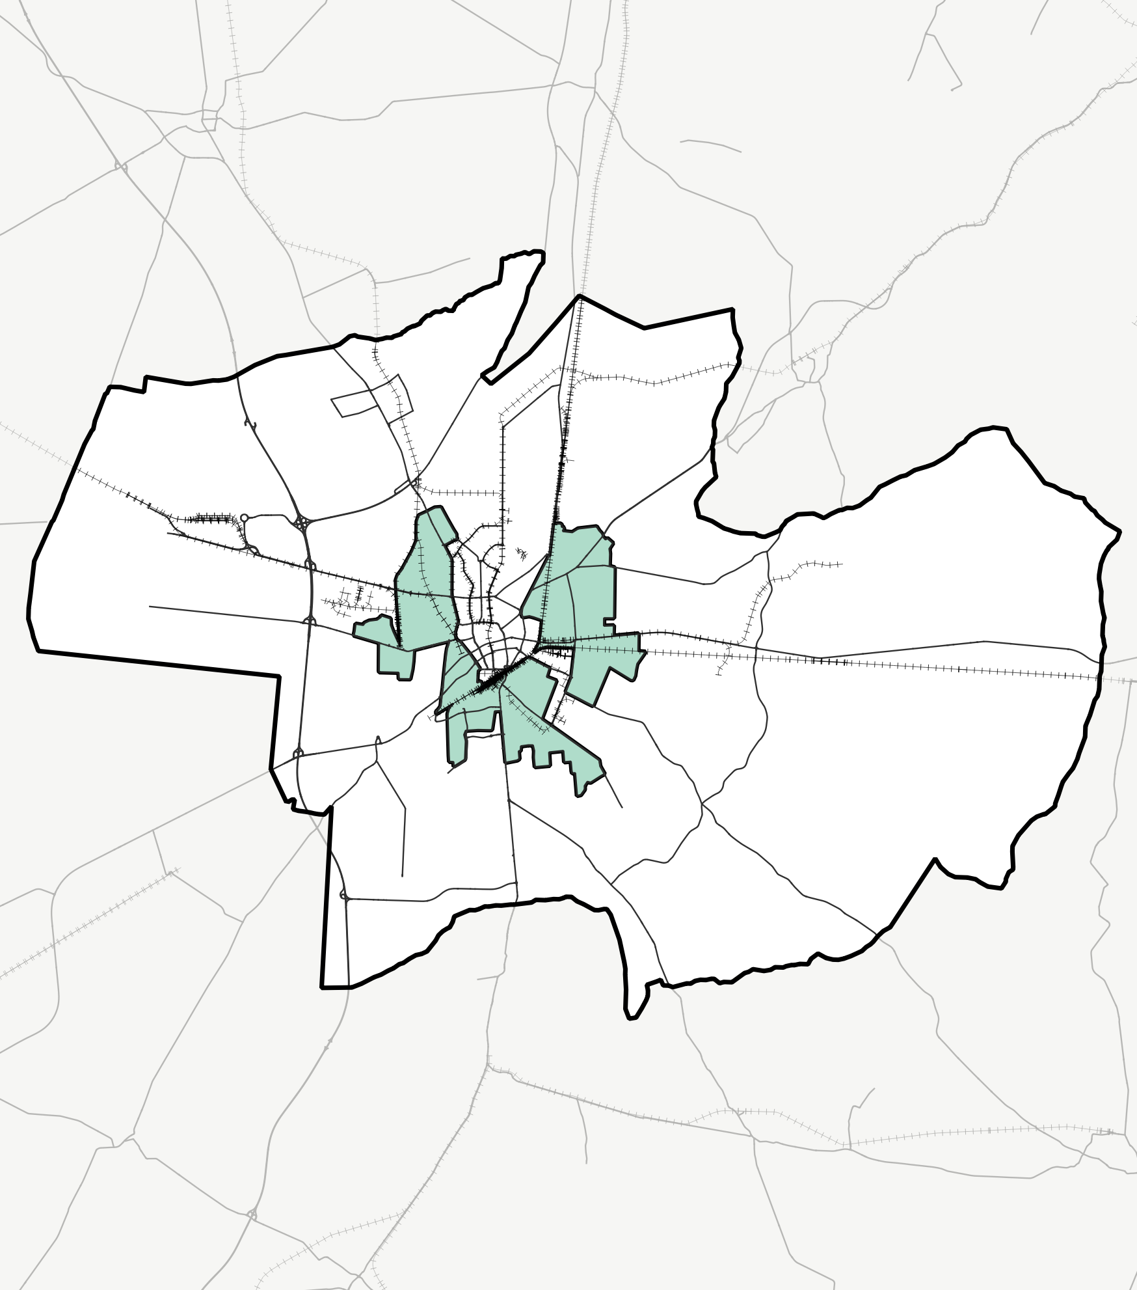
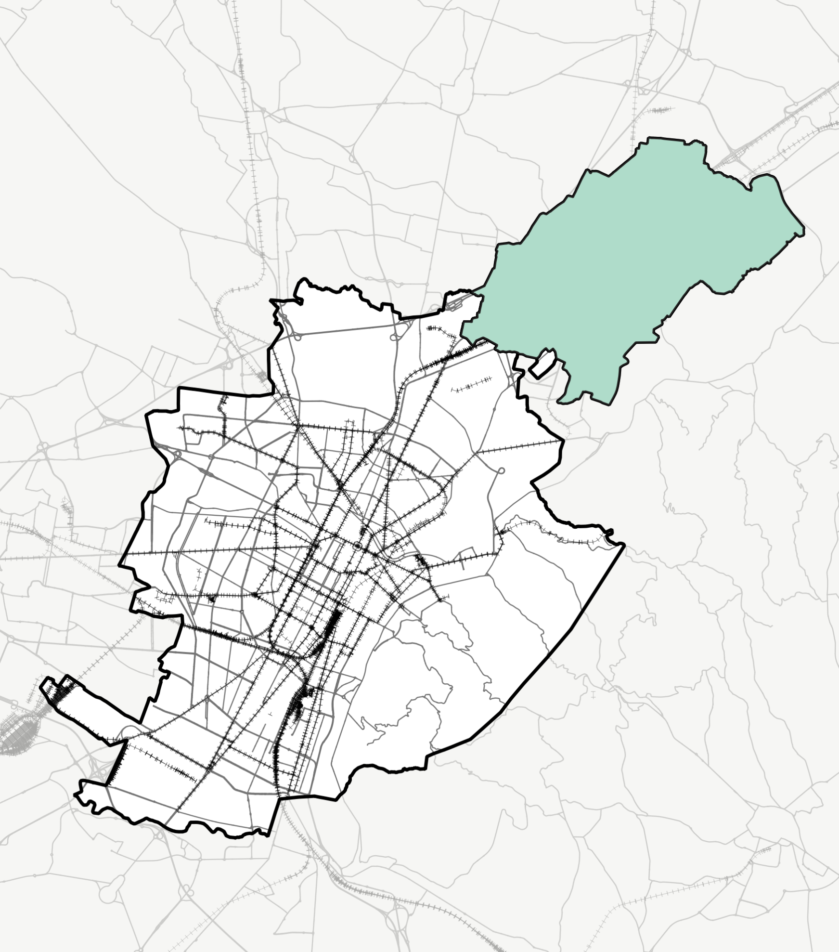
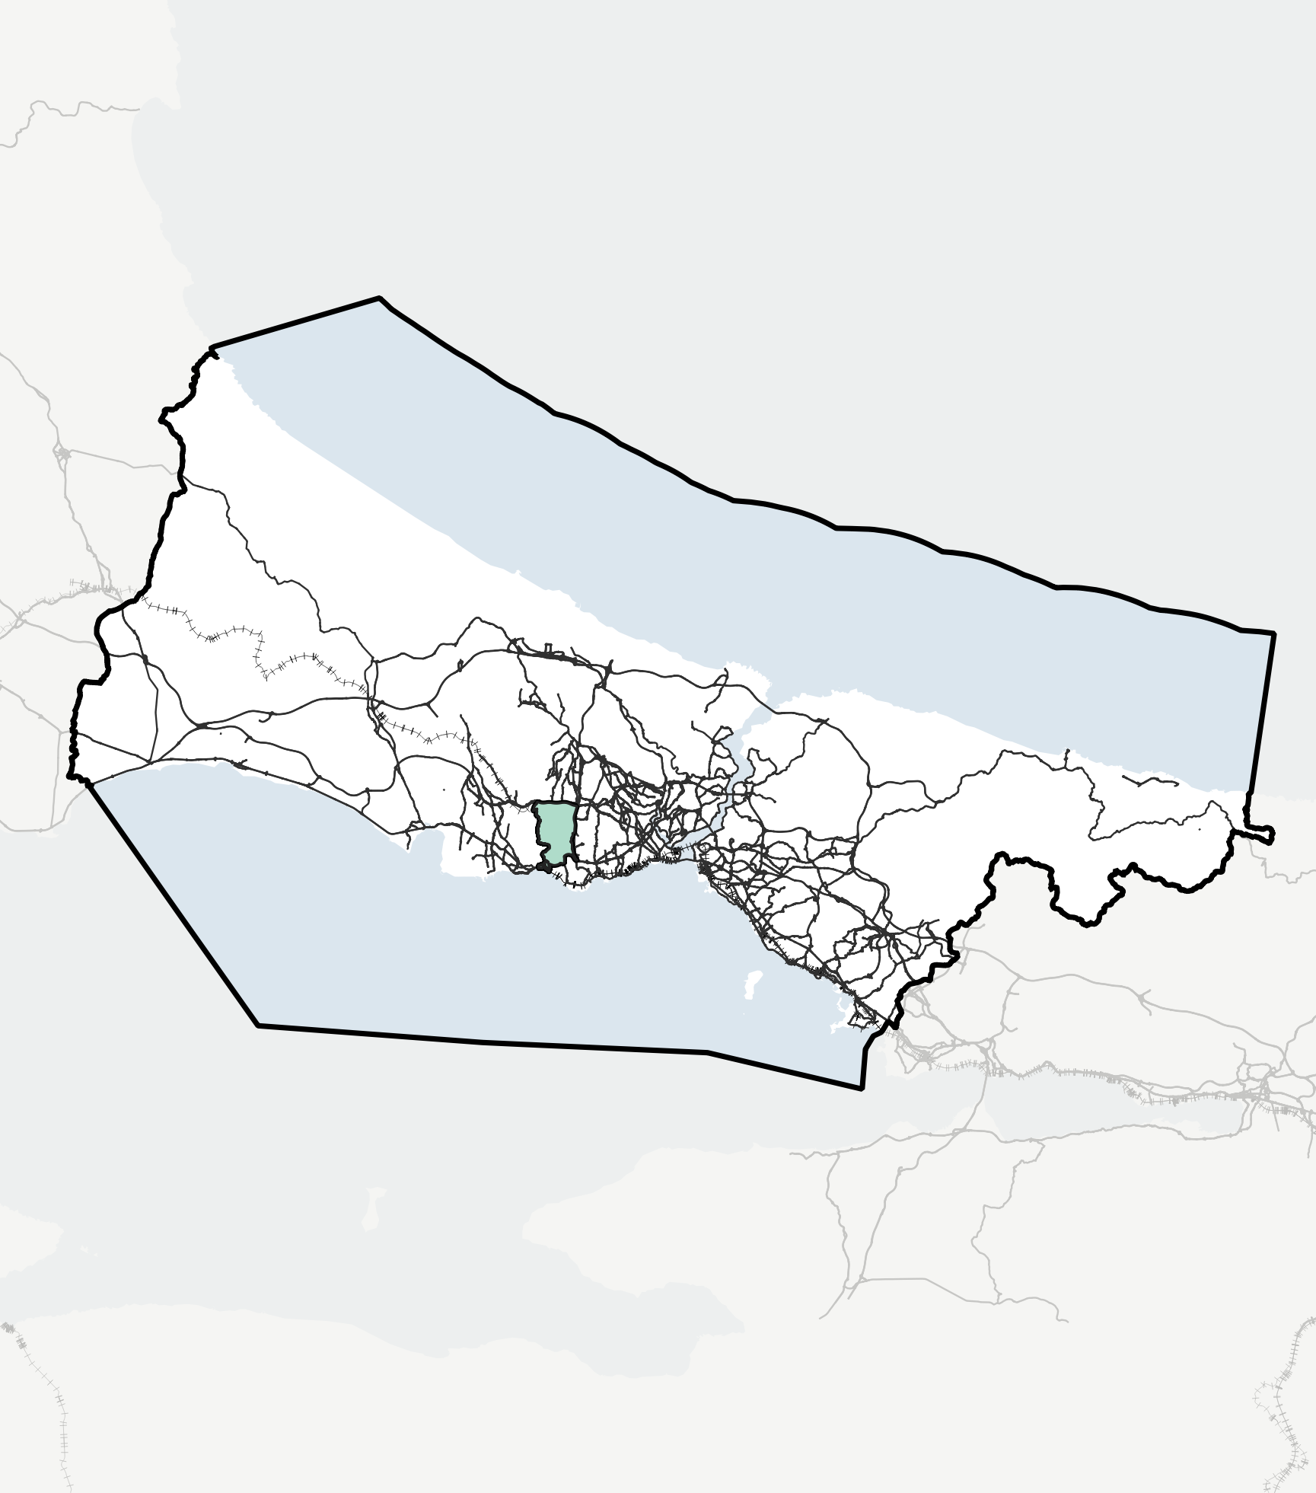
Chapter 2 - Forthcoming Cities and Urban Living Labs (ULLs)
Linking urban cores with suburban
areas: Forthcoming city-suburbs
approach
FORTHCOMING: six case studies
Overview of the case studies
Cross-ULLs insights into key characteristics

Slide 8
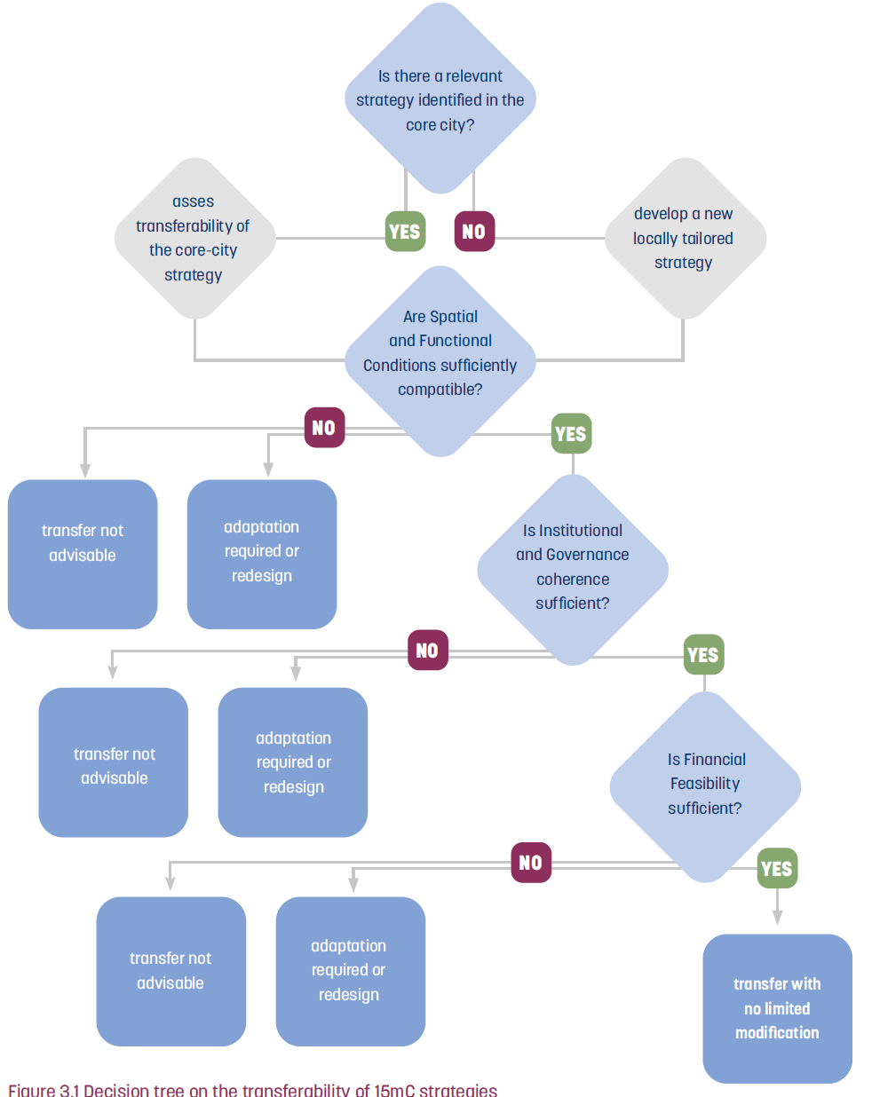
Chapter 3 - Replicating and upscaling 15-minute city practices
Transferring 15mC strategies requires more than identifying best practices. It requires understanding the conditions under which those practices emerged and assessing whether similar conditions exist, or can be created, elsewhere.
From learning to implementation
Policy transfer: replication or reinterpretation?
A structured transferability assessment method
The suburban “vicious cycle”: challenges
and barriers in peri-urban contexts
Categories of strategies for suburban replication and adaptation
Spatial and functional adaptation
principles for practice
Governance and delivery conditions in
suburban contexts
Upscaling to other contexts and cities

Slide 9
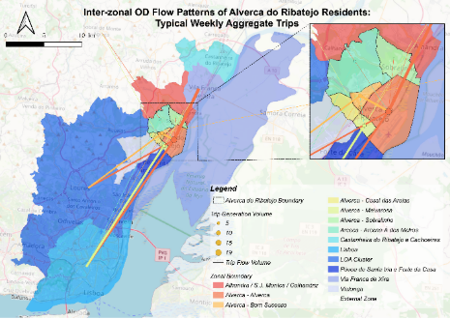
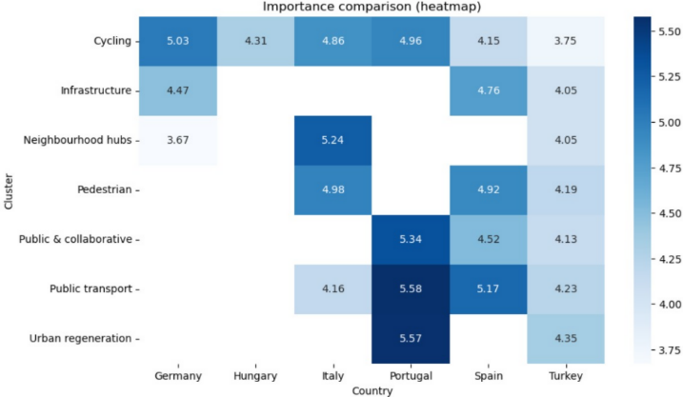
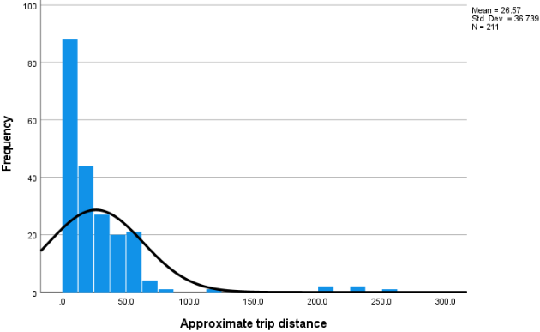
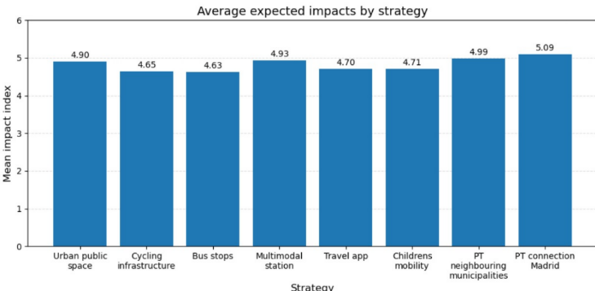
Chapter 4 - Multidimensional Impact Assessment
Survey results
The individual ULL evaluation
The analysis of the respondents’ profiles and their segmentation
The cross-comparison ULLs evaluation
of strategies
Focus group results
Individual ULL analysis
Comparative analysis
Common patterns across cases
Main differences across local contexts
Recurrent barriers and expected impacts
Differences between citizens and stakeholders
Discussion and recommendations
Conclusions and strategic takeaways

Slide 10
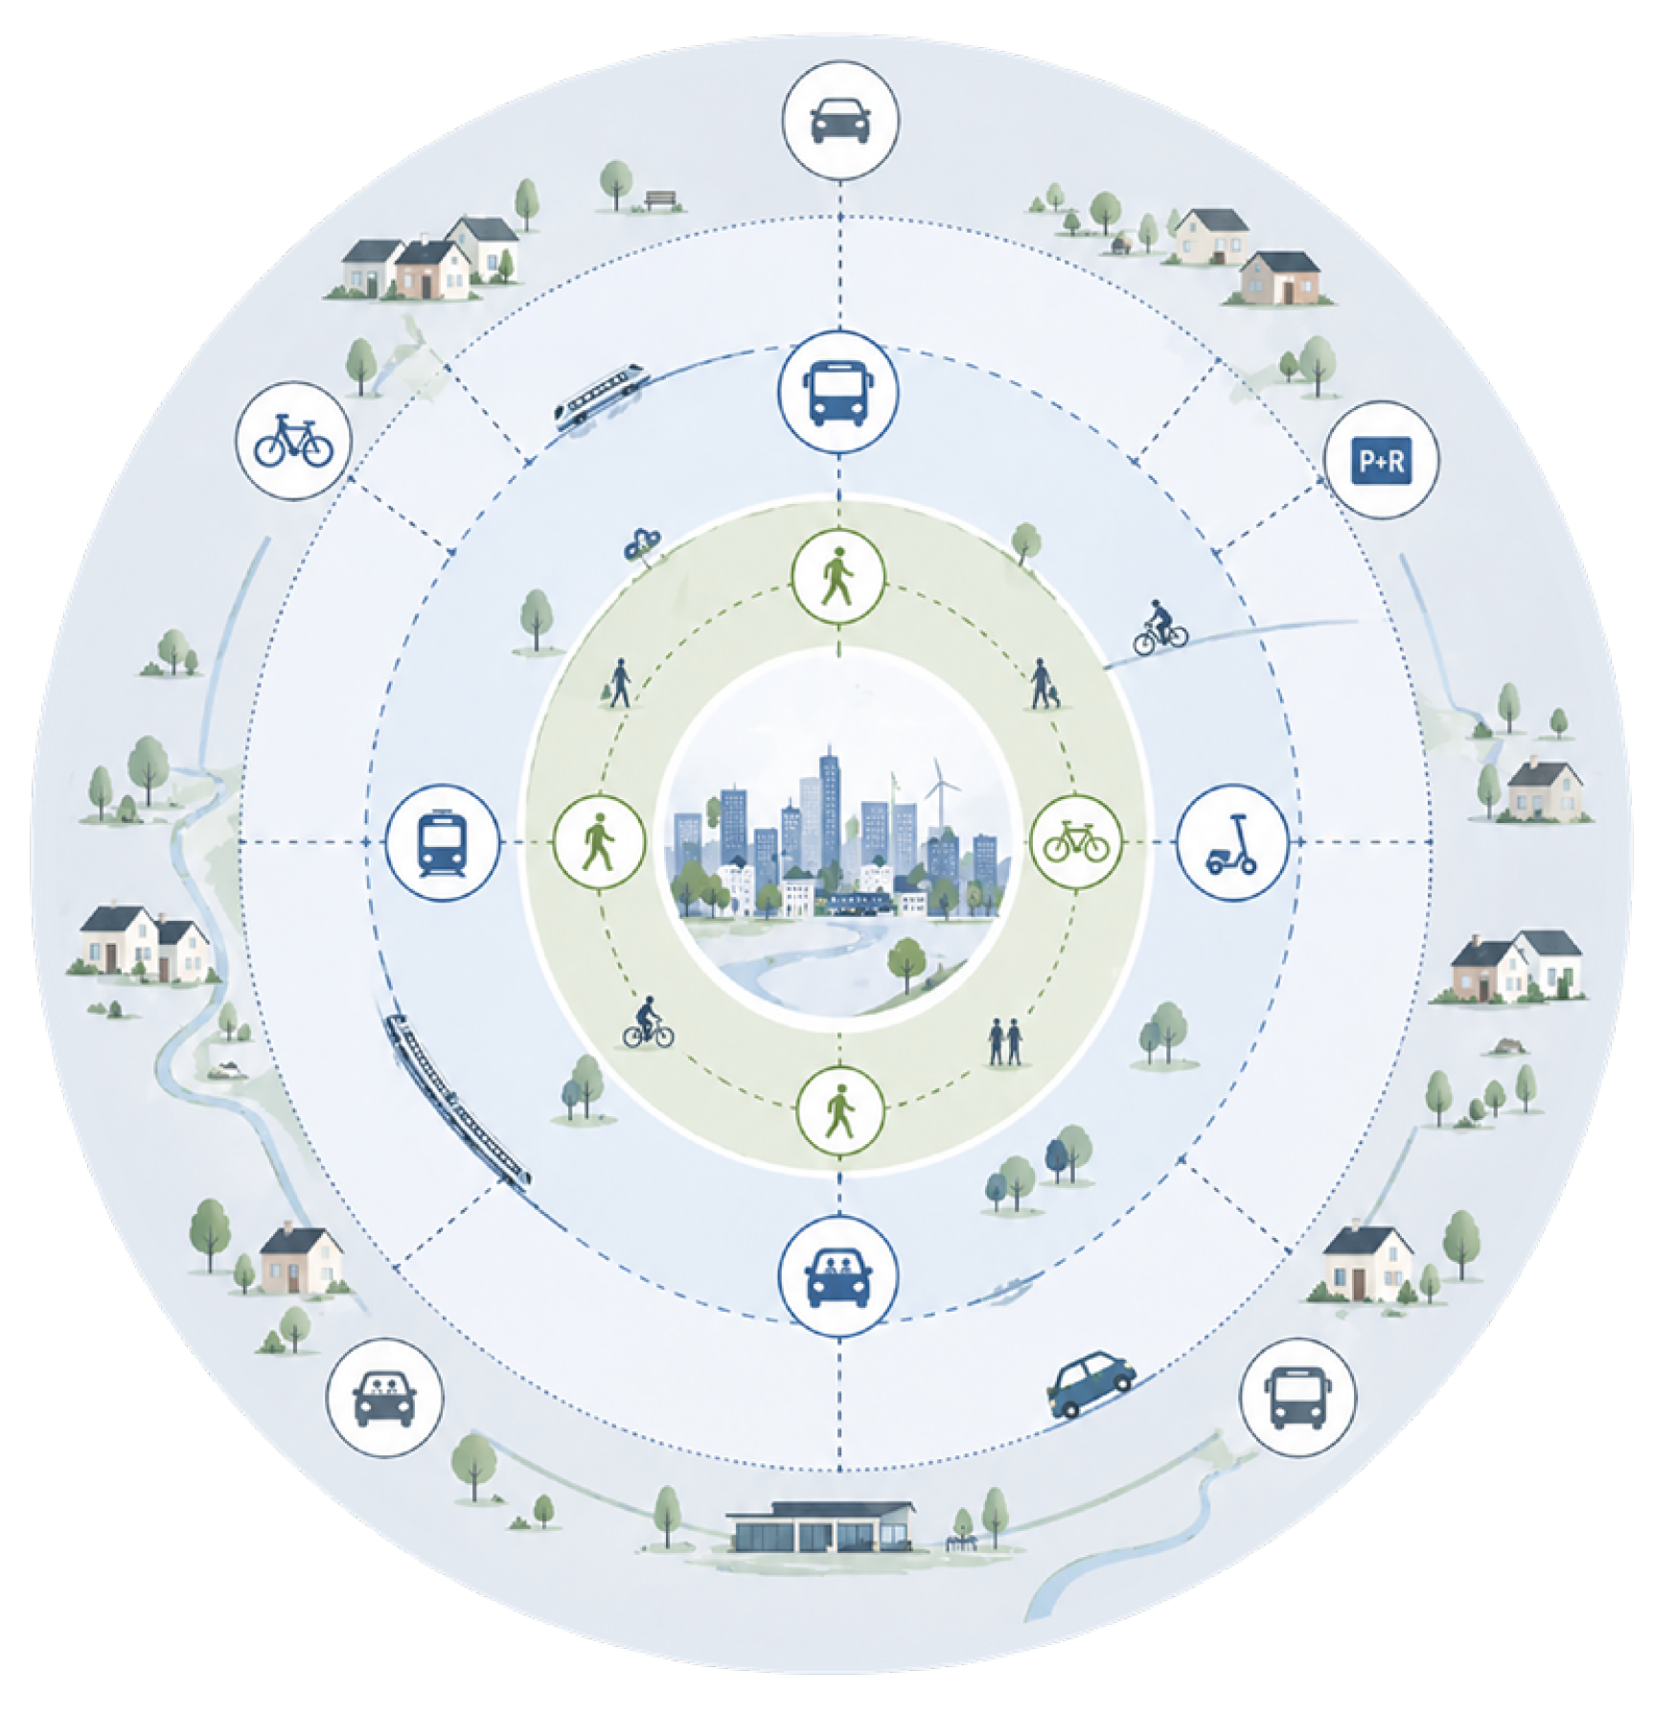
Chapter 5 - Key findings for the successful implementation of 15mC strategies in peri-urban areas​
Comprehensive summary of main FORTHCOMING findings
Reflections on the applicability and adaptability of the 15minC in suburban settings
Future research directions

Slide 11

15-minute City Implementation Guidebook for Suburban Areas
will be made available in the end of July 2026
Follow us for more updates!
www.forthcoming.info www.linkedin.com/company/forthcomingproject/
THANK YOU!

