Slide 1



Project Overview
FORTHCOMING
Andrés Monzón
Brussels, 27/05/2026

Slide 2
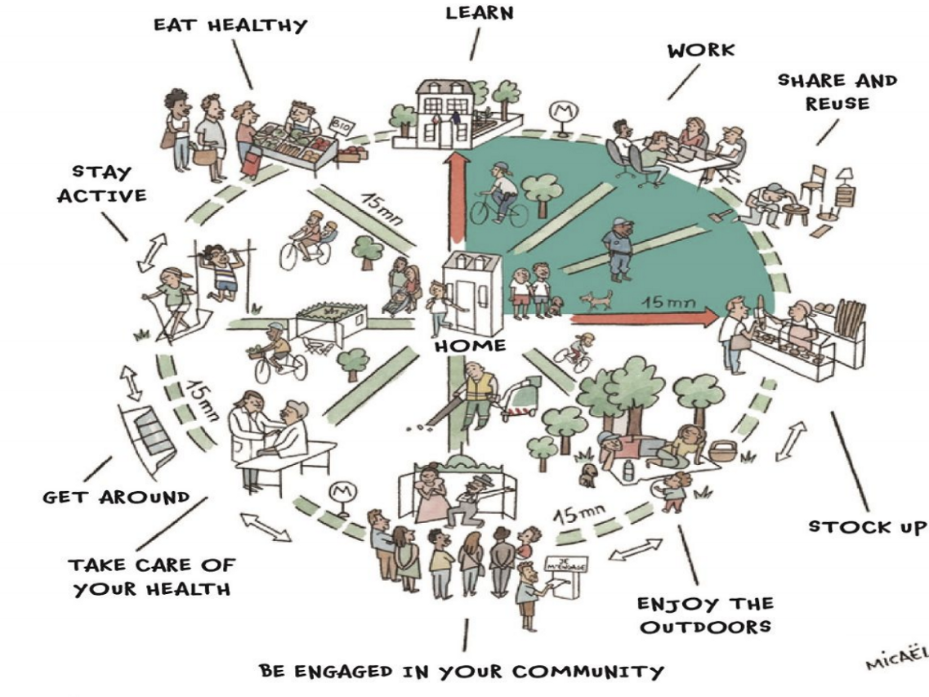
The 15-minute city
What is it?
An urban set-up in which residents can access all their basic daily needs without using a private vehicle, on foot or by bicycle within 15 minutes. (Moreno et al., 2021)
What for?
To foster active and sustainable travel and reduce car-use.
To achieve more liveable and healthier cities, by decreasing pollution and increasing physical activity

Slide 3
The 15-minute city framework
How?
Based on four pillars
Density
Diversity
Proximity
Digitalisation
Common in central urban areas…
…but often not present in suburban areas.
Density
15
minute city
Proximity
Diversity
Digitalisation
15-minute city framework. Adapted from Moreno et al., (2021)

Slide 4

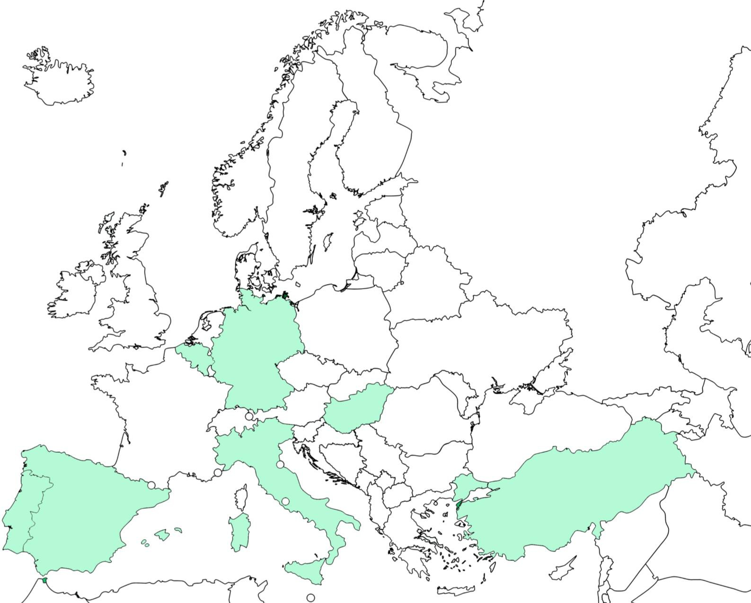







FORTHCOMING project
Project partner
FOsteRing THe City Of proximity through Maas INteGration
19 International partners and 6 case studies
Start date: December 2023
Main Objective
Case study– core city
Case study – Urban Living Lab
EU Cities Mission
Adapt the 15 minute city to suburban areas, boosting the transition to liveable, inclusive and climate neutral cities
HAMBURG
Altona District
Kertváros
Settimo
Torinese
DEBRECEN
Define key strategies and include them en ‘15minCity Implementation Guidebook for Suburban Areas’, serving as guidelines for local authorities and practitioners
TURIN
Küçükçekmece
Alverca
do Ribatejo
Las Rozas
ISTANBUL
LISBON
MADRID
Notes:
-resumir: INSTITUCIONAL, OTRAS CIUDADES, GUIDEBOOK

Slide 5
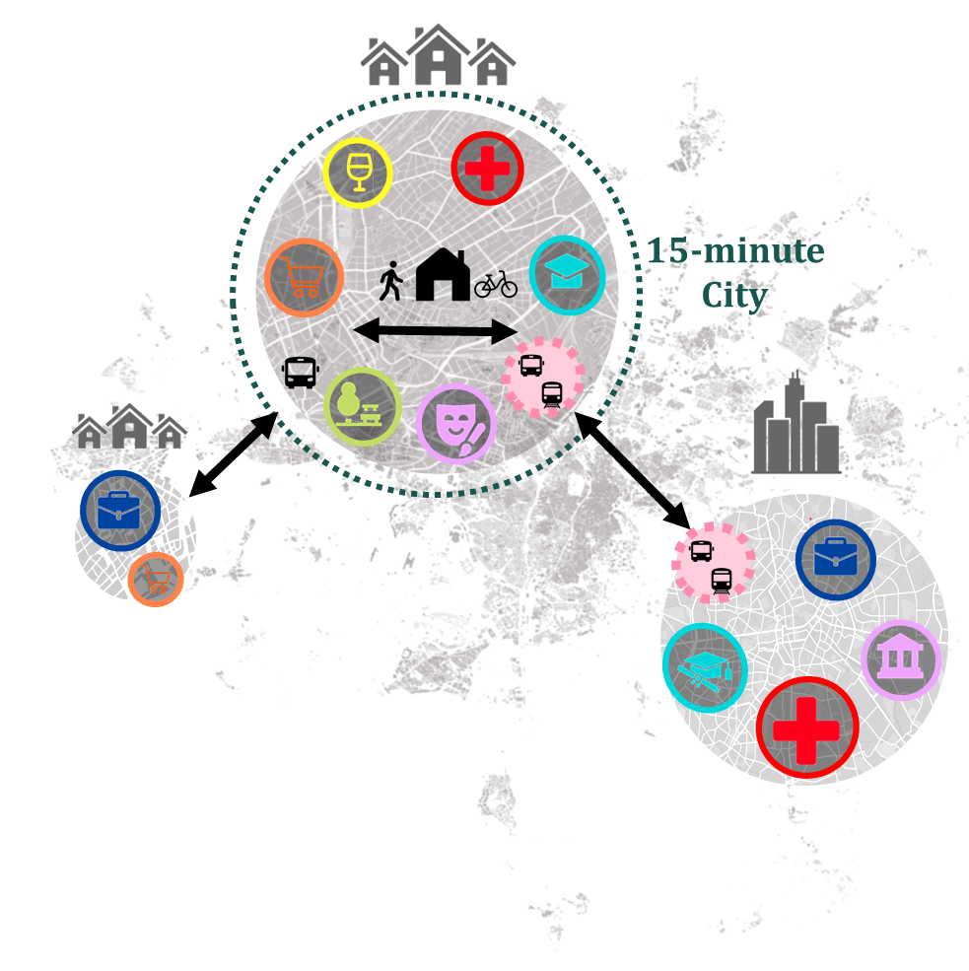
Scaling the 15mc beyond the core
Goal
Reduce the use of private cars and promote a modal shift by:
  Encouraging sustainable and local travel within the municipality
  Achieving more trips by public transport to the central city

Slide 6
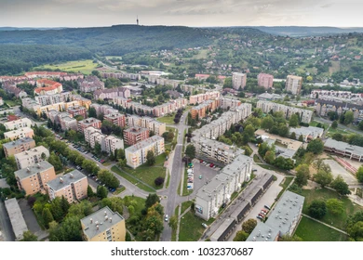
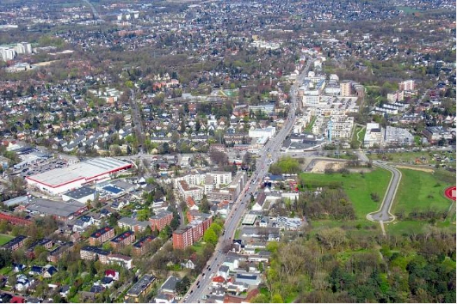
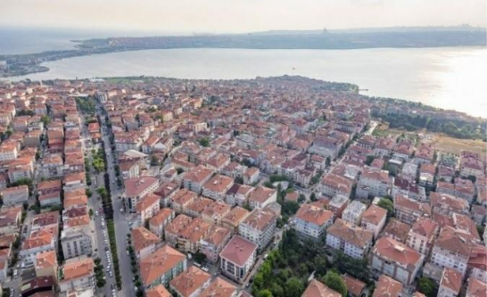
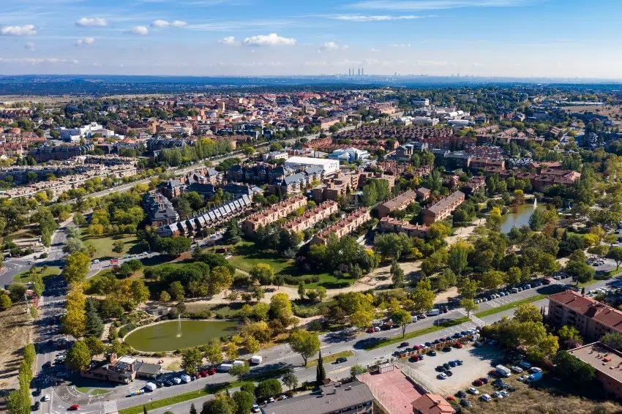
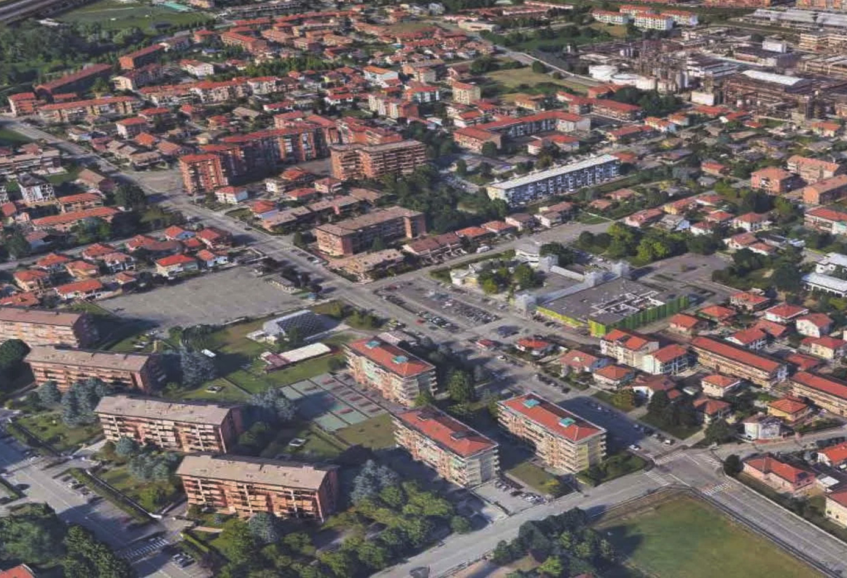
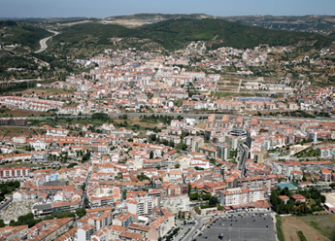
Case studies: Core city + Suburban ULL
Debrecen
Kertváros
Hamburg
Lurup Altona
Istanbul Küçükçekmece
Lisboa
Alverca do Ribatejo
Madrid
Las Rozas
Turin
Settimo Torinese

Slide 7
Case studies: Suburban Urban Living Labs
 |  | Population inhabitants | Density inh/km2 | Built-up area (%) | Motorisation rate (cars/1000 inh) | Share of car traffic (%) | Share of Public Transport (%)
Hungary | Debrezen- Kertváros | 70.000 | 2.539 | 9 | 356 | 36 | 36
Germany | Hamburgo- Lurup | 37.451 | 5.952 | 88 | 322 | 31 | 19
Turkey | Istambul- Küçükçekmece | 792.030 | 17.977 | 93 | 209 | 20 | 31
Portugal | Lisbon- Alverça do Ribatejo | 32.273 | 1.668 | 42 | 609 | 65 | 13
Spain | Madrid- Las Rozas | 98.590 | 1.639 | 25 | 537 | 70 | 16
Italy | Turin- Settimo Torinese | 45.693 | 1.464 | 33 | 650 | 80 | 7

Slide 8
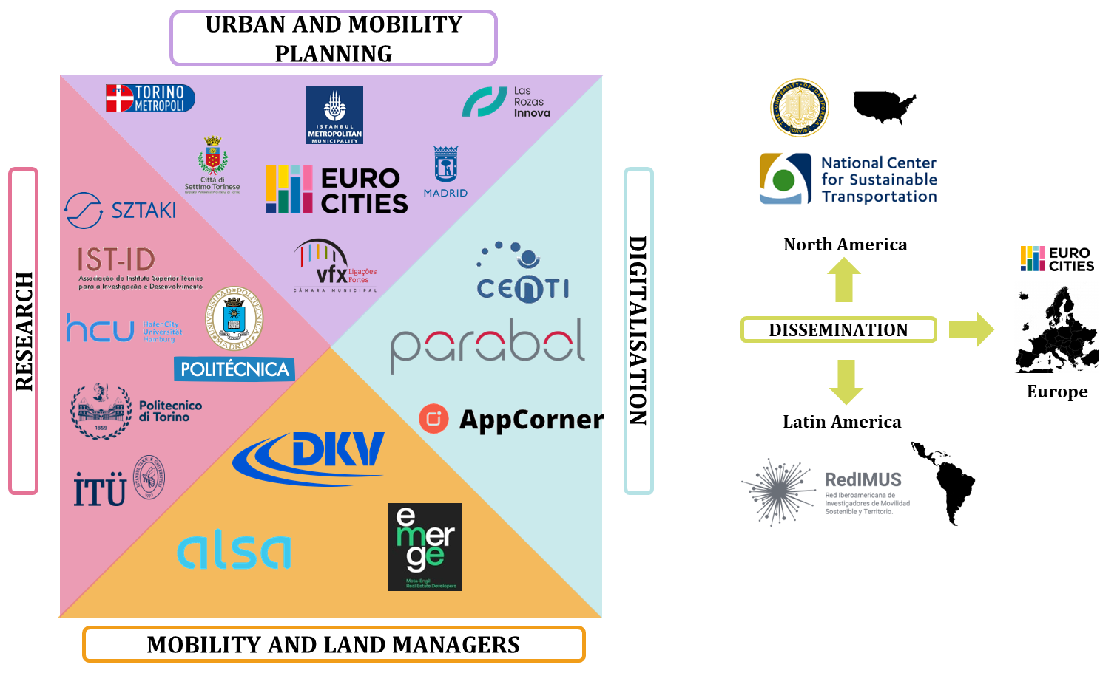
FORTHCOMING Consortium
Coordinator
UPM
Partners
Eurocities
HCU
Sztaki - BME
Polito
IST
ITU
Parabol
Cities&Regions
Las Rozas
Madrid
Settimo
Torino
Debrezen
Villafranca
Hamburg
Istambul

Slide 9
Key activities - Timeline
WP2
WP2
WP6
15mC State of the art
Portfolio of best 15mC practices
WP4
WP5
Impact assessment: Survey in ULLs
ULL set-up
Policy transfer methodology
Kick Off Dec 23
2024
2025
2026
Final Event
WP3
KPI definition
WP4
WP5
WP6
WP1
Interviews:
transfer potential in other contexts
Impact assessment: FGs in ULLs
WP3
ULL Cross-sectional analysis
Webpage
15mC SWOT via Focus Groups
WP7
15 minute City Implementation Guidebook for Suburban Areas

Slide 10

WP1 Project management and Coordination
All the projects results available at:
https://www.forthcoming.info/

Slide 11
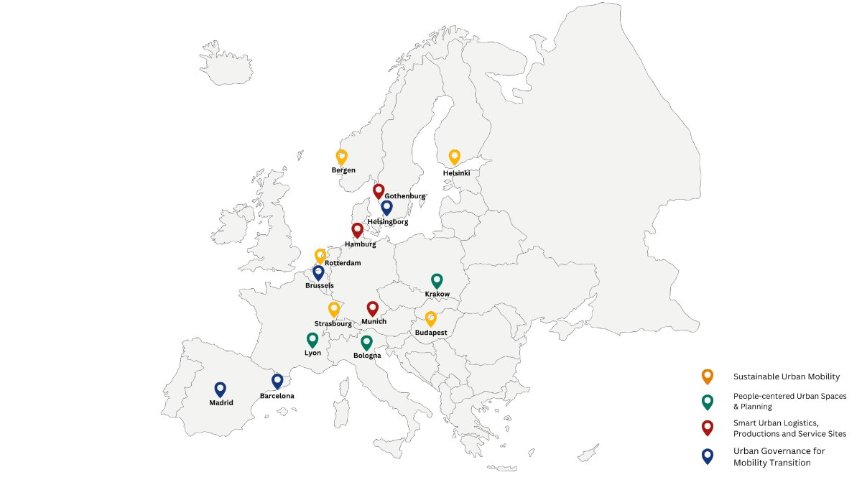
WP2 Portfolio of Succesful 15minC strategies
D.2.1 Portfolio of Successful 15minC Strategies in Urban Areas
The report presents 15 European best 15mC practices with lessons for adapting these approaches to suburban areas through the project’s ULLs

Slide 12
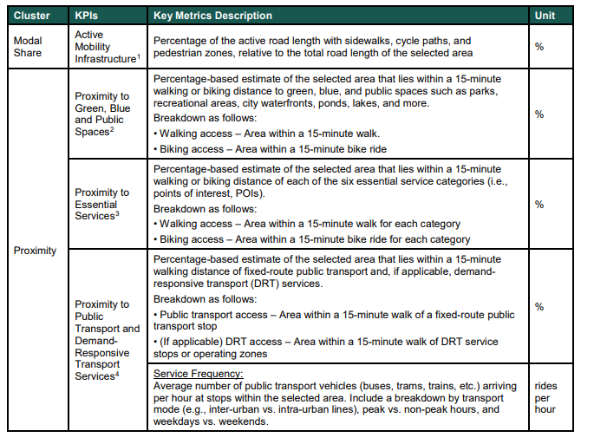
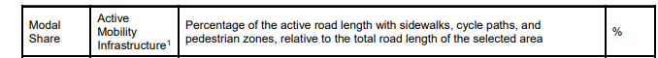
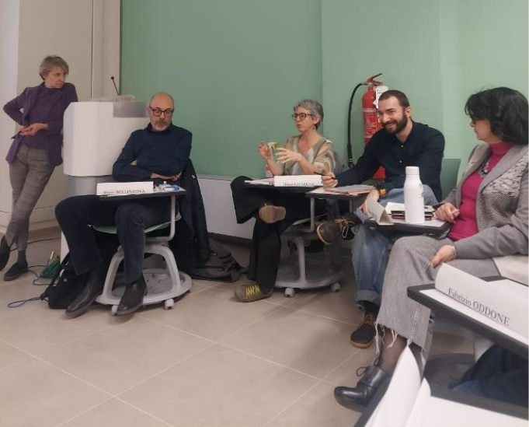
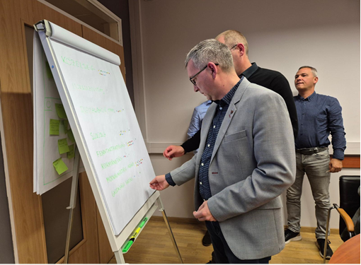
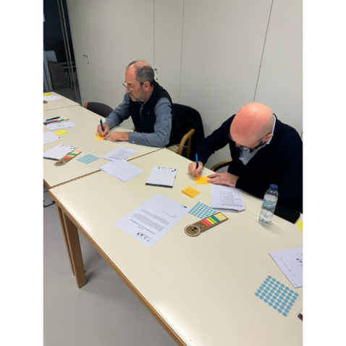
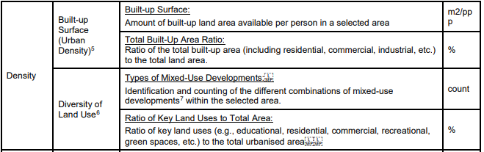
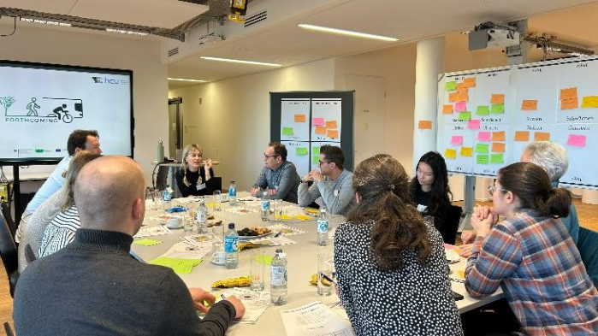
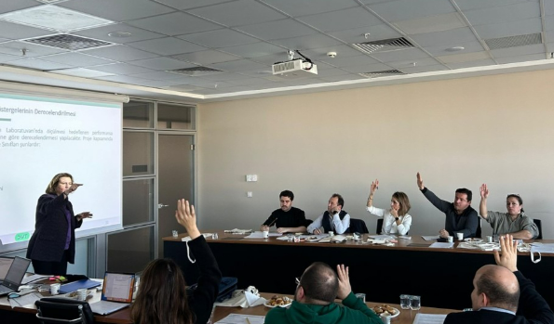
WP3 SWOT Analysis of 15minute-City Strategies
D3.1. SWOT Analysis of 15minC Strategies.
D3.2. Definition of the Key Performance Indicators (KPIs): Input-KPIs, Process-KPIs, and Outputs-KPIs.
Swot via FGs + KPI cluster ranking: 8 FGs in 5 countries
KPI definition

Slide 13
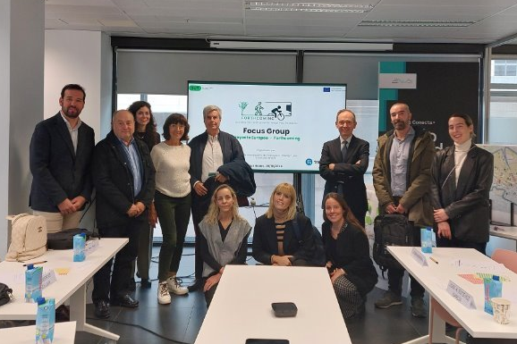
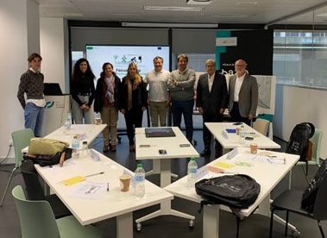
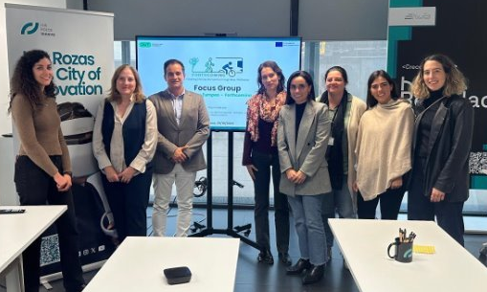
WP3 SWOT Analysis of 15minute-City Strategies
Example: Las Rozas (ES) FGs
​ | Target Group​ | Participants (# & type)​
FG #1​ | Administrative bodies, mobility stakeholders & associations​ | 6: Las Rozas Mobility Planning Department (1), PT authority (1), University (1), mobility service providers (2), urban designer (1), ​
FG #2​ ​ | Administrative bodies, mobility stakeholders & associations​ | 9: Mobility service providers (3), PT authority (1), University (2) , Las Rozas City Council (1), ITS consultant (1), Citizen local association (1)​
FG #3​ ​ | Businesses, retailers and other service providers ​ | 6: 2 representatives of local shopping centres, 1 local business owner, 1 director of the local vocational training centre, 1 representative of Local Retailers association and city council member for commerce​
3 FGs
Introducing of the 15mC and FORTHCOMING project
Presentation and debate of selected mobility measures following 15Mc framework
Propose alternative strategies
SWOT analysis
KPI ranking
More than 50% of the participants live in Las Rozas

Slide 14
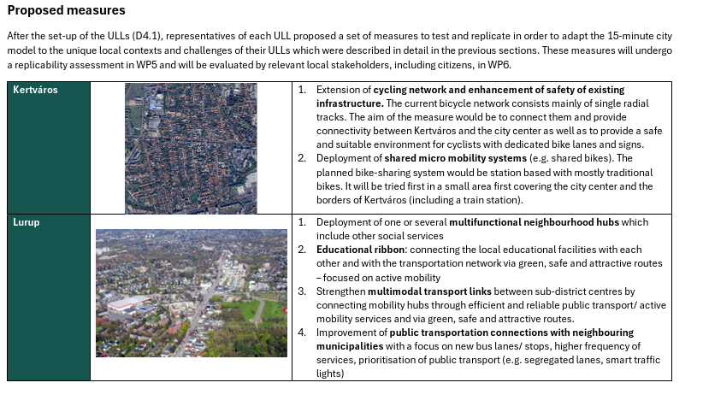
WP4 6 EU 15minC Urban Living Labs
D4.1 Report on the set-up of 6 European Living Labs
D4.2 Cross-sectional Analysis of 6 European Living Labs
Characterisation of the LL: (1) Socioeconomic aspects, (2)Urban planning & Land Use, (3) Mobility and (4) Policy
Identification of shared patterns and key differences across the ULLs

Slide 15
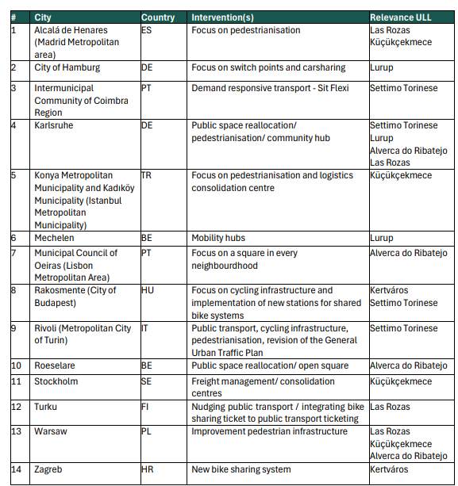
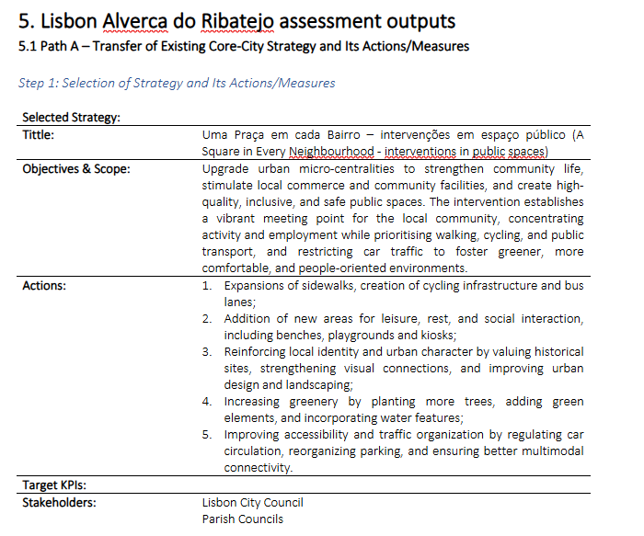
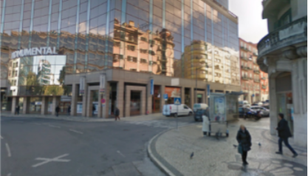
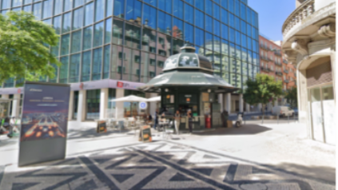
WP5 Transfer Guidelines of the 15minC (scale-up)
D5.1. Methodology for Transferring 15minC Strategies from Core Cities to Suburban Cities.
D5.2. Transfer potential city-to-suburbs and scaling-up to other contexts and cities.

Slide 16
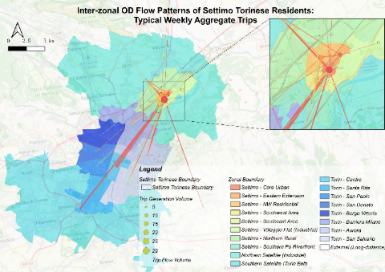
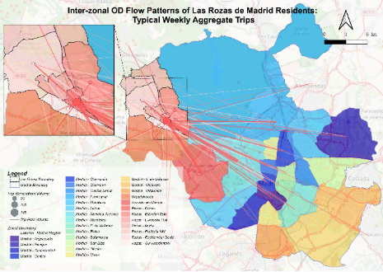
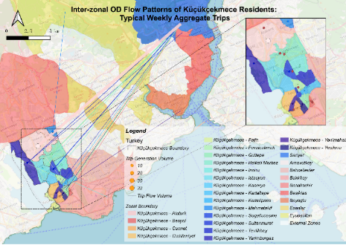
WP6 Multi-Stakeholder Impact Assessment (common/city specific)
D6.1. Multi-Stakeholder Impact Assessment Methodology (common/city specific)
D6.2. Assessment by Case Study and Cross-sectional Analysis
Survey in ULLs design & analysis
FGS in ULLs
for validation

Slide 17

WP7 Dissemination and Transferability
15 minute City Implementation Guidebook for Suburban Areas
Key learnings from the project to serve as guidelines for local authorities and practitioners who wish to render suburban areas more proximity-friendly
Will be discussed more in a later session

Slide 18


WP7 Dissemination and Transferability
Scientific publications
Gangneux, J. (2026), Contested Places: Navigating the Politics of the X-Minute City in Bell, K., Foster, E. & Satheesh, S. (eds)The SAGE Handbook of Eco-Social Policy and Politics. SAGE Publications.
Brownrigg-Gleeson, M. L., Lopez-Carreiro, I., Monzon, A., & Lopez, E. (2026). Designing proximity futures: Mobility pathways to the X-minute metropolis in Madrid. Journal Of Urban Mobility, 9, 100226. https://doi.org/10.1016/j.urbmob.2026.100226
Terzi, A. F., Aksu, K., Koçyiğit, A., & Demirel, H. (2026). Mapping social vulnerability through accessibility Patterns: the Istanbul case. International Archives Of The Photogrammetry, Remote Sensing And Spatial Information Sciences, XLVIII-4/W18-2025, 323-329. https://doi.org/10.5194/isprs-archives-xlviii-4-w18-2025-323-2026
Terzi, A. F., & Demirel, H. (2026). When cities learn themselves: A meta-learning-based spatial framework for 15-minute cities [Manuscript submitted for publication].
And 6 conference presentations and 2 master thesis

Slide 19
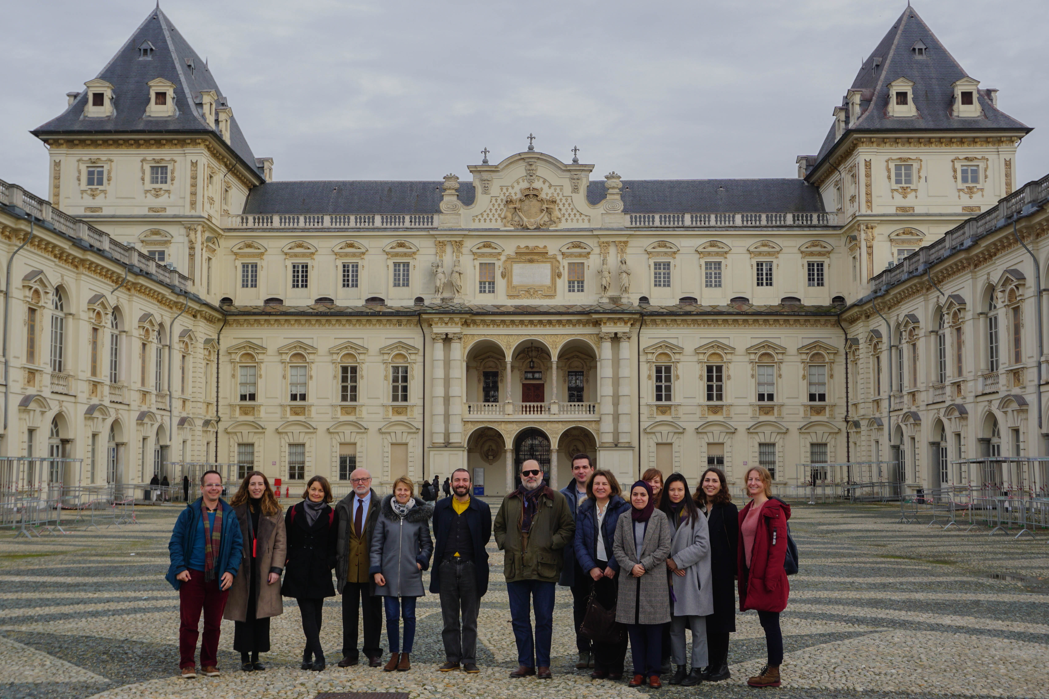
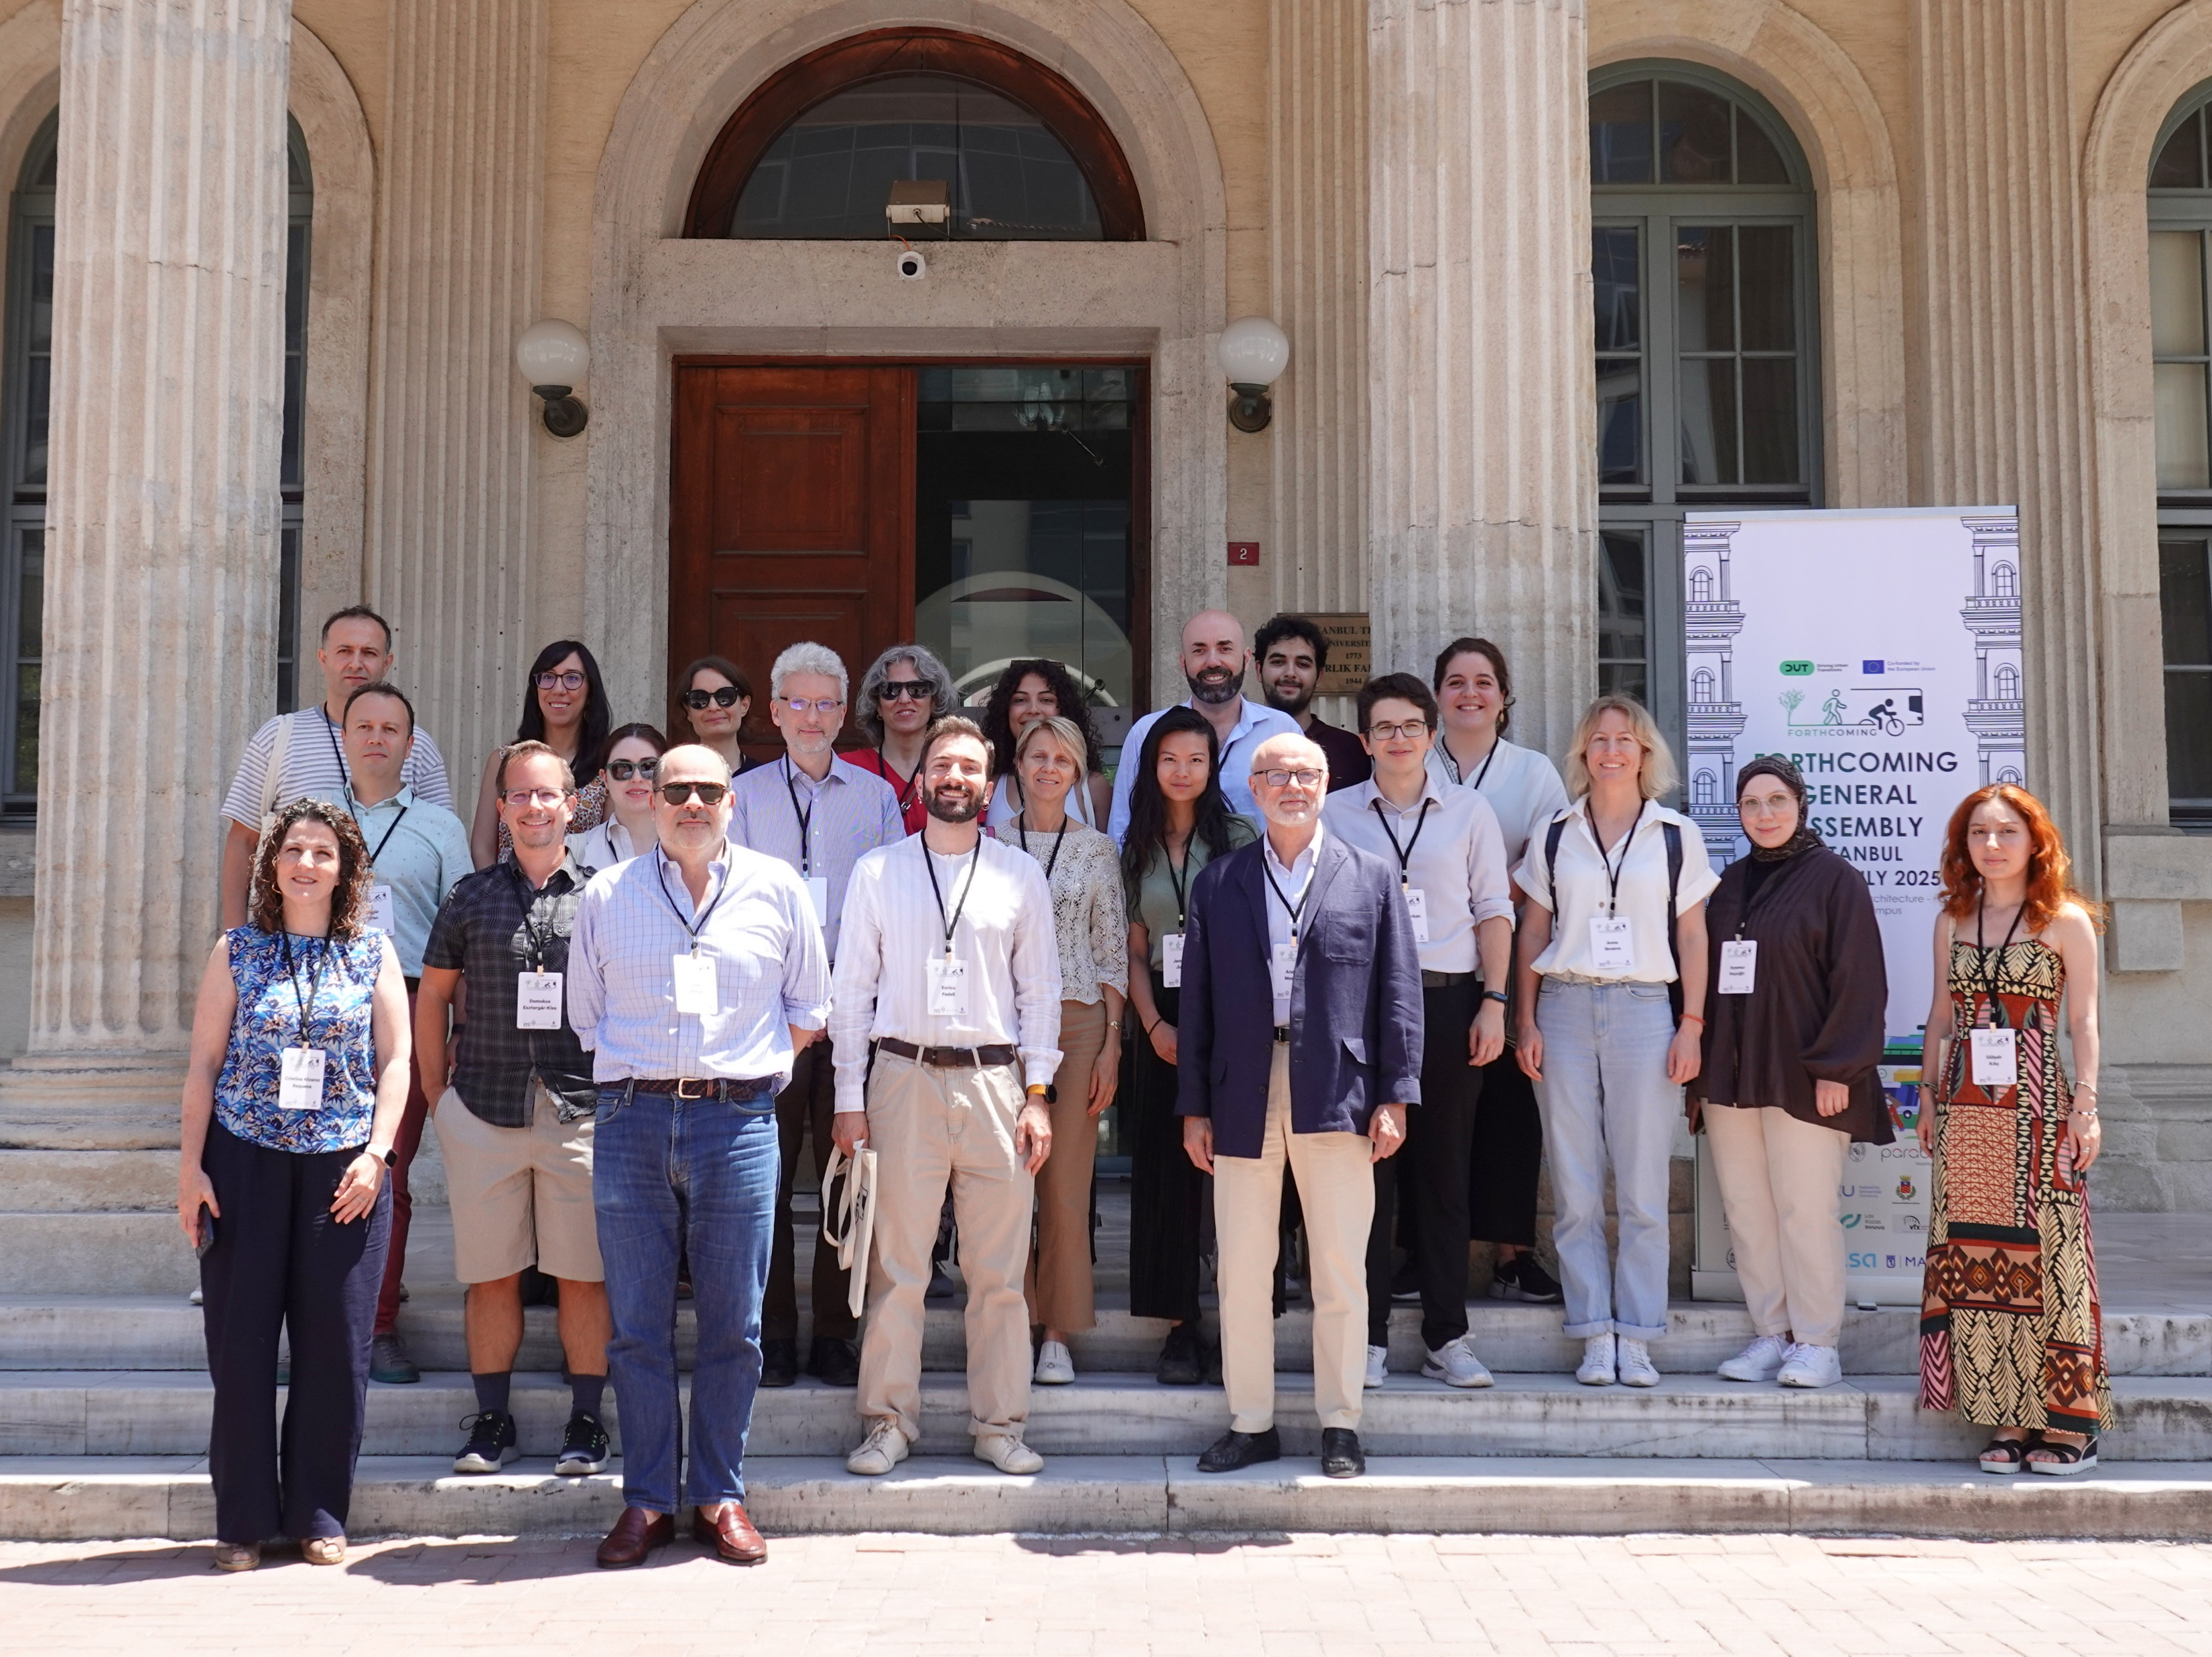
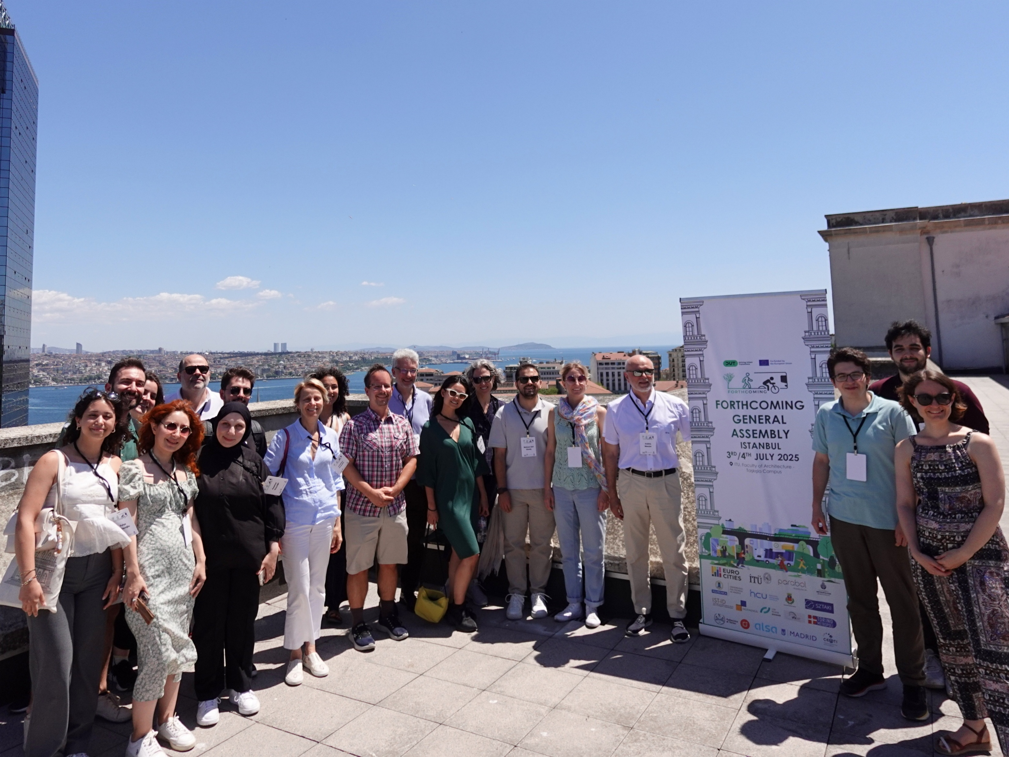
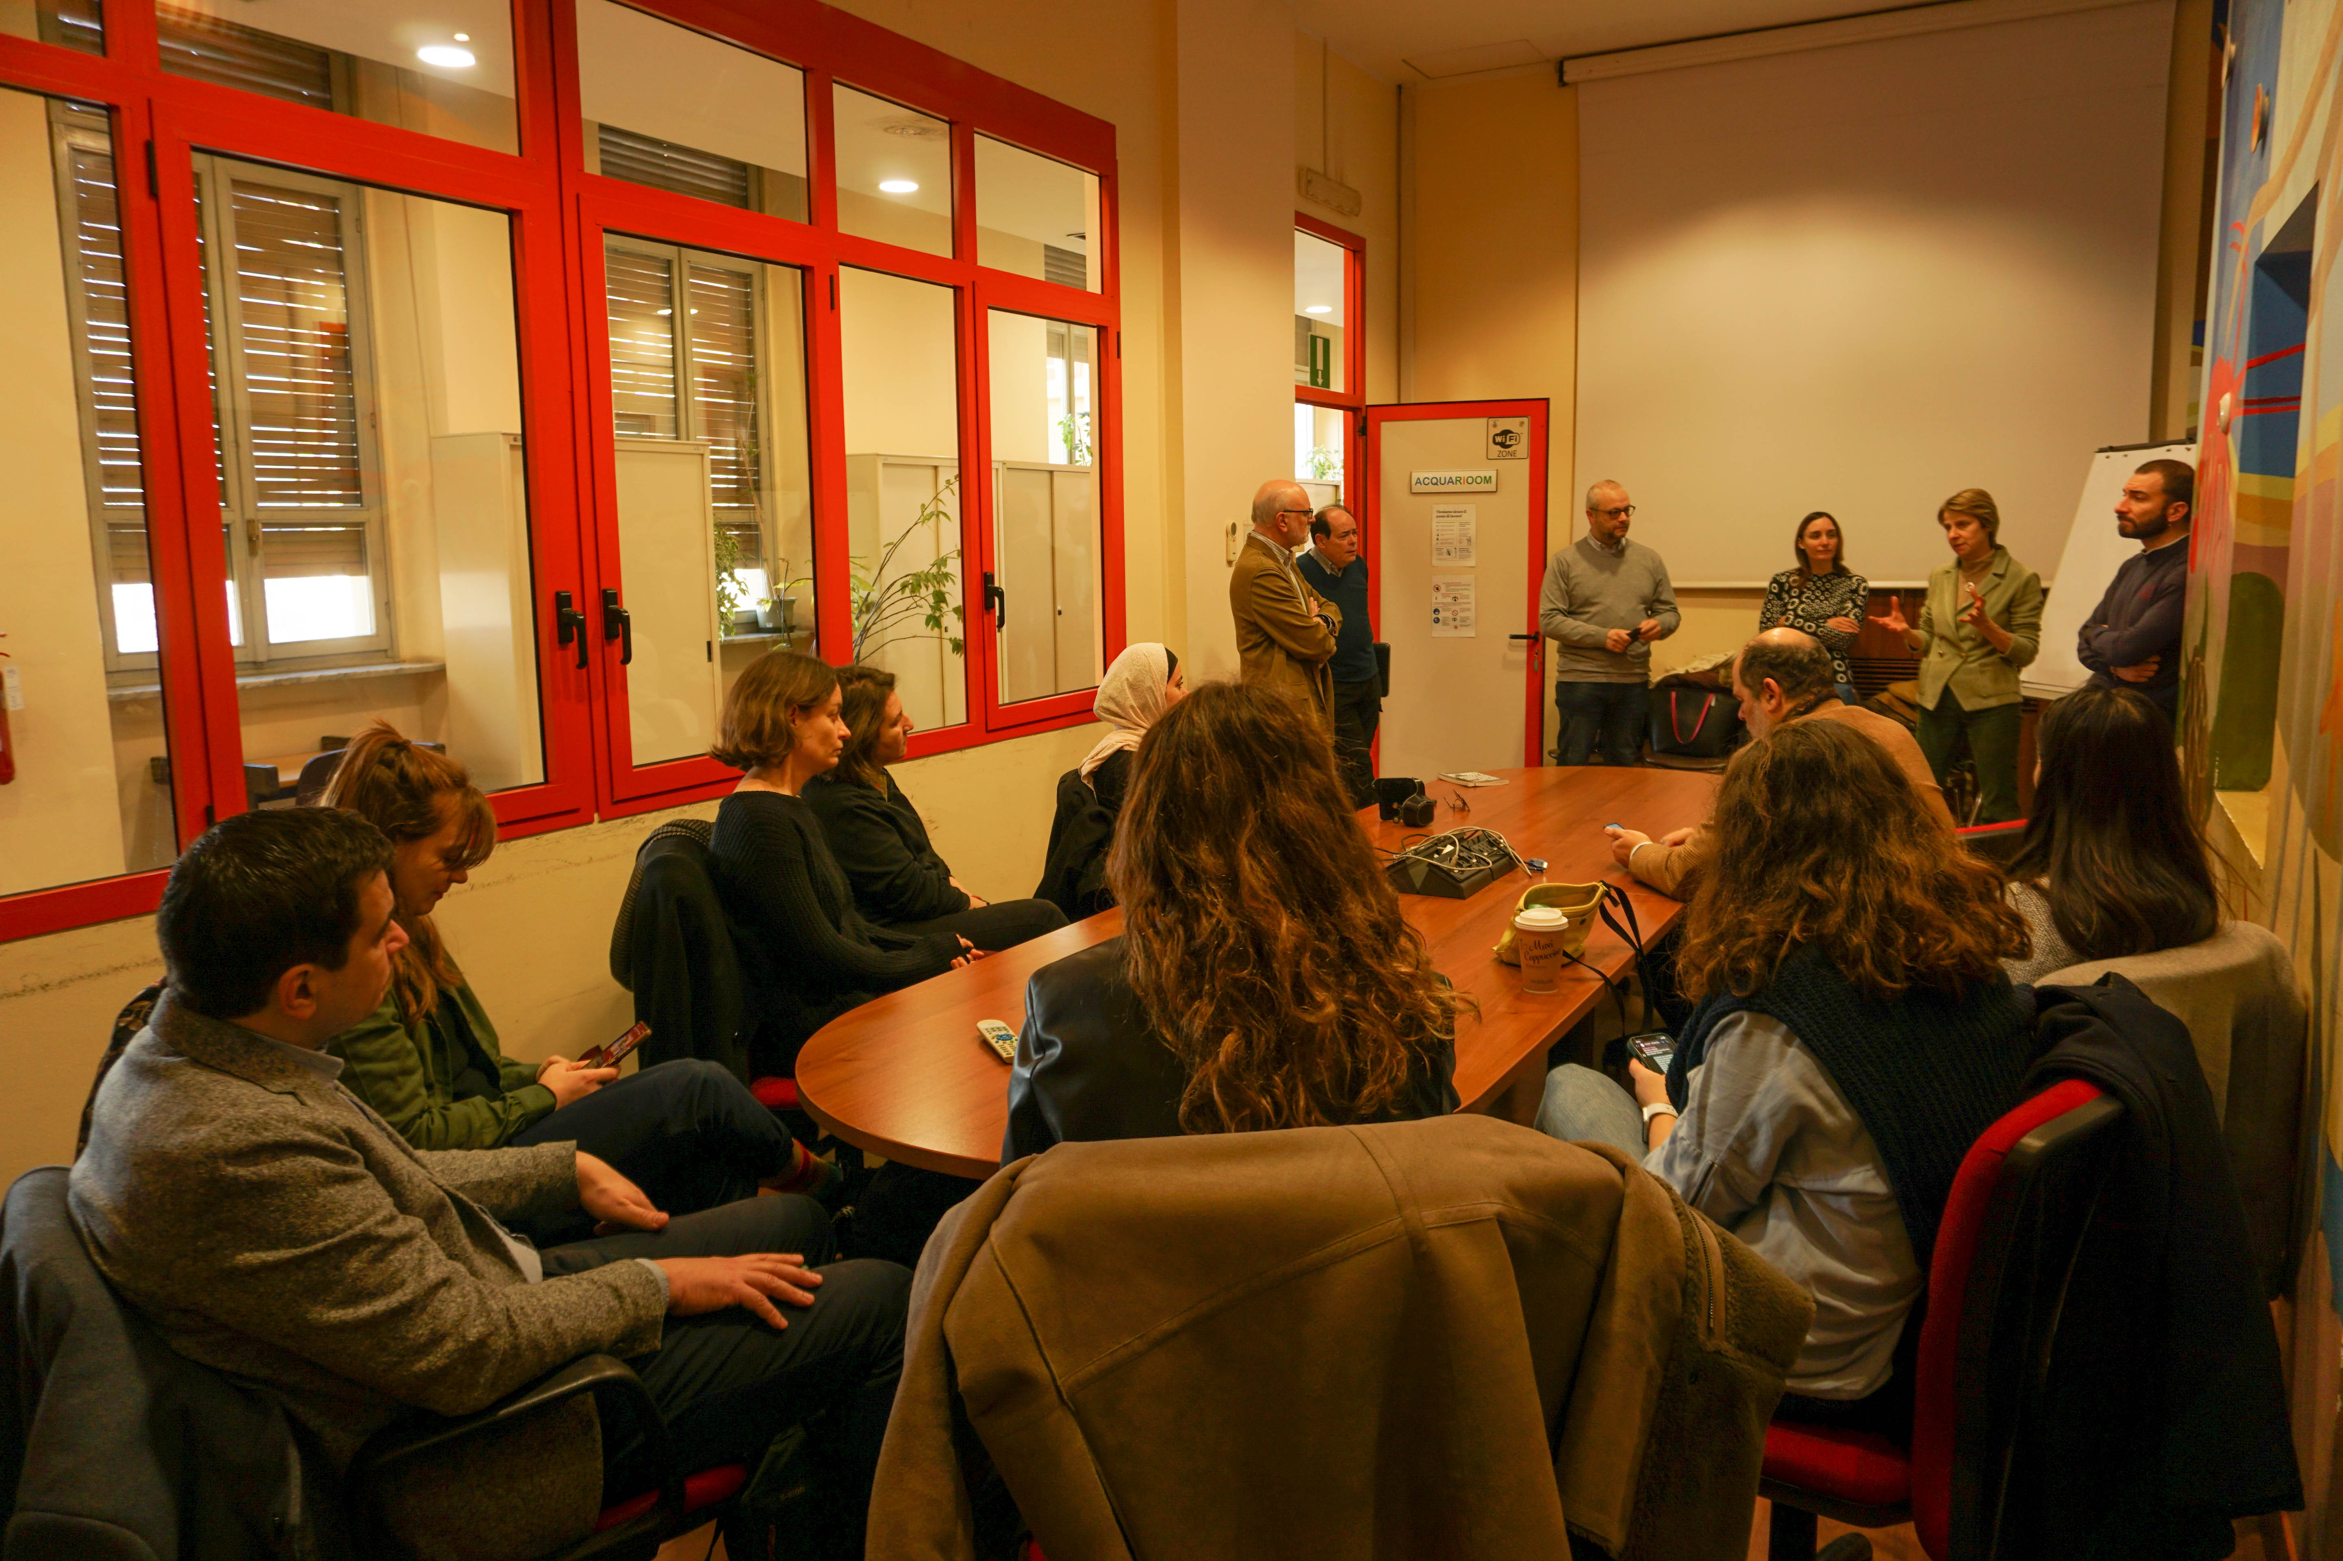
https://www.forthcoming.info/

Slide 20

Group photo & Coffee Break

